Slide 1
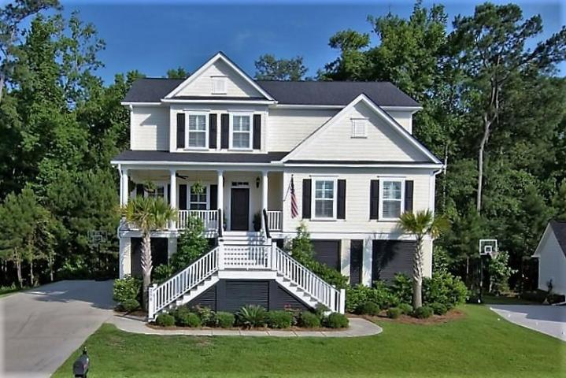
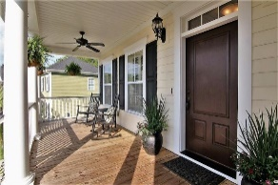
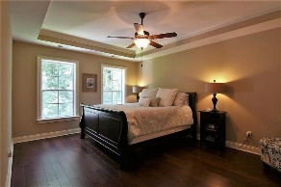
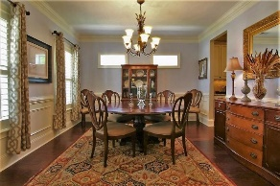
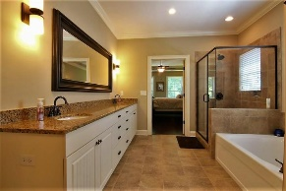
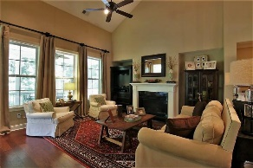
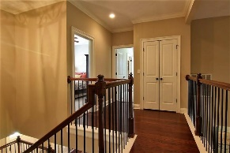
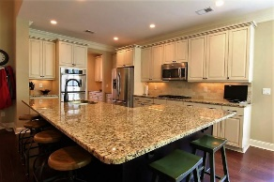
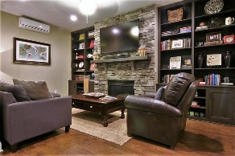
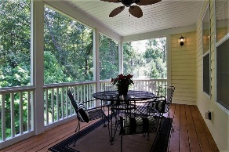
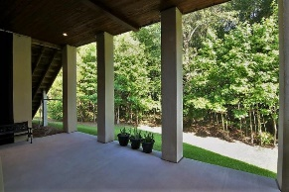


Beautiful Elevated Home in The Preserve at Legend Oaks
258 Silver Cypress Circle
Summerville, SC 29485
MLS# 16014161 ~ $529,000
Reduced!!
You will want to see this beautiful, elevated home in THE PRESERVE section of THE CLUB at LEGEND OAKS! It has everything you want and MORE! When you step into the foyer you will see gorgeous wood floors, a formal dining room and a fabulous great room. Entertaining is easy with the flow from the dining room to the open kitchen, great room, and screened porch. Enjoy a family dinner in the eat-in kitchen while overlooking the peaceful backyard or step out on the screened porch for your morning coffee. The granite countertops, stainless steel appliances, dual ovens and gas cooktop make up the perfect kitchen for any cook. The owner's suite is located on the main floor for convenience with the master bath displaying a separate tub, shower, and dual vanity. The master closet is huge!
The top floor has a great floor plan with a "jack and jill" on one side and 2 additional bedrooms and a bath on the other. The bath between the "jack and jill" has dual sinks which is perfect for sharing. There is storage galore off of the bedrooms as well as in the pull down attic. The bottom floor completes this fabulous home. It is the BEST use of FLEX space. It currently showcases a casual sitting area with a floor to ceiling stone fireplace with gas logs, beautiful built-in bookcases, a full bath, and a spacious sleeping room. It is a fun space for guests and entertaining but also could serve as a "man cave", playroom, home gym, home office, sewing room, 6th "bedroom" or a combination of things. It is an impressive space! Electricity and plumbing are in place if one desired to complete a kitchenette on this level.
This elevated home provides great space underneath. There is room for parking two cars as well as LOTS of storage. The enclosed workshop is a wonderful place to store all of your tools for working around the house. The yard is beautifully landscaped with irrigation and landscape lighting in place. You will see that this well maintained home has had a lot of TLC! Make an appointment to see it today!
THINGS TO NOTE:
* There is a place for an ELEVATOR (Elevator Shaft).
* The Plantation Shutters and Dining Room curtains will convey.
Kea Whatley
Mobile 843-408-8704
keawhat@aol.com
AgentOwned Preferred Group | 824 Johnnie Dodds Blvd | Mt Pleasant, SC 29464

