Slide 1

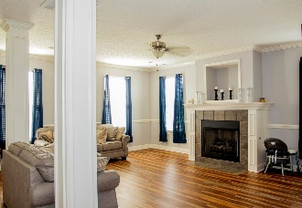
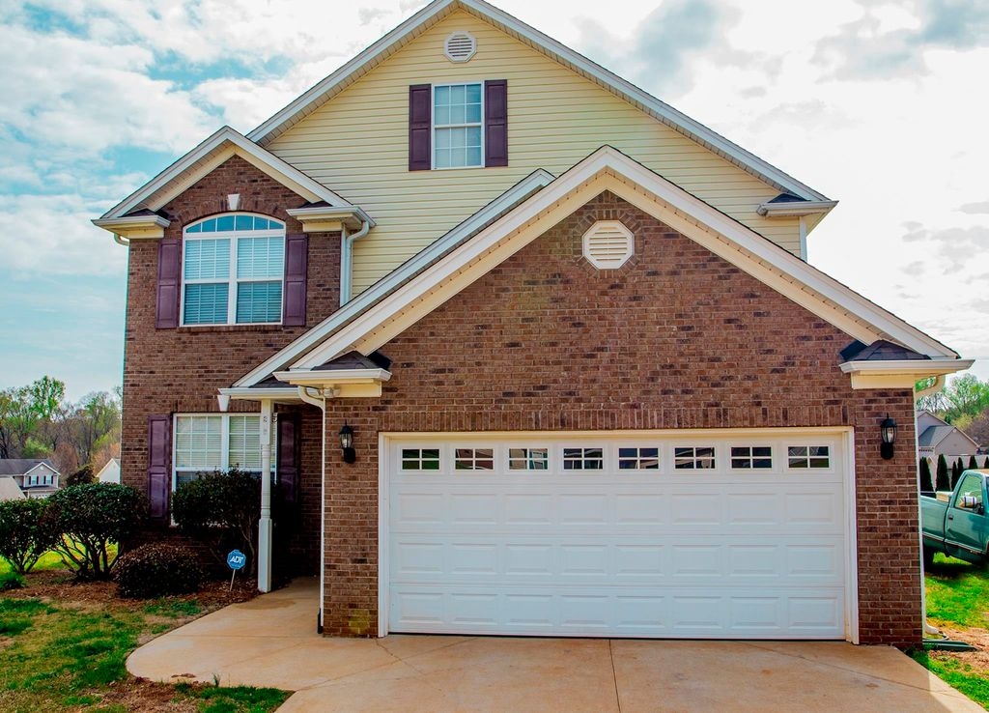
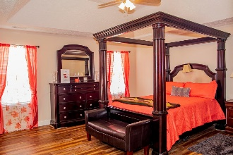
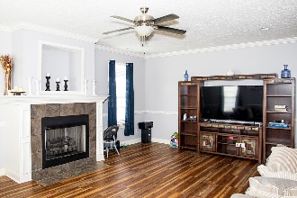
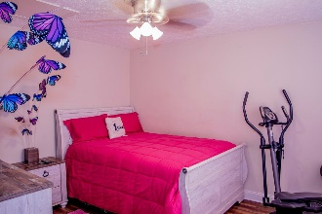


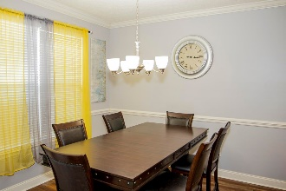
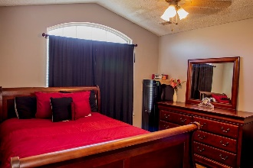

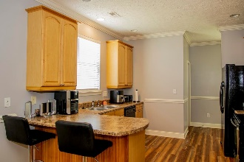
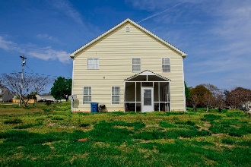






Stop By For An Open House Saturday, April 22nd from 1-4
258 Gibbs Rd
Wellford, SC, 29385 | MLS# 298967 | $280,000
1,946 sq ft
3 Bed
2 ½ Bath
0.6 acres
Tracey Suber, Realtor
tsuber69@gmail.com | 864-441-3834 | www.bnre.info
Brand Name Real Estate | 4 Carriage Lane, Suite 106 | Charleston, SC 29407

