Slide 1
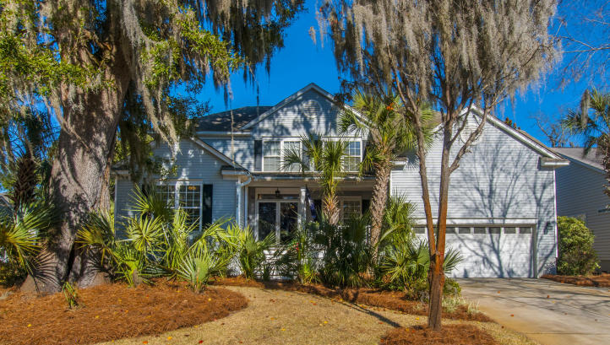
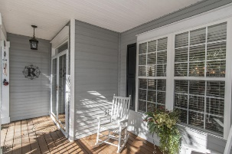
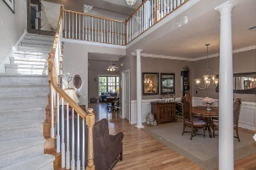
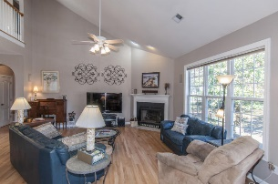
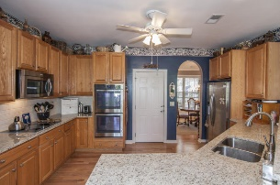
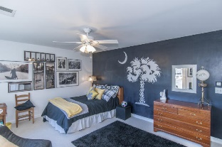
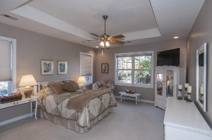
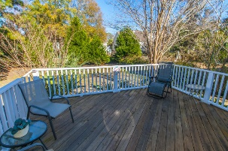
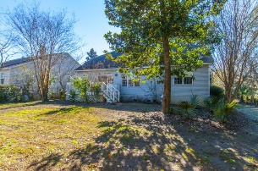

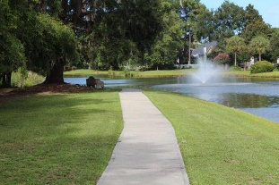


New Listing!!
2600 Magnolia Woods Drive
Seaside Farms - Mount Pleasant - MLS# 16002513 - $550,000
This home at 2600 Magnolia Woods Drive boasts 3 bedrooms and 2 and a half baths with the master bedroom suite on the first floor. The kitchen is updated with granite countertops and new sink, new appliances including a double oven, and a subway tile backsplash. Beautifully finished hardwood floors cover most of the first floor. There is a large multi-purpose room off of the breakfast area that has granite countertops and a sink in addition to the laundry area. This room is a blank slate to make it into whatever you wish. The first floor also has a formal dining area and a library that could be used as a den or an office. The second floor has two spacious bedrooms with a loft between them, perfect for children or teens to have their own space. This home has been well cared for by its first and only owners. Seaside Farms is the ideal location in Mt. Pleasant, just a six minute drive to the beach and walking distance to the pool, playground, and "The Shoppes at Seaside Farms." The Shoppes include Target, Harris Teeter, and amazing restaurants like Crave and Basil. There is something for everyone!
Del Shaffer
843.408.6821
dshaffer@carolinaoneplus.com

