Slide 1
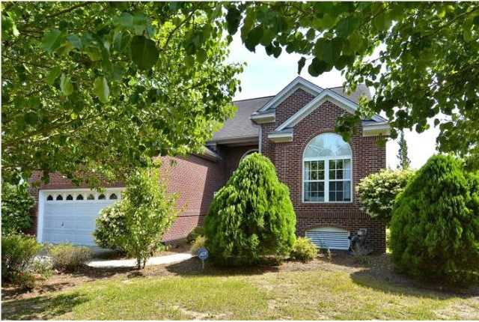
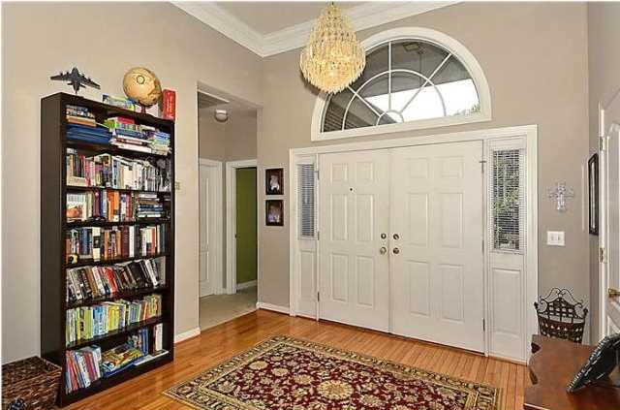
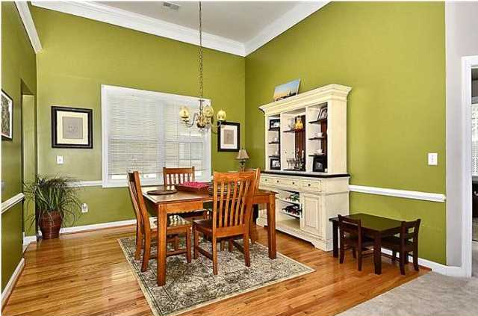
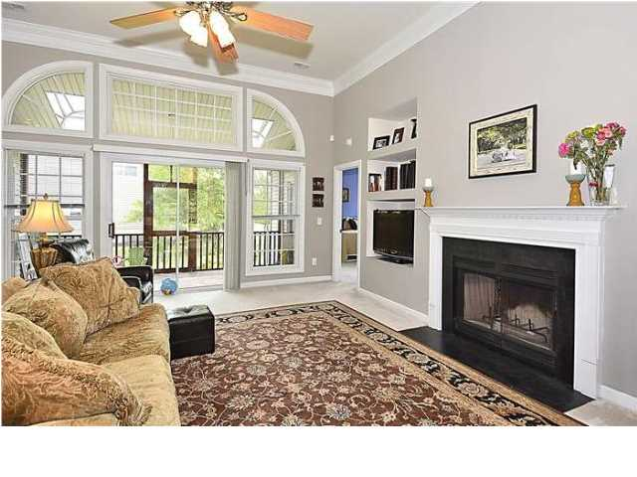
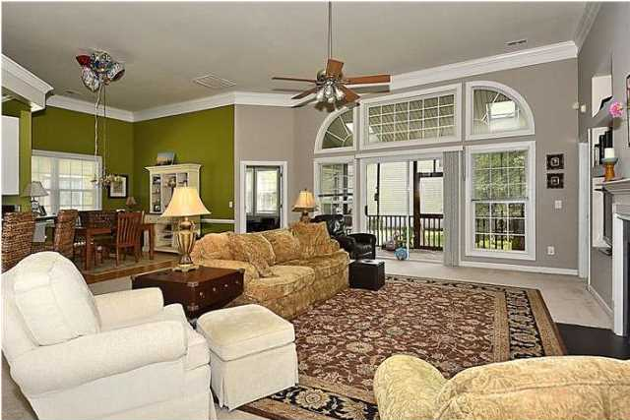
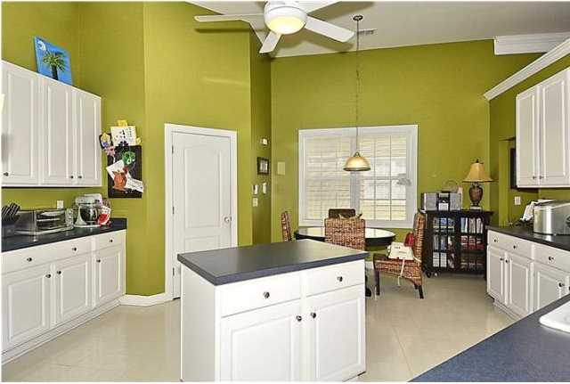
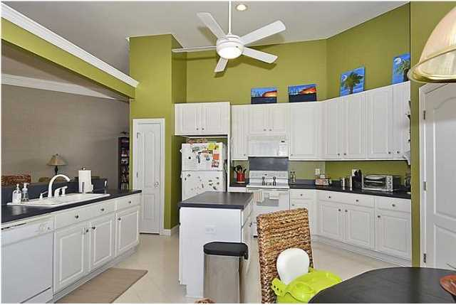
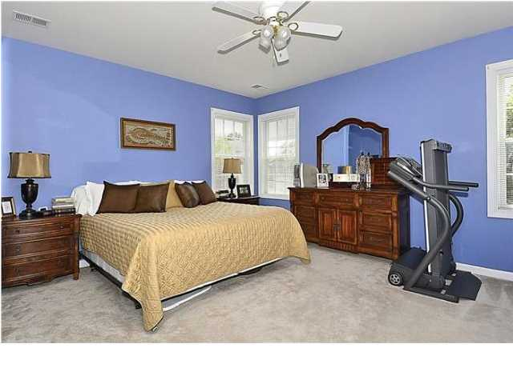
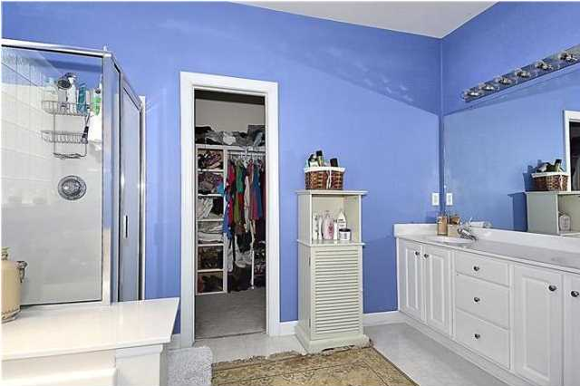
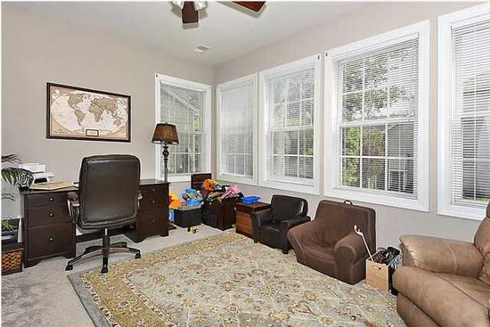
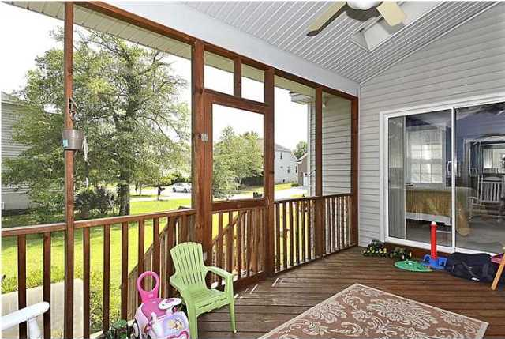
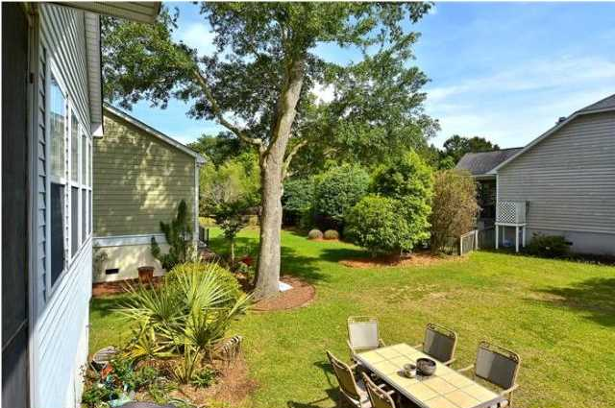
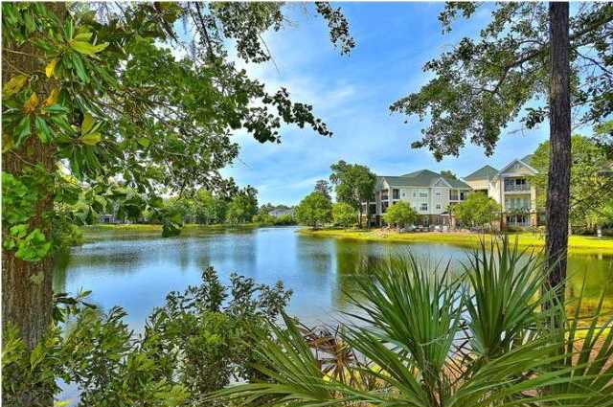


2601 Coral Vine Ct Seaside Farms Mt Pleasant MLS# 1412872 $475,000 3 Bedrooms | 2 Baths
Beautiful one story home with a stunning open floor-plan located in Highly desirable Seaside Farms - just minutes from the beach!. Large eat-in Kitchen is open to huge great room - perfect for entertaining family & friends. The great room features high ceilings, custom fireplace & surround, and built in shelving. The extra-large screened-in porch which overlooks the back yard is the perfect place to enjoy that morning cup of coffee or your evening beverage. Very nice master bedroom suite, two generously sized secondary bedrooms and a home office. Did I mention that This Fantastic location is just minutes to the beach, easy access to Hwy 17, Interstate 526, the airport & to historic downtown Charleston? The Shoppes at Seaside Farms offers something for everyone. Whether you're looking for unique shopping, great restaurants or a relaxing massage, the choice is yours. The Shoppes also feature a Harris Teeter store and Target for your everyday shopping convenience. All of this is right in the neighborhood along with wonderful amenities, & miles of walking trails! Come see this home today before it is gone!
Minutes from the Beach!
Maggie Curtis
ABR, EPRO, LMC
(843) 693-8207 M
maggiecurtis@comcast.net

