Slide 1
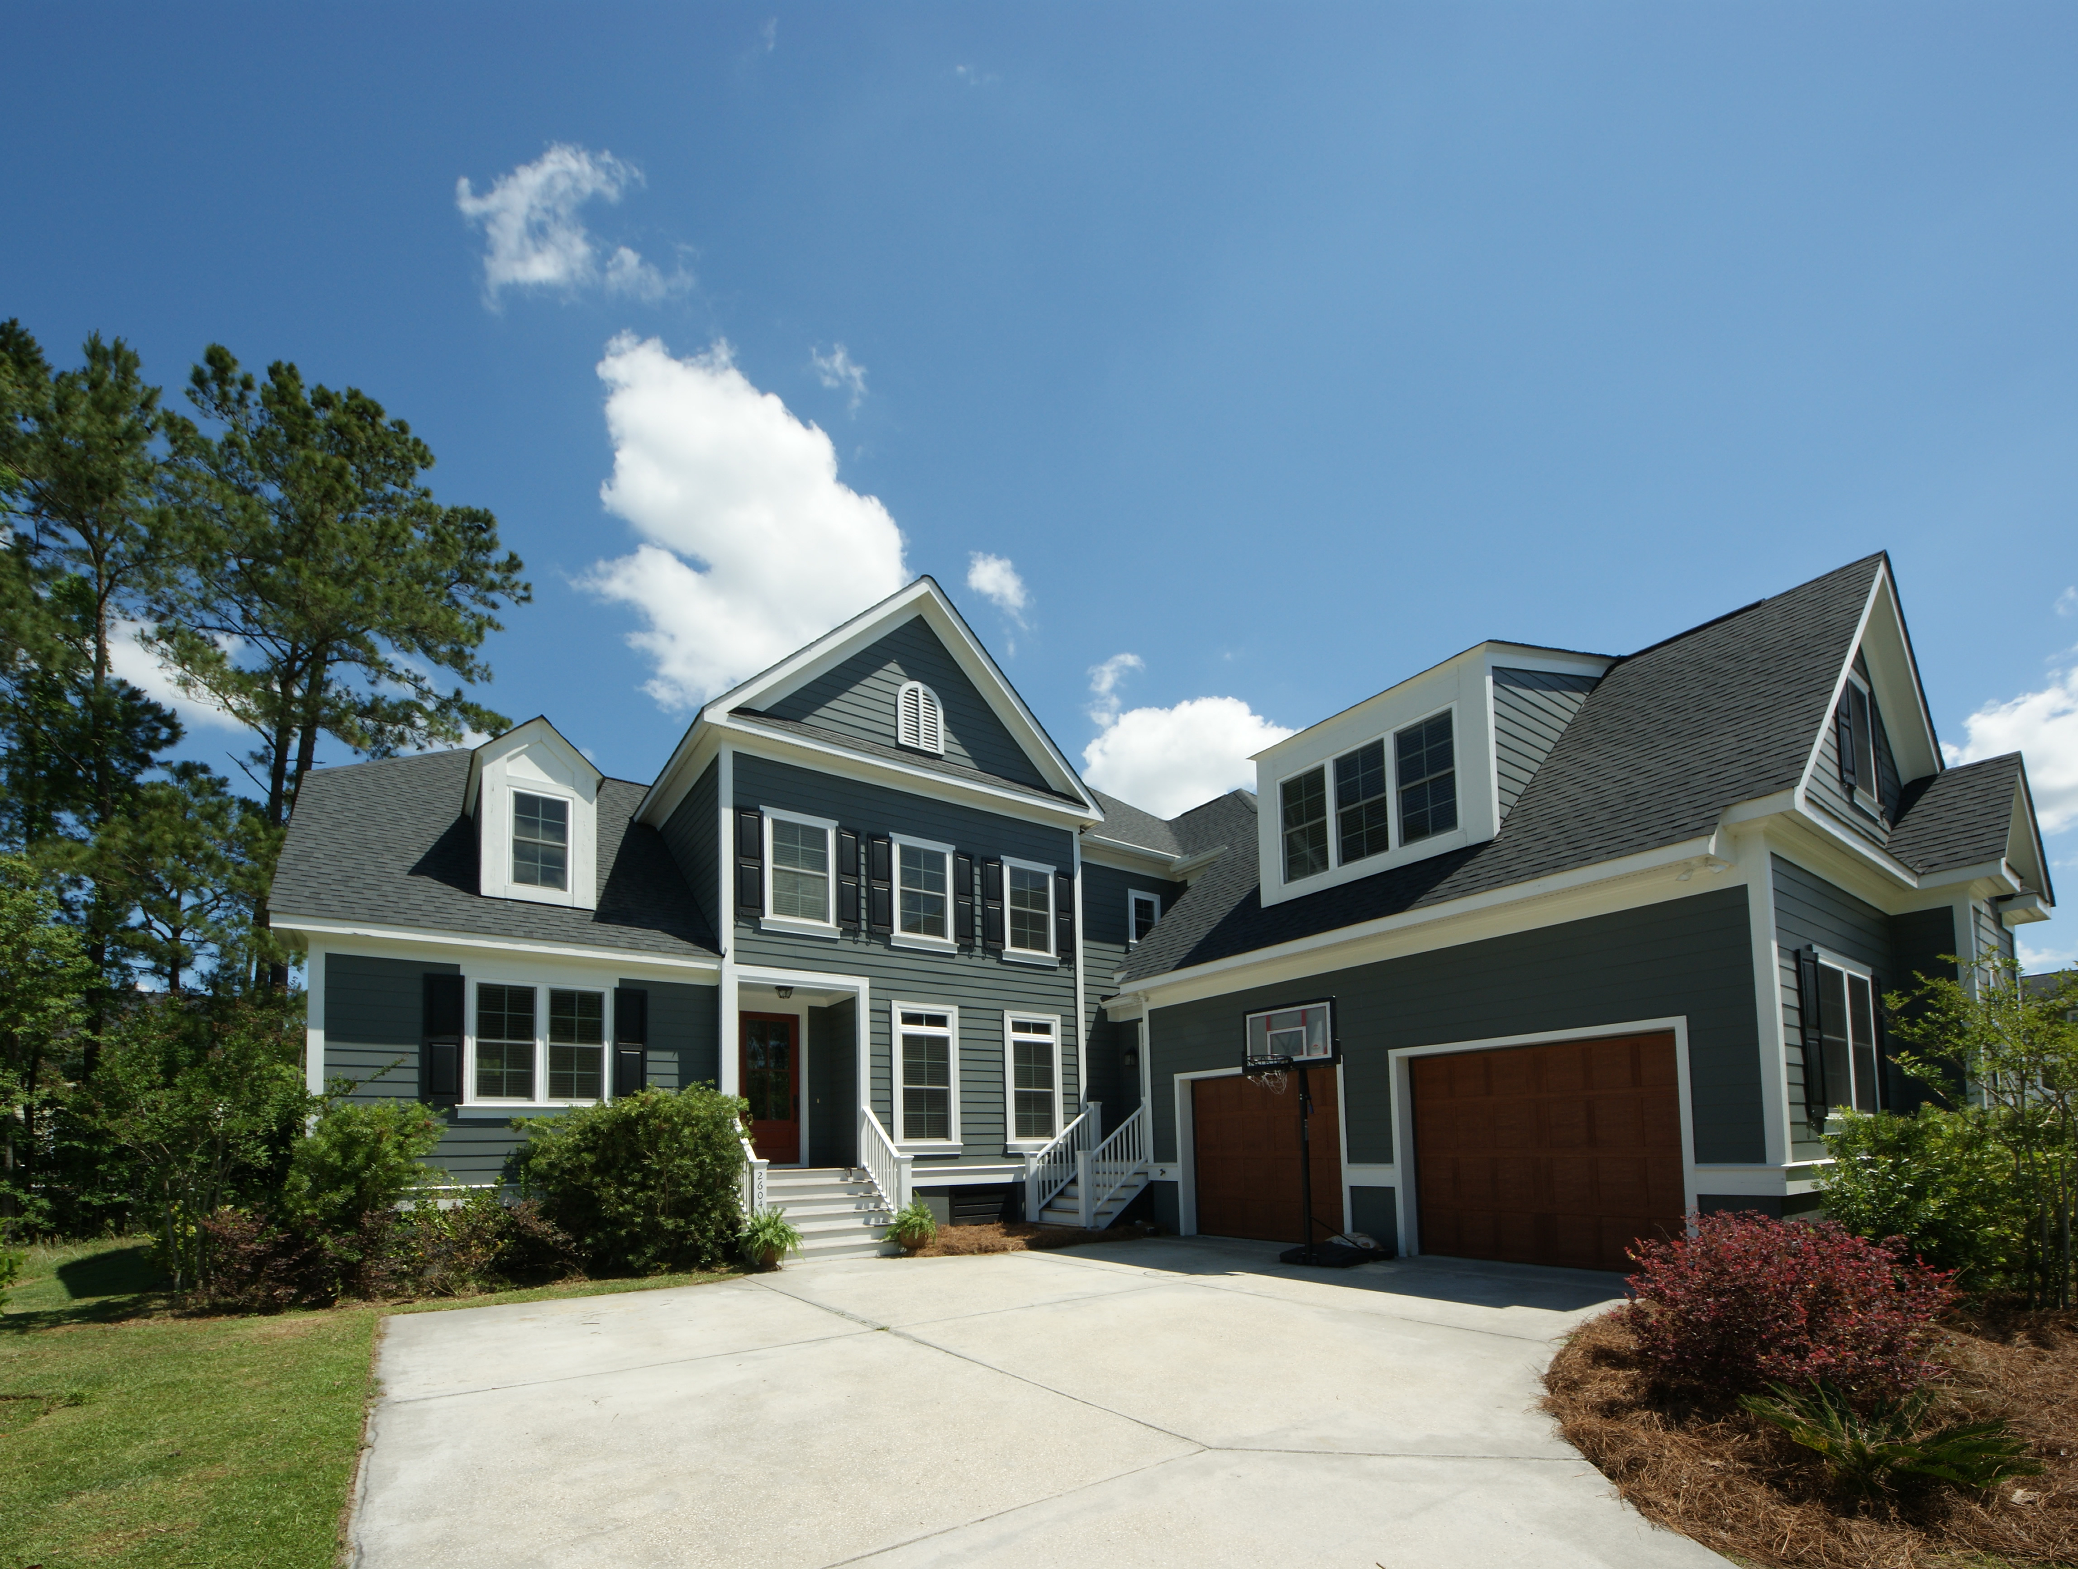
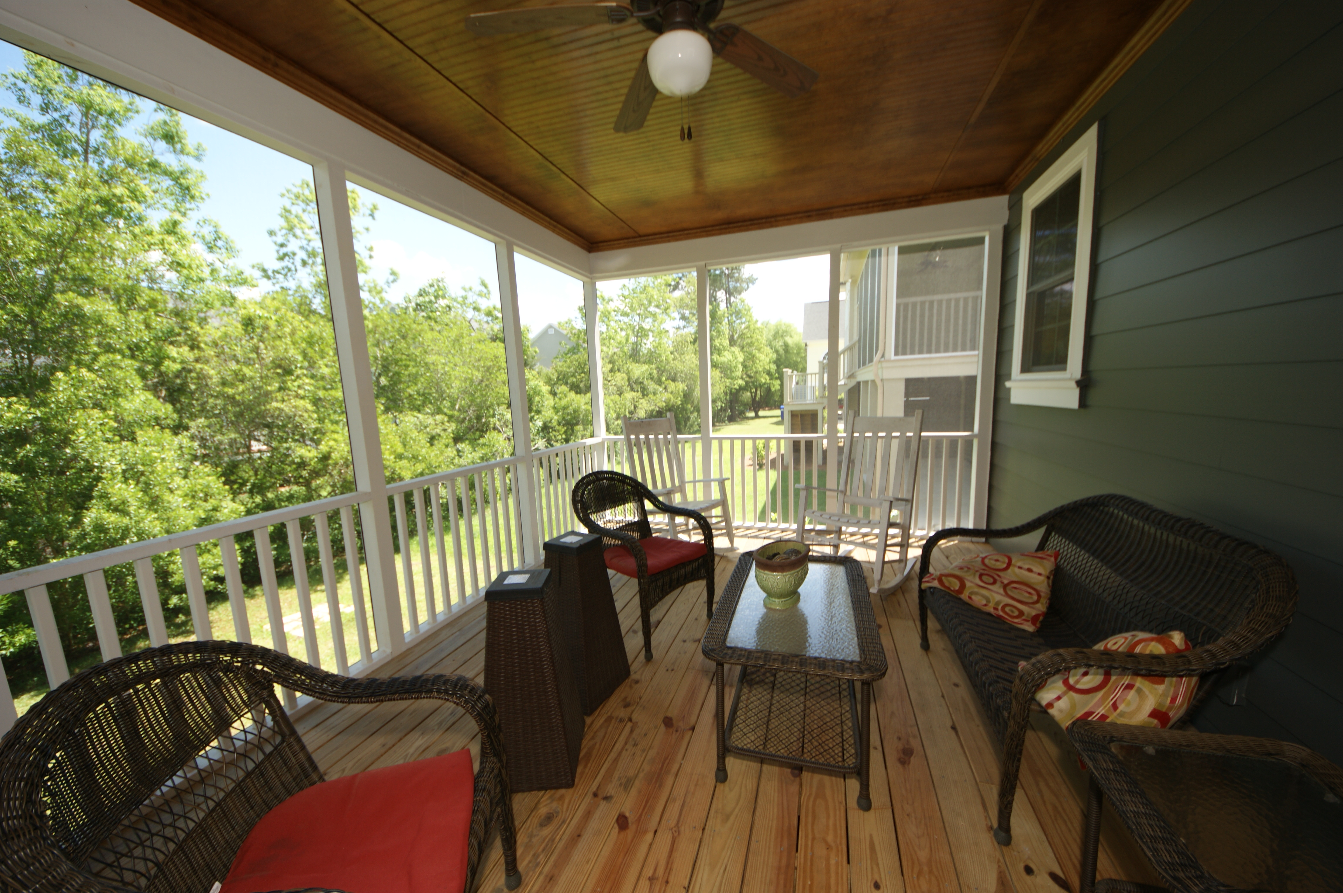
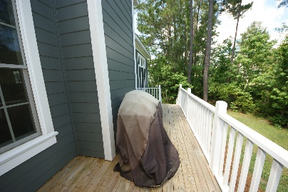
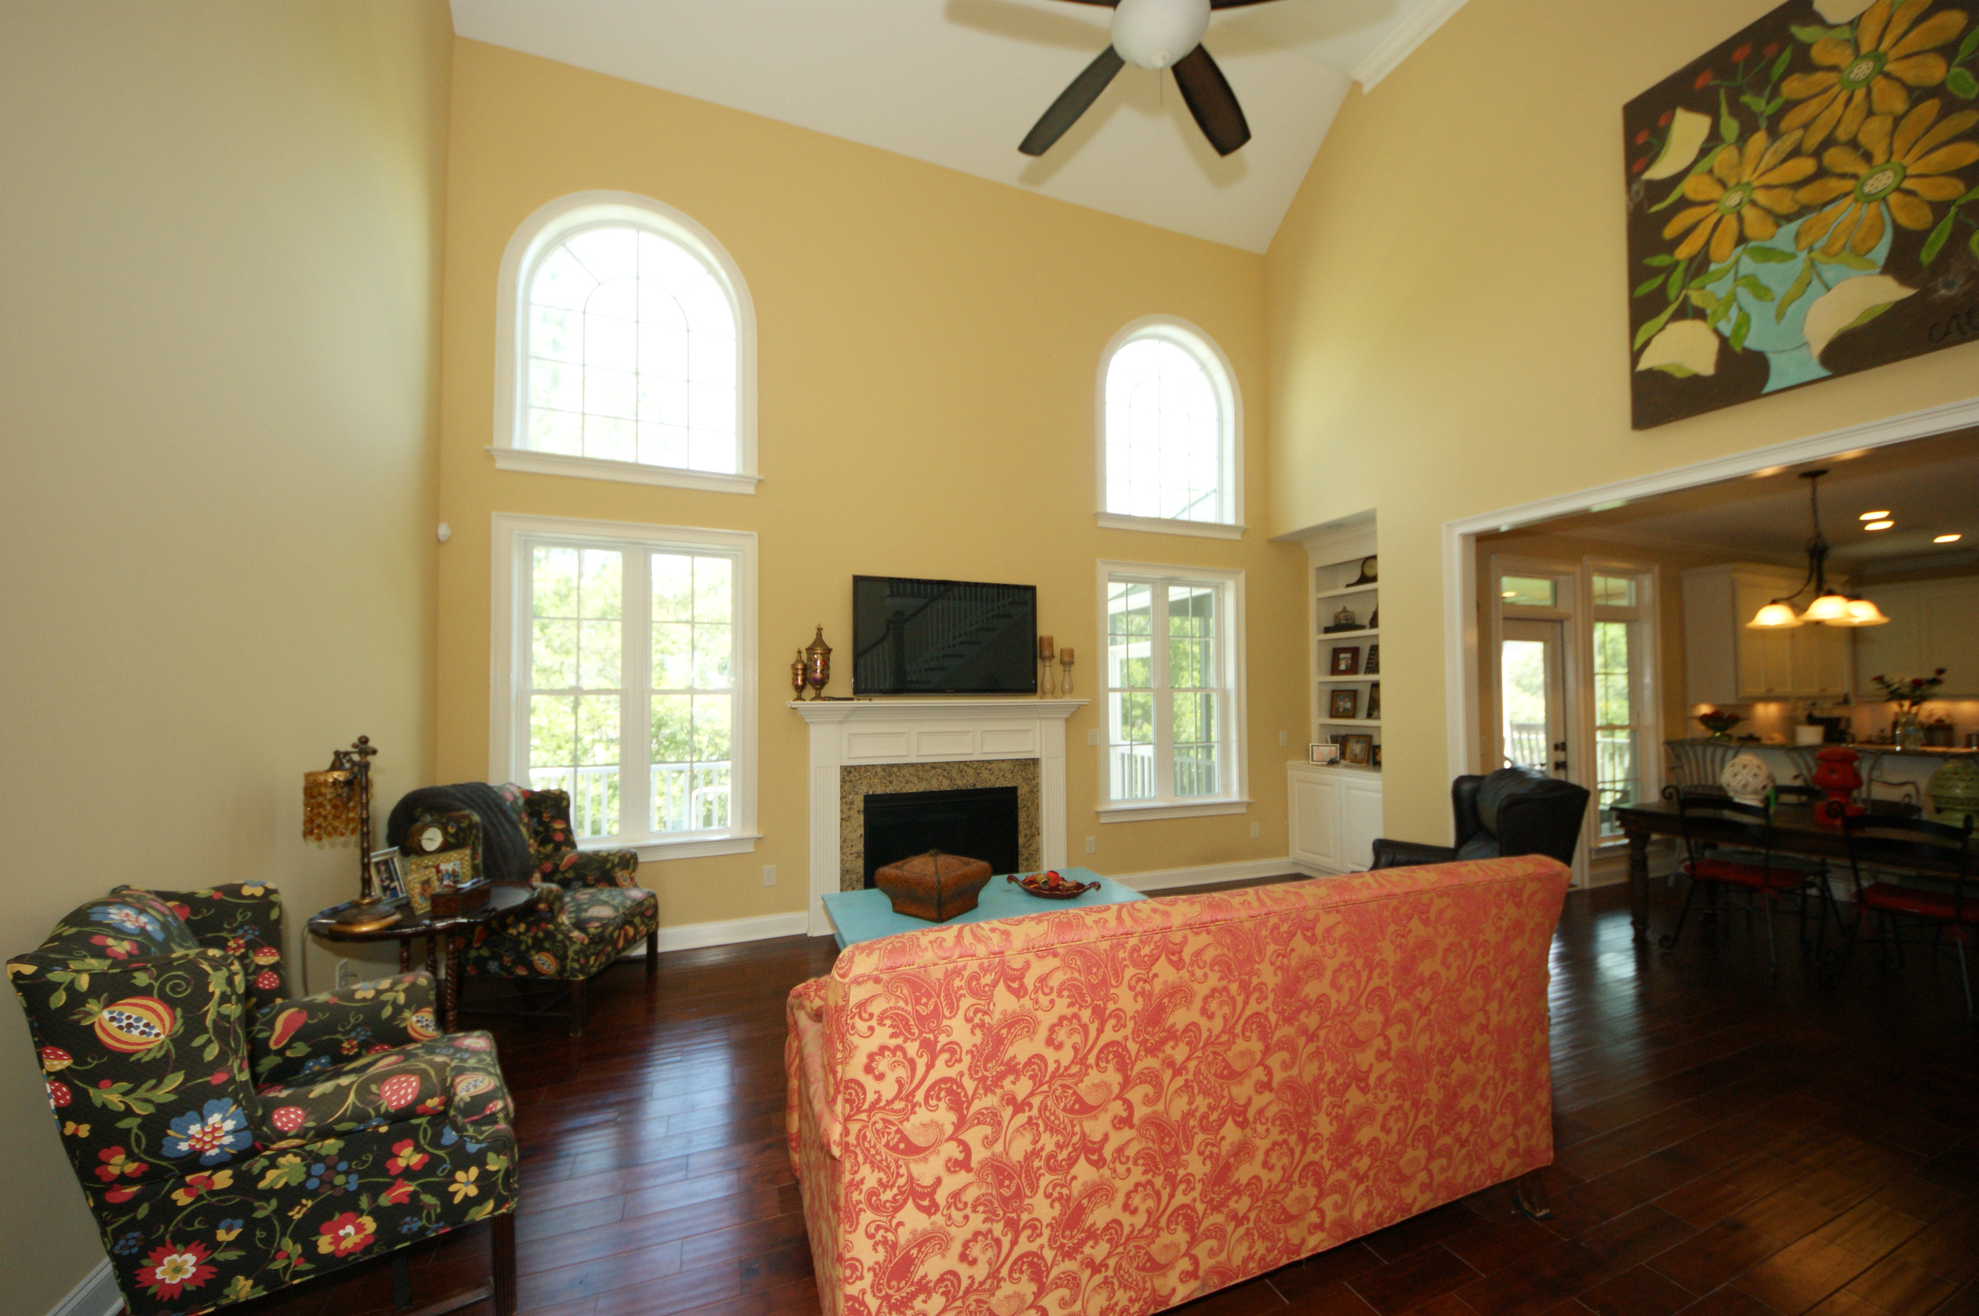
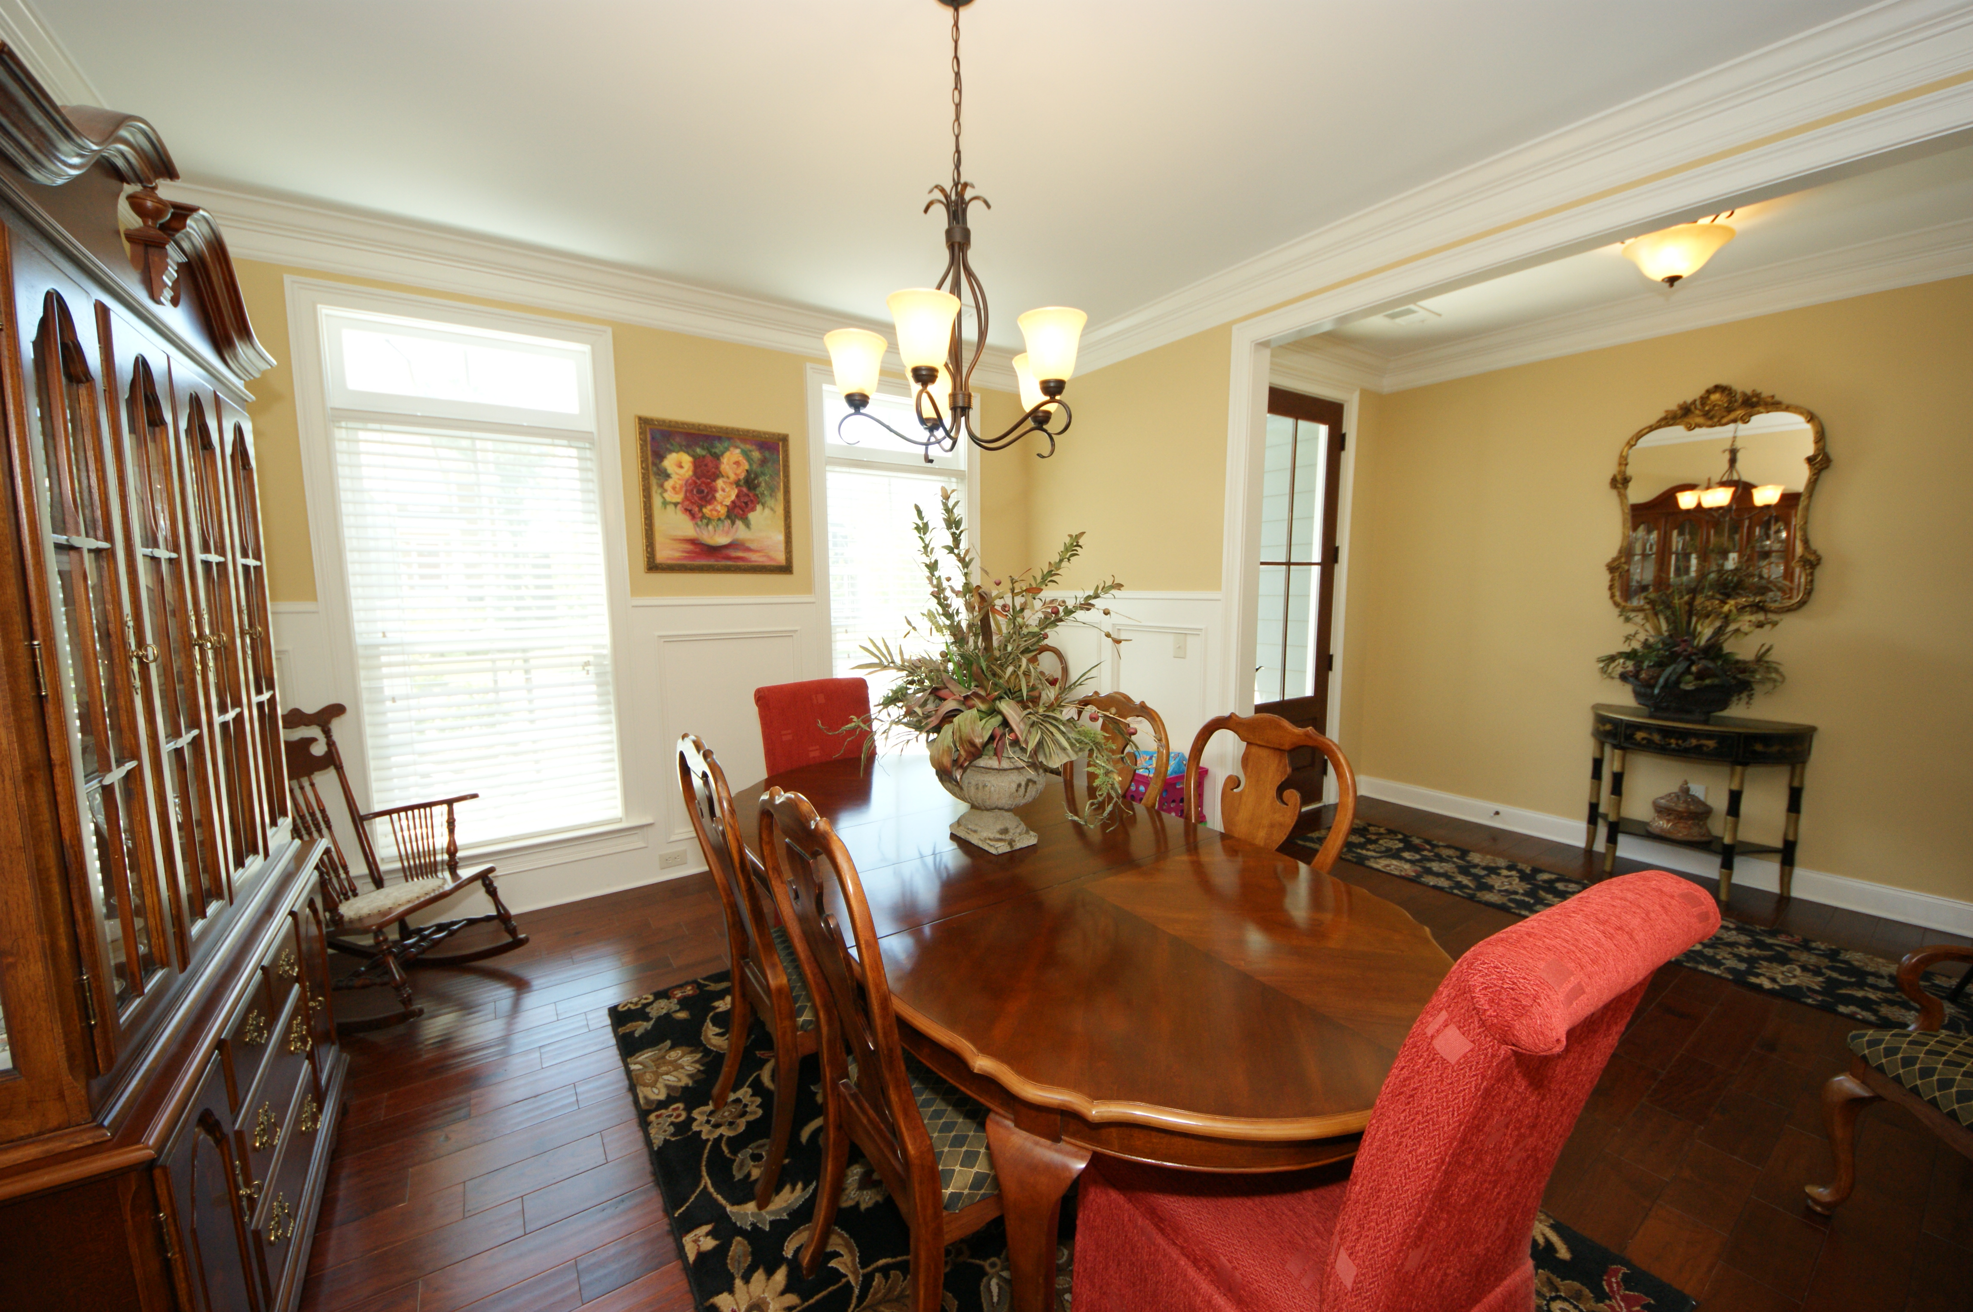
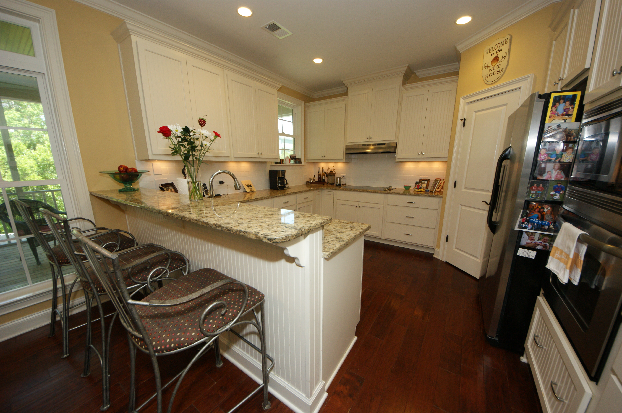
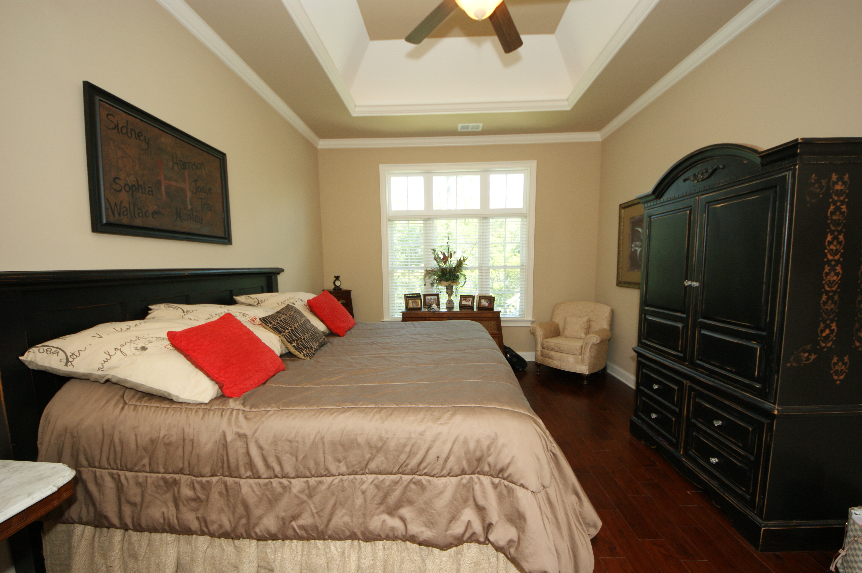



2604 Alderly Lane
Rivertowne On The Wando
Mount Pleasant, SC 29466
MLS# 16012686
$625,000
5 Bedrooms ▪ 4 Baths ▪ 3,284 sq. ft.
Open House ~ Sunday 2-4
Just Listed
Welcome Home Family!
This beautiful, custom built, 5 bedroom, 4 bath home is only 3 years old, has 3,284 sq. ft. of living space, and was designed with a family in mind. Tastefully done with upgrades galore! Wide plank hardwoods throughout, crown moldings, recessed lighting, gourmet kitchen, elegant baths, children’s den upstairs, a separate dining room with plank paneling, children’s entrance with storage for book bags, coats, etc. and a separate laundry room with laundry sink. Master ensuite on main level featuring tile flooring, garden tub, separate tiled shower, dual vanities with granite counters and walk-in closet. Second bedroom downstairs with full bath and granite. Three additional bedrooms upstairs. One has its own bath and the other two share a Jack and Jill. There is also an office where the kids can do their homework. Screened porch, a deck for grilling and a two car garage. Neighborhood has golf memberships, club house memberships with pool and tennis. All conveniently located to award winning schools, beach, Town Center Shopping Center, restaurants and highways.
Don't miss out on this one. It's a gem!
Jennifer Nipper, Realtor®
(843) 478-1800 | jen@AgentOwned.com
www.AgentOwned.com
The AgentOwned Realty Co | 824 Johnnie Dodds Blvd | Mt. Pleasant, SC 29464
Real Estate • Mortgage • Insurance

