Slide 1
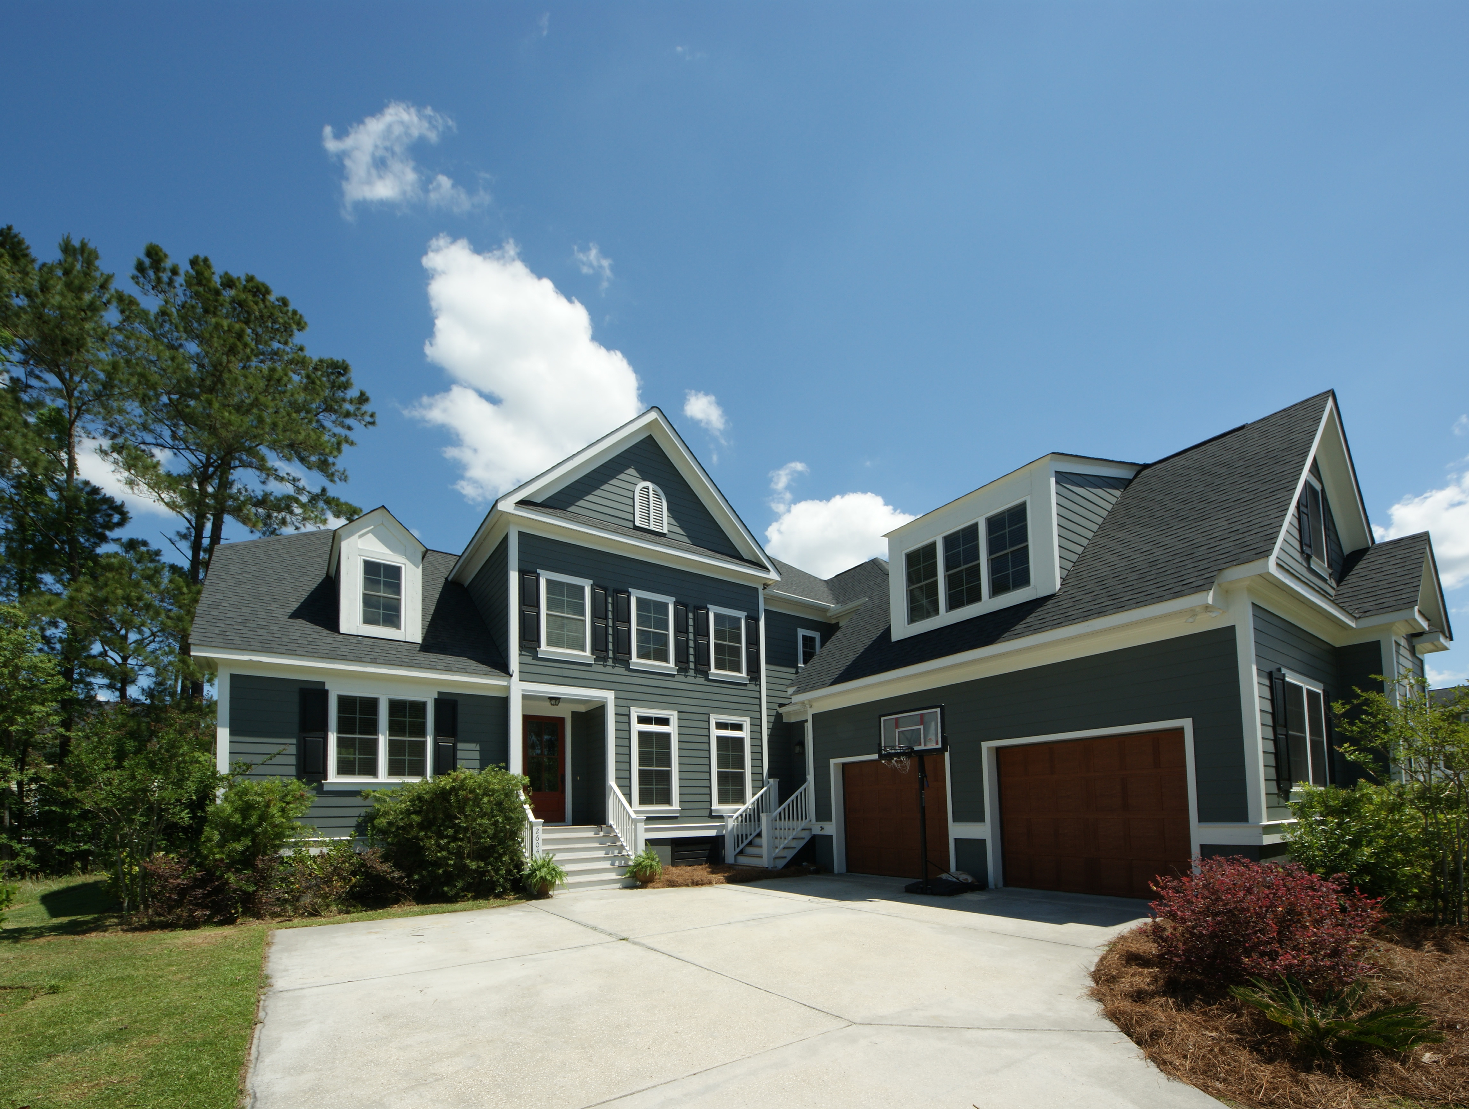
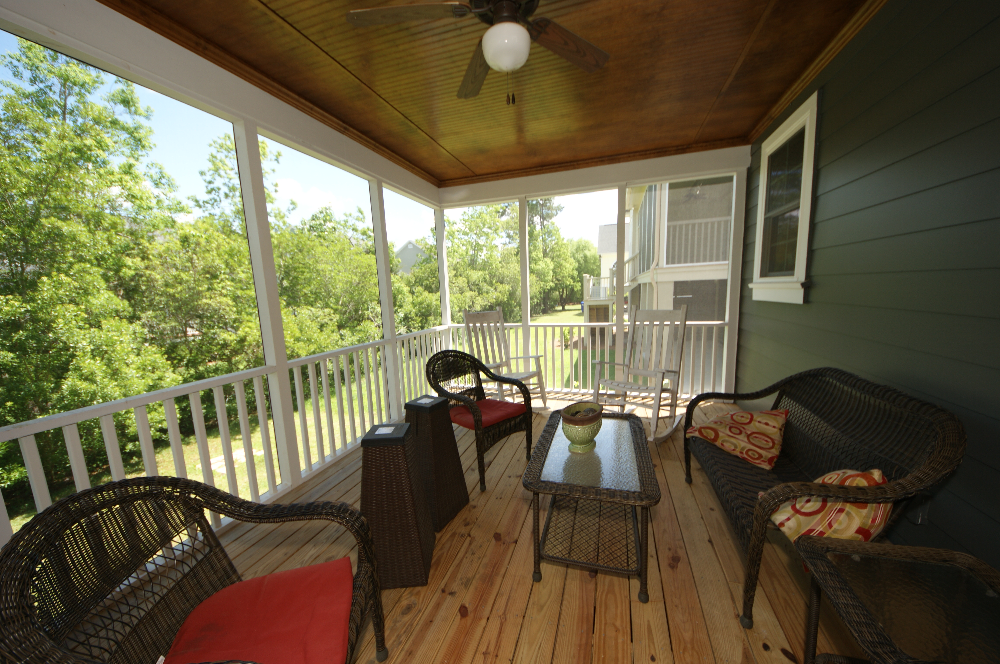
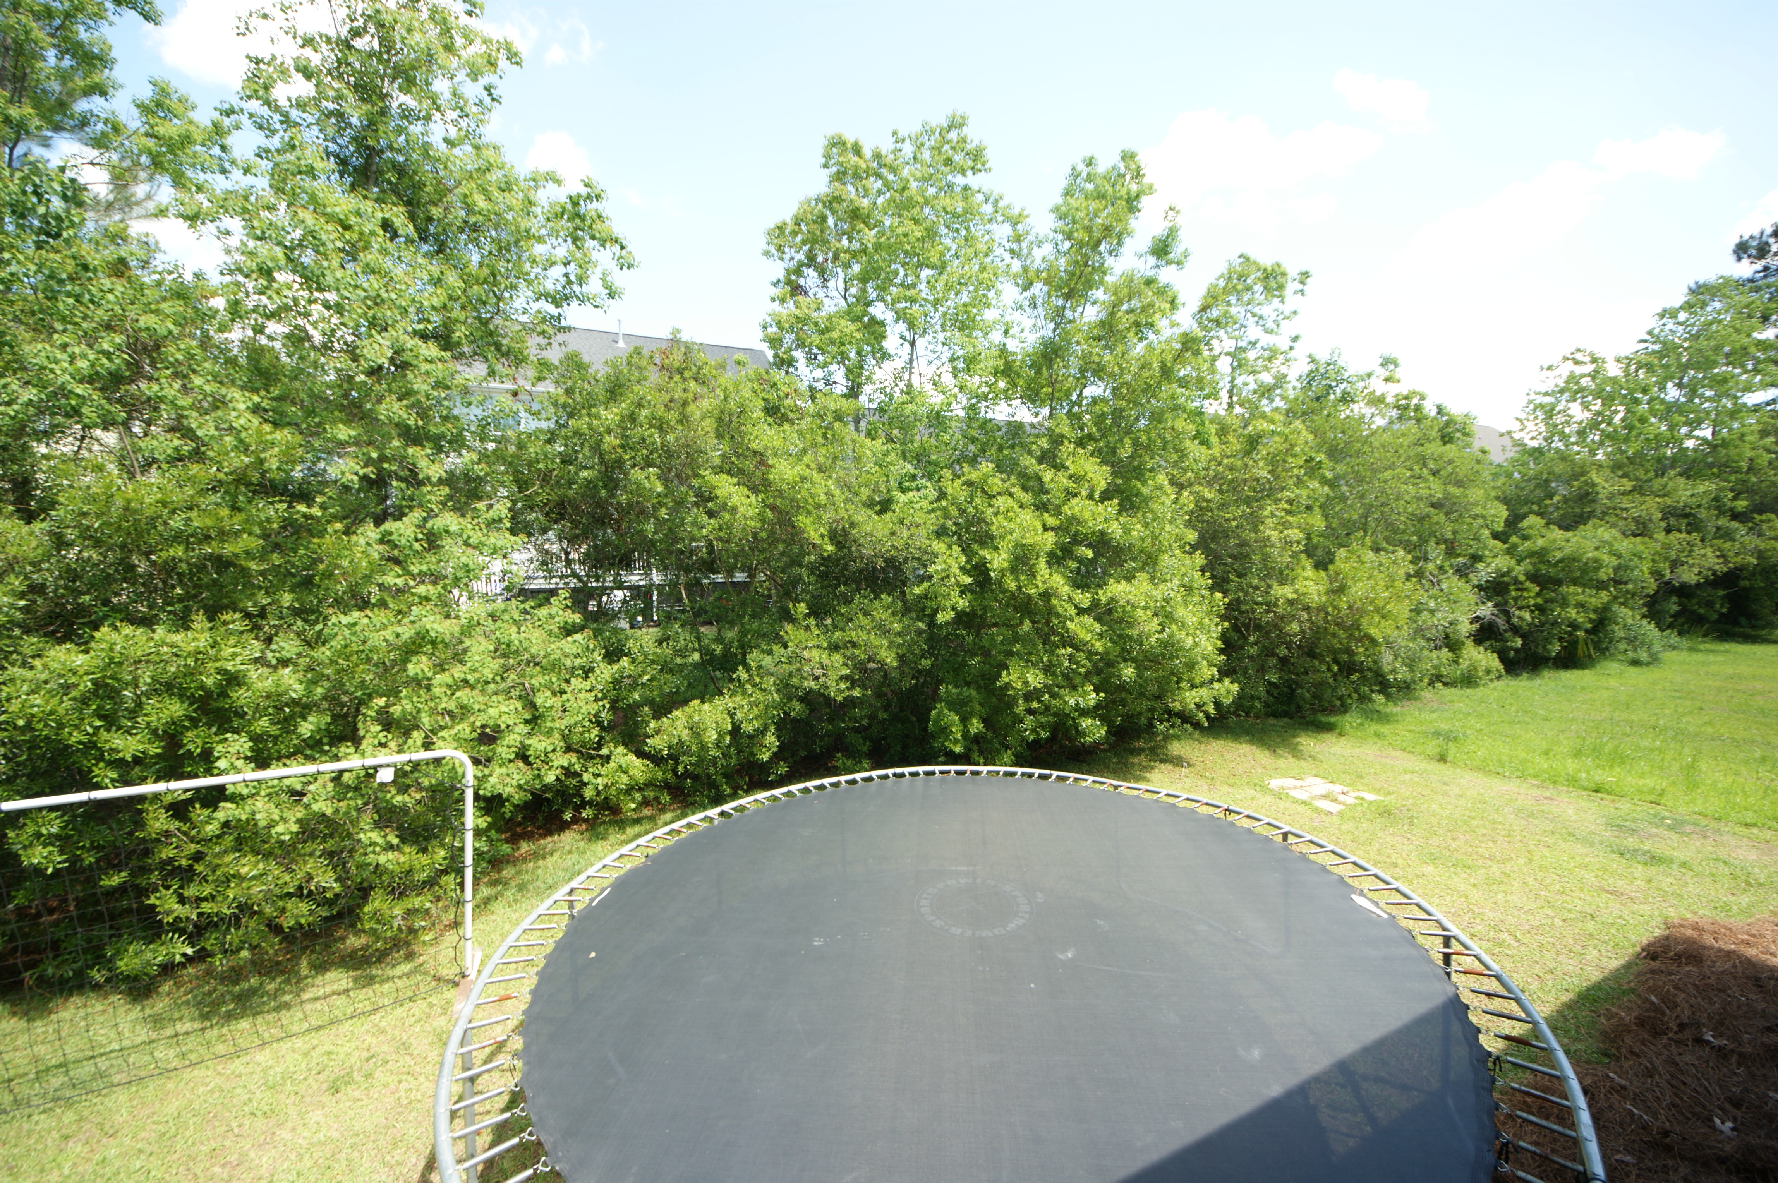
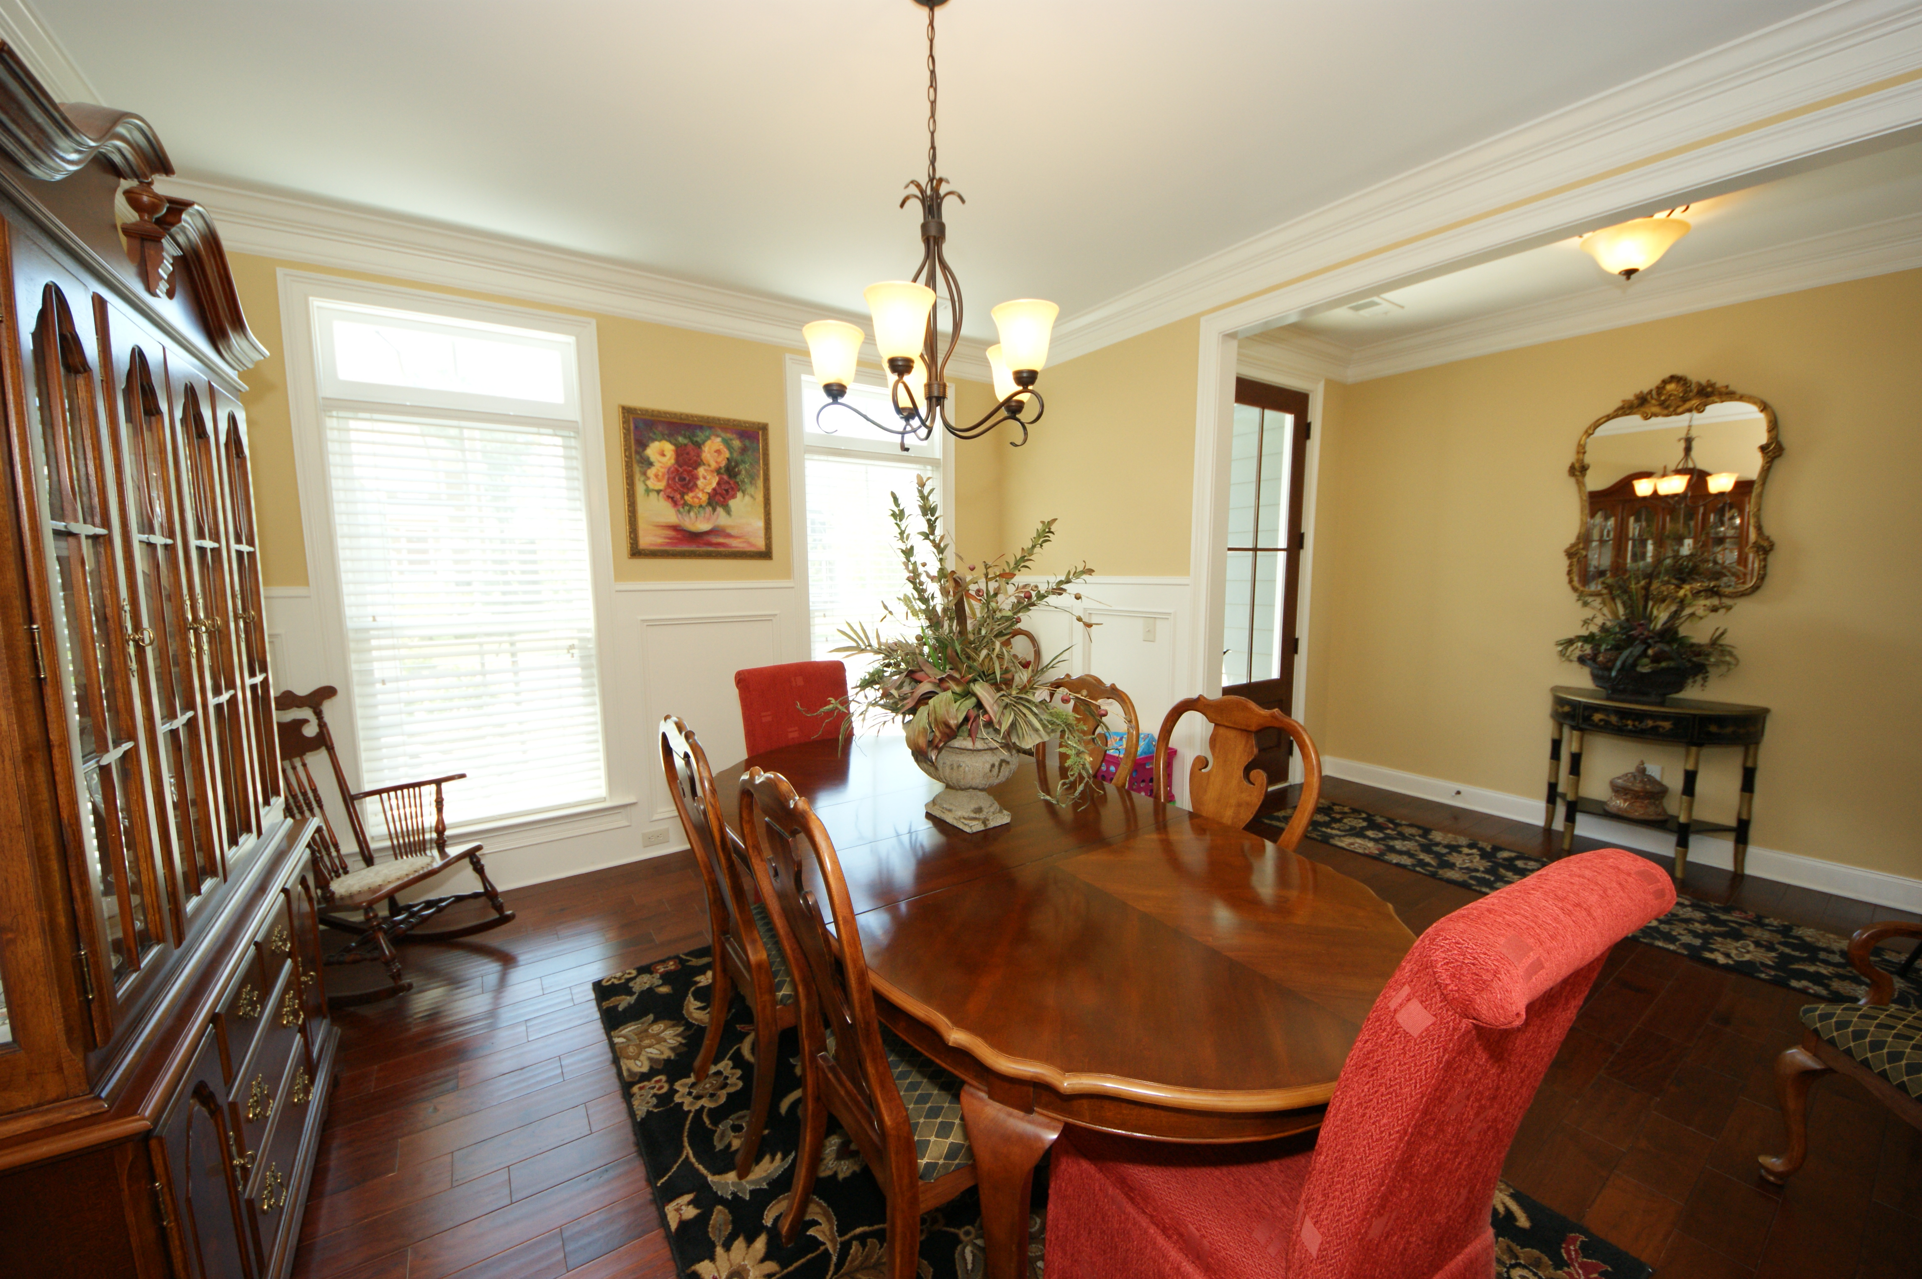
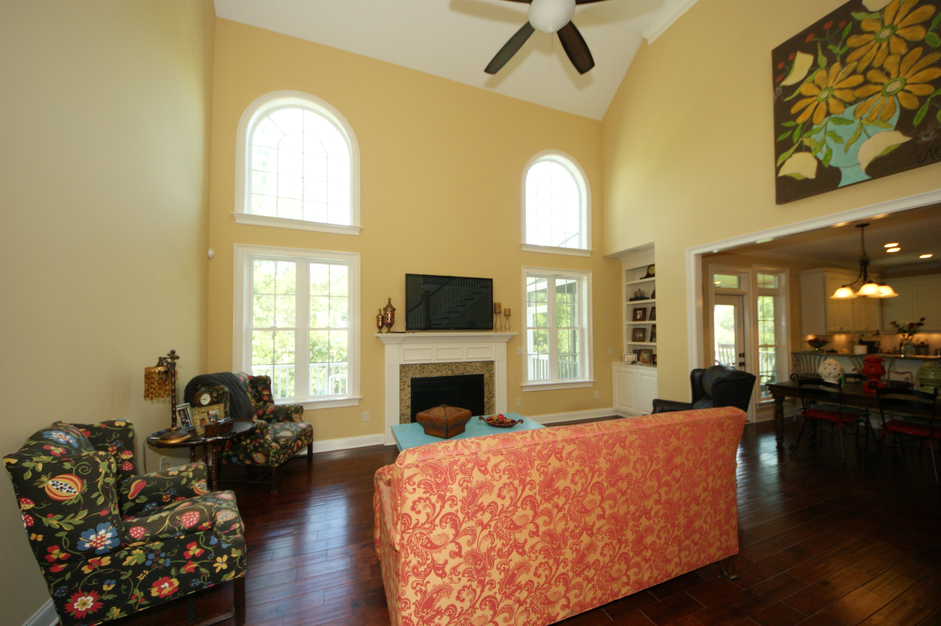
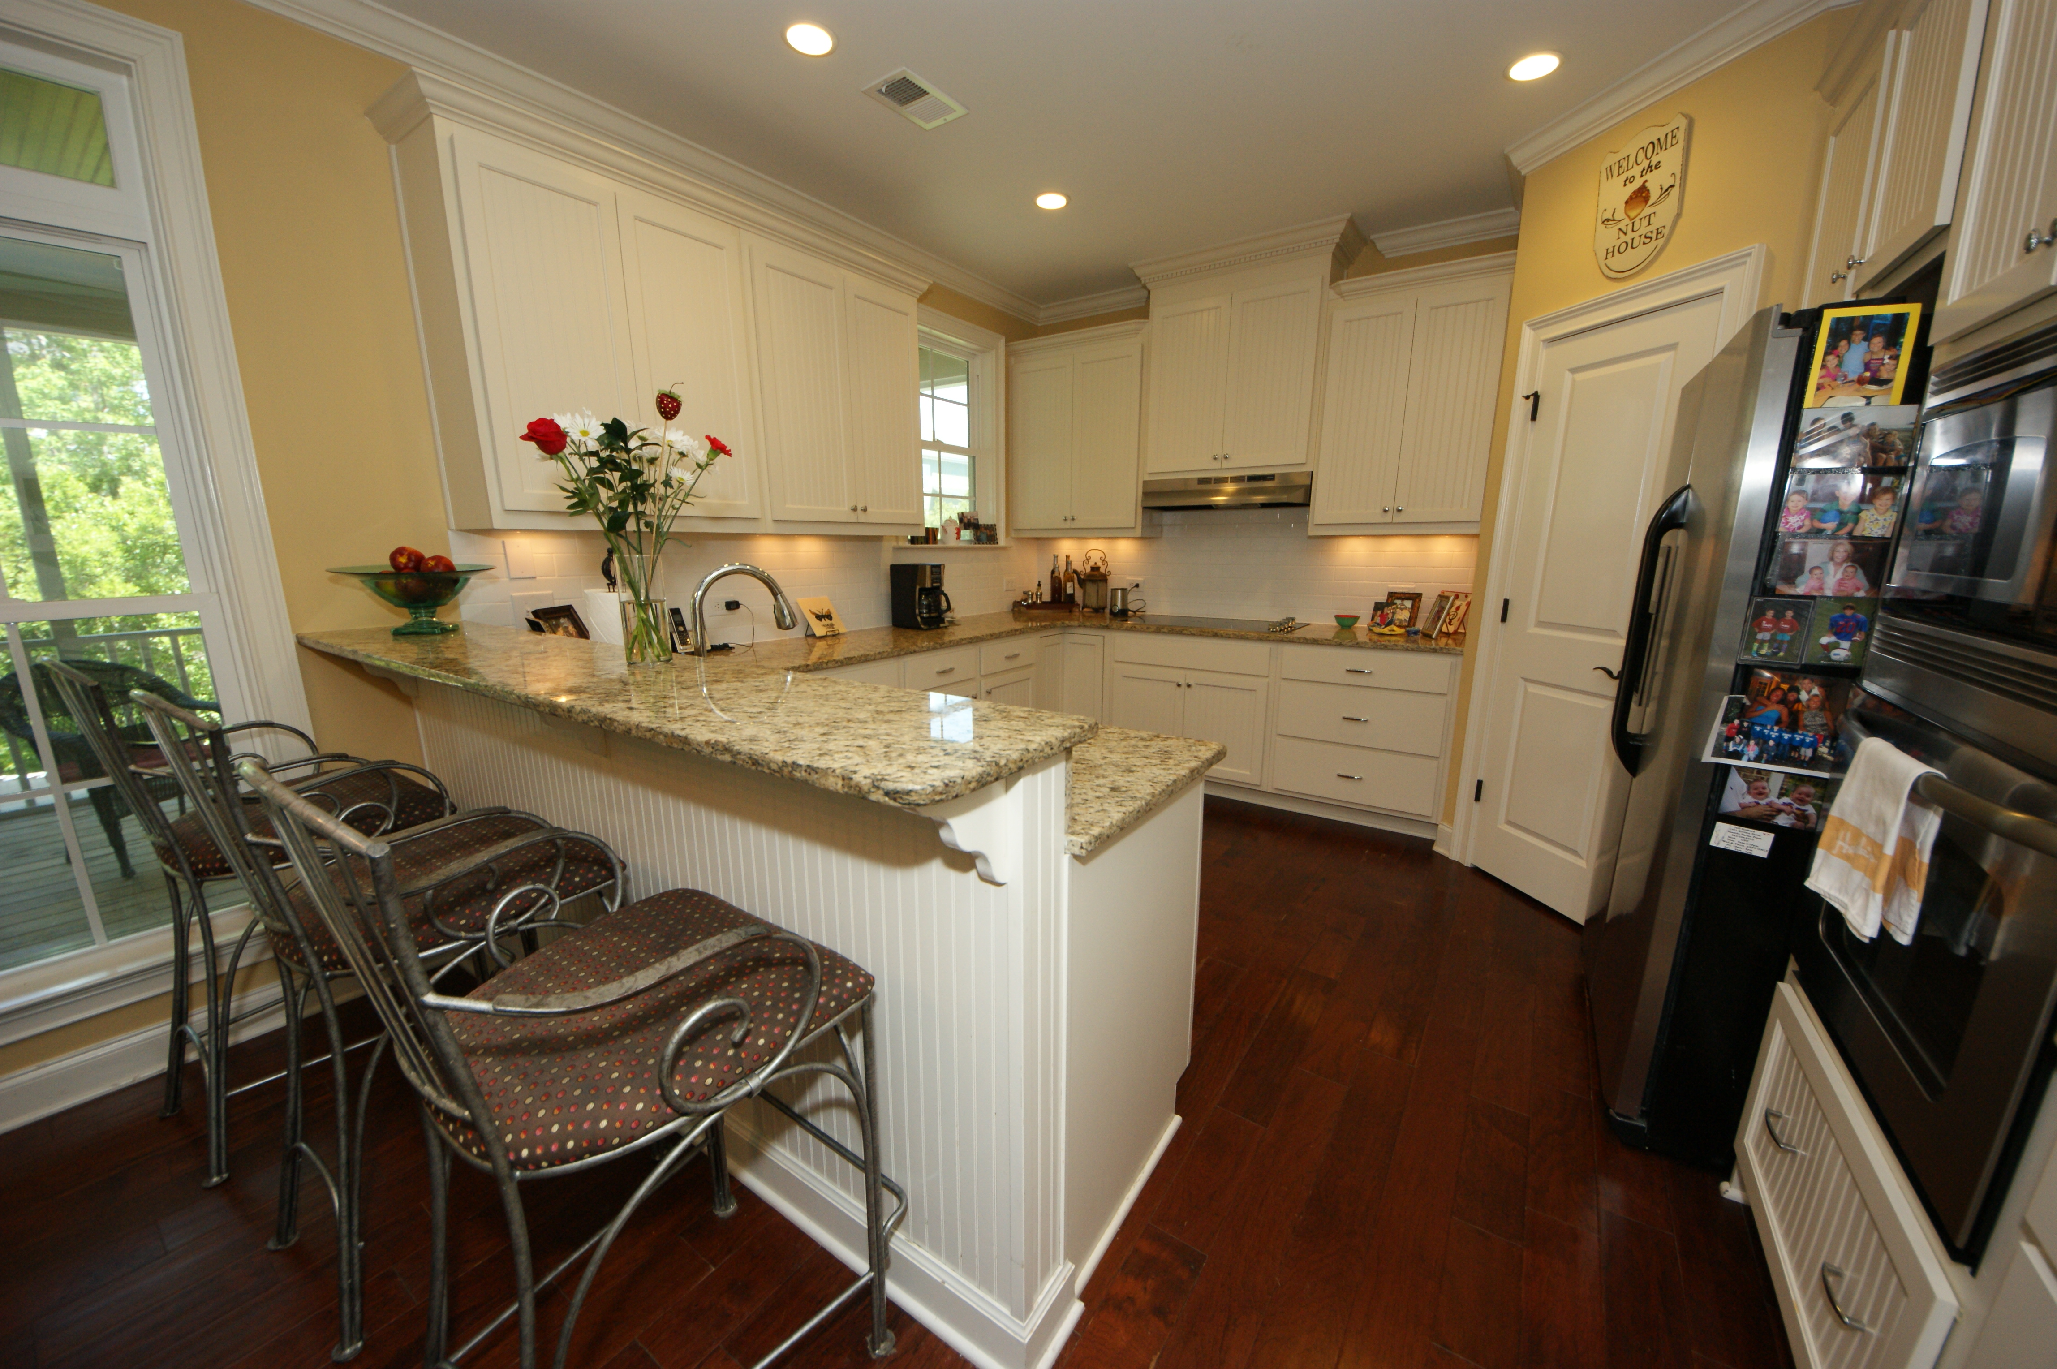
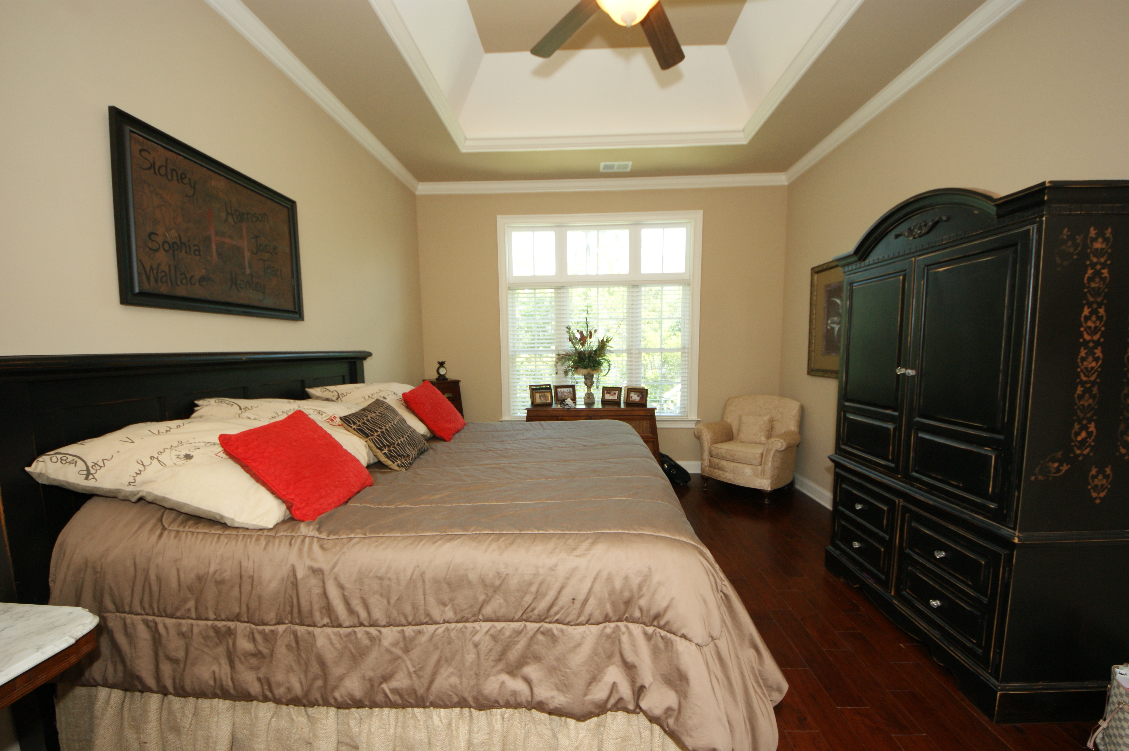
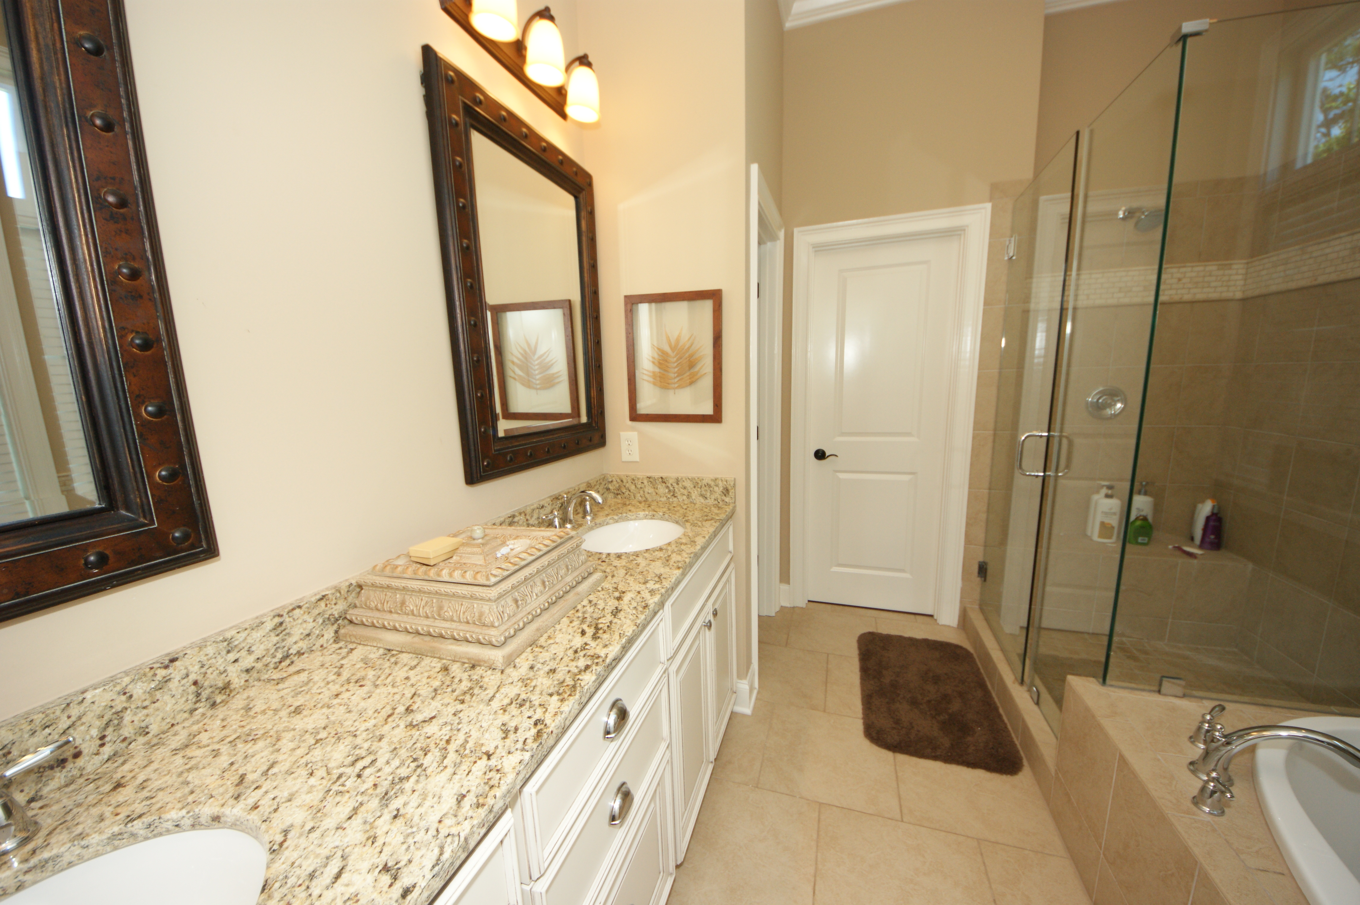



2604 Alderly Lane Rivertowne On The Wando Mount Pleasant, SC 29466 MLS# 16012686 $625,000 5 Bedrooms ▪ 4 Baths ▪ 3,284 sq. ft.
Just Listed
Just Reduced!
Welcome Home Family!
This beautiful, custom built, 5 bedroom, 4 bath home is only 3 years old, has 3,284 sq. ft. of living space, and was designed with a family in mind. Tastefully done with upgrades galore! Wide plank hardwoods throughout, except for baths, crown moldings, recessed lighting, gourmet kitchen, elegant baths, children’s den upstairs away from downstairs great room so it’s very quiet, a beautiful separate dining room with plank paneling and chandelier, side door for children’s entrance with adorable storage for book bags, coats, etc. and a separate laundry room with laundry sink. A fantastic floor plan with the master ensuite on main level with tray ceiling, bath features tile flooring, garden tub, separate tiled shower with glass surround, dual vanities with granite counters and walk-in closet. Second bedroom downstairs which would be a great guest room with separate full bath featuring shower/tub combo, and granite counters for sink. The remaining three bedrooms are upstairs with one bedroom having its own bath and the other two share a Jack and Jill. Upstairs there is also an office where the kids can do their homework, share a computer, whatever they need and tons of storage. Screened porch off of great room, a deck off of screened porch for grilling and a two car garage. (Please view pics and virtual tour for more details) Neighborhood has golf memberships, club house memberships with pool and tennis. All conveniently located to award winning schools, beach, Town Center Shopping Center, restaurants and highways.
Don't miss out on this one. It's a gem!
Jennifer Nipper, Realtor®
(843) 478-1800 | jen@AgentOwned.com
www.AgentOwned.com
The AgentOwned Realty Co | 824 Johnnie Dodds Blvd | Mt. Pleasant, SC 29464
Real Estate • Mortgage • Insurance

