Slide 1
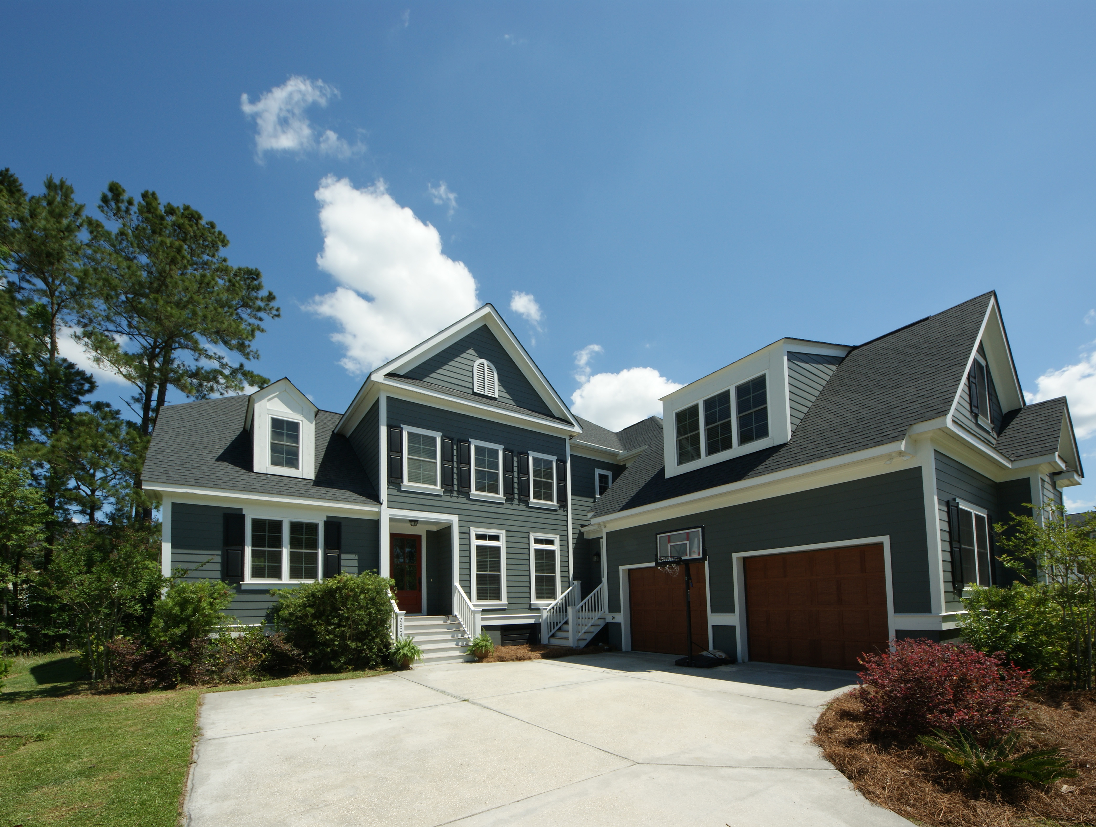
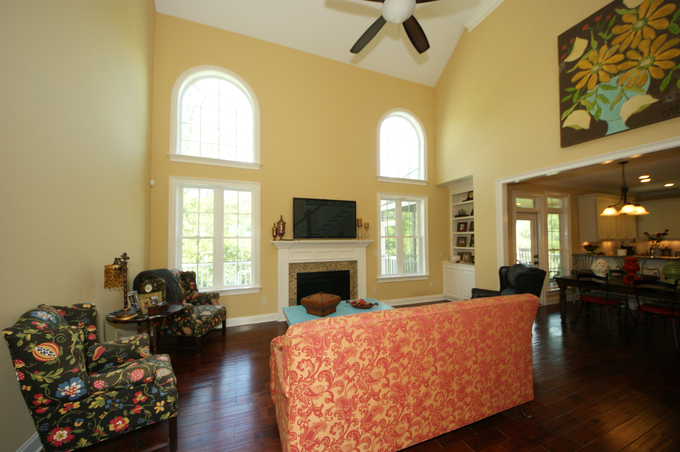
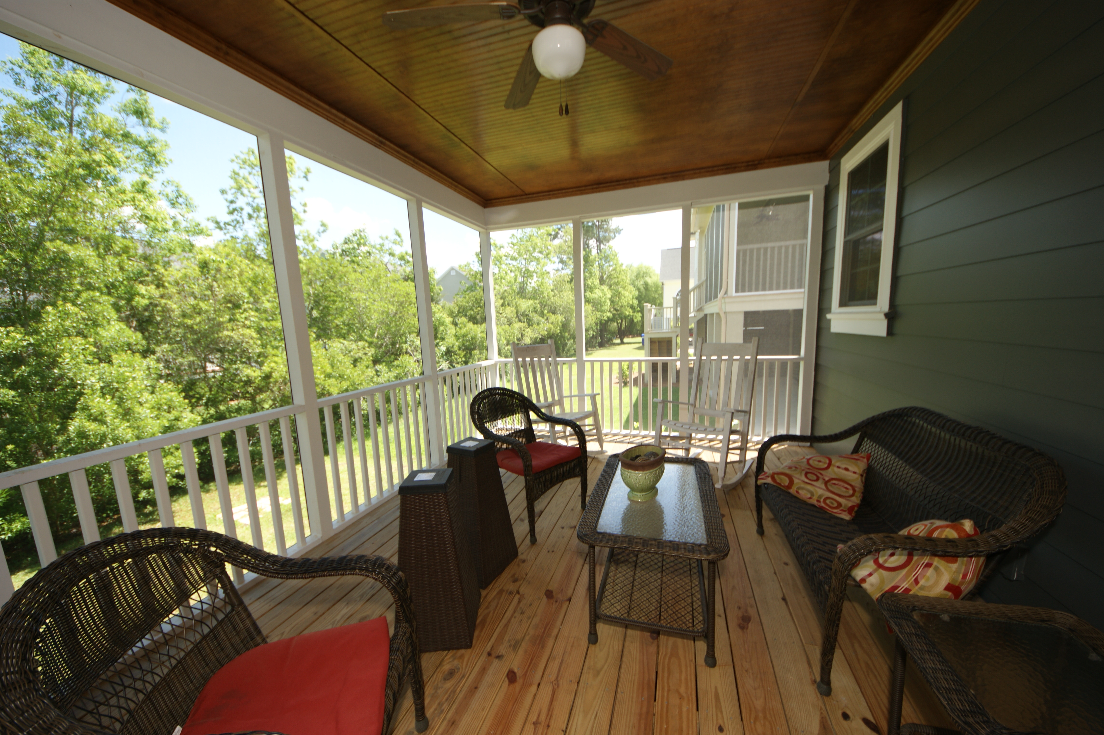
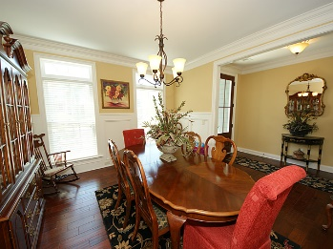
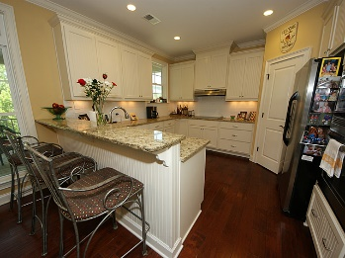
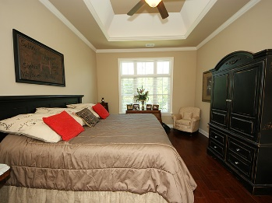
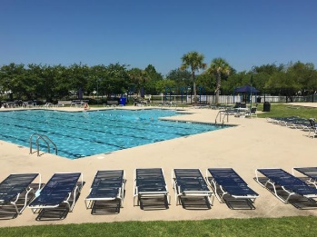
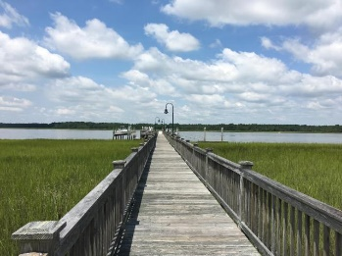



2604 Alderly Lane
Rivertowne On The Wando
Mount Pleasant, SC 29466
MLS# 16012686
$589,000
5 Bedrooms ▪ 4 Baths ▪ 3,284 sq. ft.
Price Reduced!
Just Reduced
Practically a Brand New Home!
This beautiful, custom built home by Paul Spencer, has 5 bedrooms, 4 baths and has 3,284 sq. ft. of living space located in Rivertowne on the Wando. Hardwoods throughout, crown moldings, and upgrades galore. Great room with cathedral ceiling, built-ins and gas fireplace open to kitchen with granite, stainless appliances and a bar. A formal dining room with plank paneling. Master suite downstairs with a tray ceiling, master bath has a separate tiled shower with glass surround, garden tub, dual vanities and granite. There is a second bedroom downstairs with a full bath that is located away from the master suite – a perfect guest room! Laundry room with laundry sink is also located on main level. Three remaining bedrooms are upstairs with one bedroom having its own bath and the other two share a Jack and Jill. There is also an office upstairs and tons of storage. Large finished FROG for an upstairs den, kids den, playroom or whatever you need. Screened porch off of great room, a deck off of screened porch for grilling and a two car garage. (Please view pics and virtual tour for more details) Neighborhood has golf memberships, club house memberships with pool, tennis courts and play parks. Walk to the neighborhood private dock right on the Wando. All conveniently located to award winning schools, beach, Town Center Shopping Center, restaurants and highways.
Don't miss out on this one. It's a gem!
Jennifer Nipper, Realtor®
(843) 478-1800 | jen@AgentOwned.com
www.AgentOwned.com
The AgentOwned Realty Co | 824 Johnnie Dodds Blvd | Mt. Pleasant, SC 29464
Real Estate • Mortgage • Insurance

