Slide 1
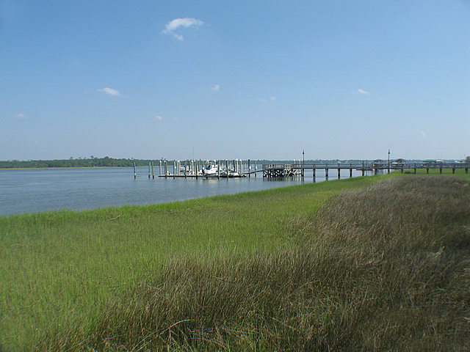
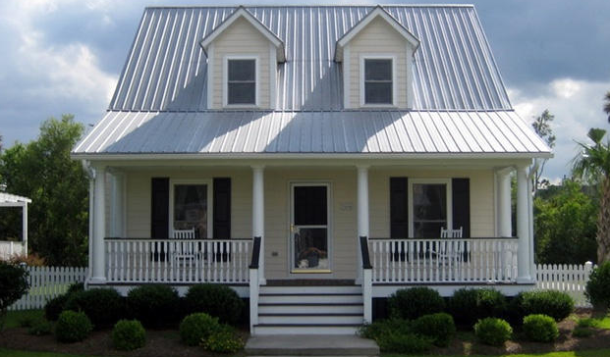
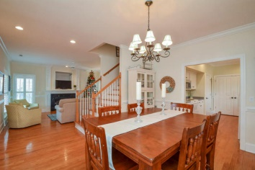
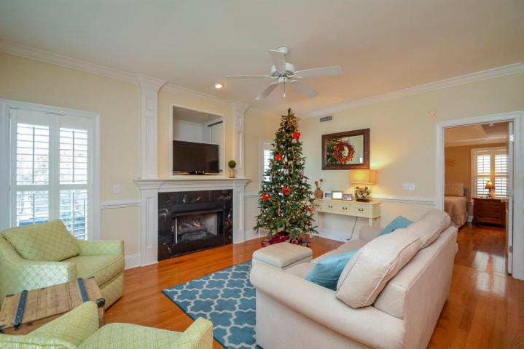
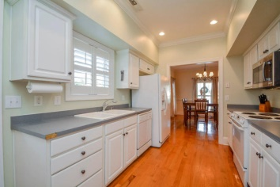

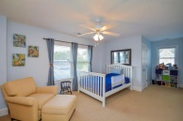

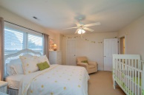

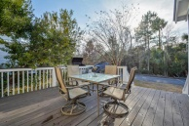
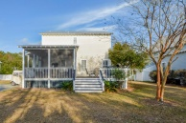
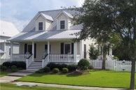
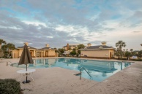


2606 Rivertowne Parkway
Rivertowne On The Wando
Mount Pleasant, SC 29466
MLS# 14031468 ~ $366,999
Last 2 homes on this street went under contract in 9 days and 20 days.
Only home in Rivertowne under $375K
Charming 2 story Cottage with metal roof has 3 bedrooms and 2 full baths
Large covered front porch and screened in back porch and deck truly extends your living space outdoors.
Open den has a gas fireplace and 9 foot ceilings.
Home features crown molding, chair rails and hard wood floors.
Backyard deck & screened in porch off the kitchen is the perfect spot for outdoor entertaining.
All of the bedrooms have carpet and ceiling fans.
Enjoy all the amenities that Rivertowne has to offer: a pool, tennis courts, sidewalks and a play park.
Open House ~ Sat, Jan 24th ~ 10a-4p
Listed Exclusively by
Christina Bucci
843-830-0888 Cell
christina@sweetgrassps.com
RE/MAX Elite | Sweetgrass Properties, 91A Broad St, Charleston, SC 29401

