Slide 1

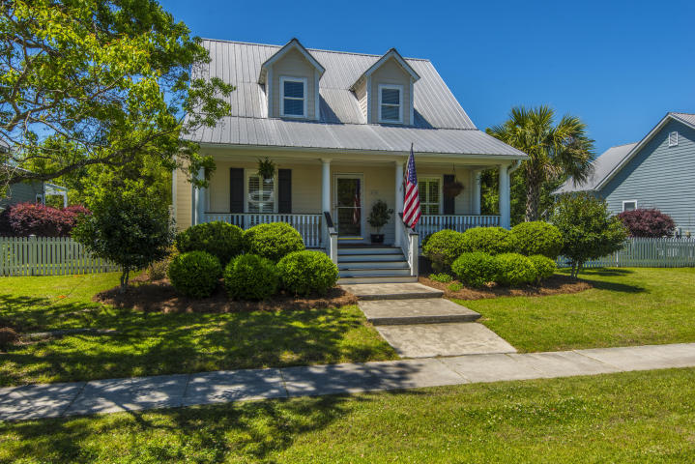
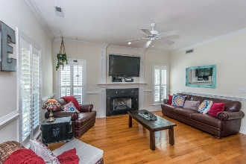
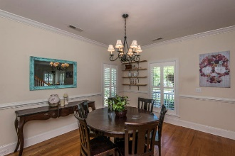
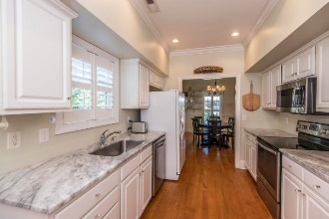
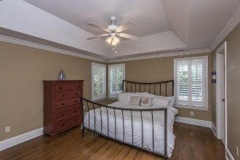
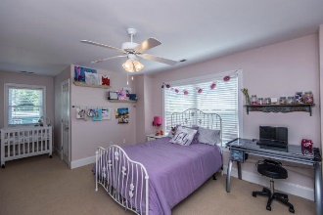
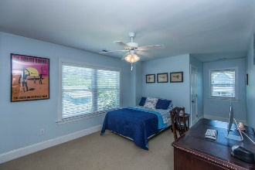
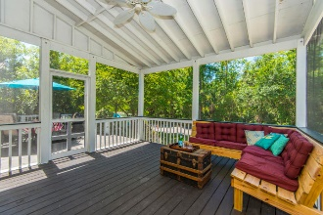
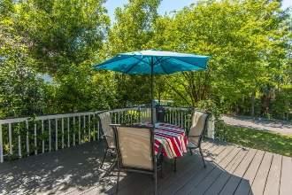
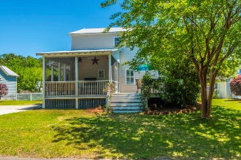


2606 Rivertowne Parkway Rivertowne ~ Mount Pleasant, SC 29466 MLS# 18012254 ~ $383,500
Lowest Price in Rivertowne
Coastal inspired, Cottage Style home in move-in-ready condition. Enjoy catching the river breeze on the full front porch. Entering the home you'll immediately notice the beautiful hardwood floors and comfortable open floor plan. The great room features a fireplace with custom mantle and upgraded trim including chair railing, crown moulding and plantation shutters. The chef's kitchen features white cabinetry and sleek white & grey marbled stone countertops as well as stainless steel appliances. An ample sized dining area can accommodate a table large enough to host family and friend for those special occasion dinners. Generously sized, the master suite is located on the main floor and features a trey ceiling, walk-in closet and en-suite bath with double sink vanity.
Upstairs, you'll find two additional bedrooms which share a full bath. There is also plenty of storage space. Outdoor living is easy in this low maintenance yard. Relax after a long day on the oversized screened porch and deck while enjoying the peaceful privacy of the wooded buffer. Rivertowne on the Wando features 3 community docks for fishing, crabbing, boating or just relaxing with the amazing Wando River sunsets. There is also a community pool and tennis courts. Rivertowne Country Club with an Arnold Palmer Signature Golf Course is just minutes around the corner. Conveniently located for shopping, dining, schools and hospitals. This well priced home won't last.
Asking $1,200,000
MLS# 17023051
3,692 SqFt
4 Bed/3½ Baths
Short Drive to Historic Downtown Charleston & Beaches
Don Dawson 843-514-0452 ddawson@carolinaone.com Carolina One Real Estate • 2713 Highway 17 North • Mount Pleasant, SC 29466
www.TeamDawsonSC.com

