Slide 1
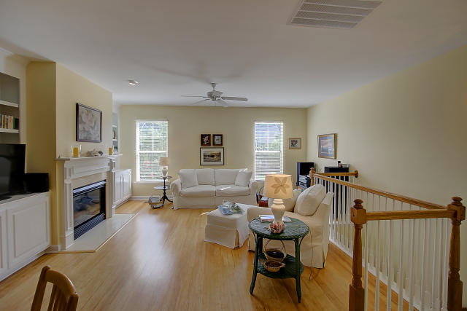
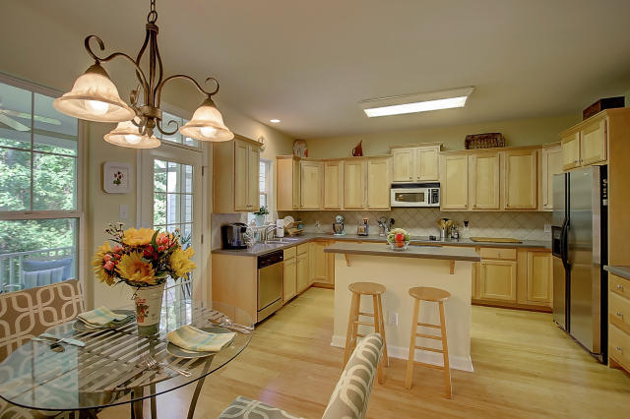
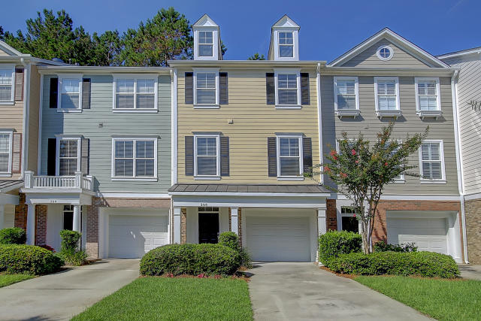
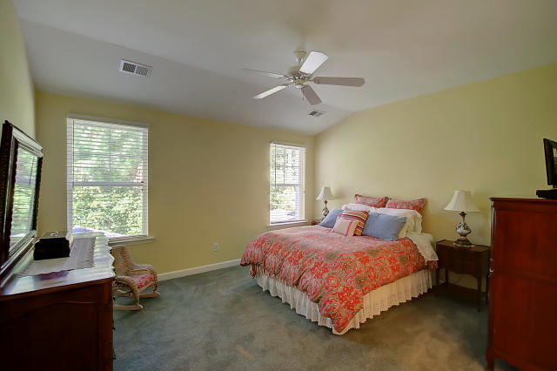
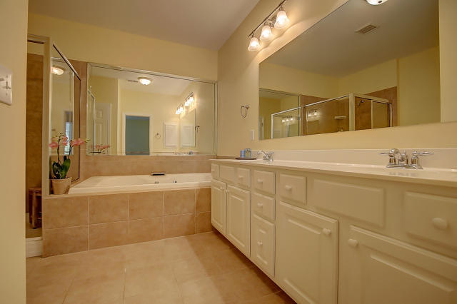
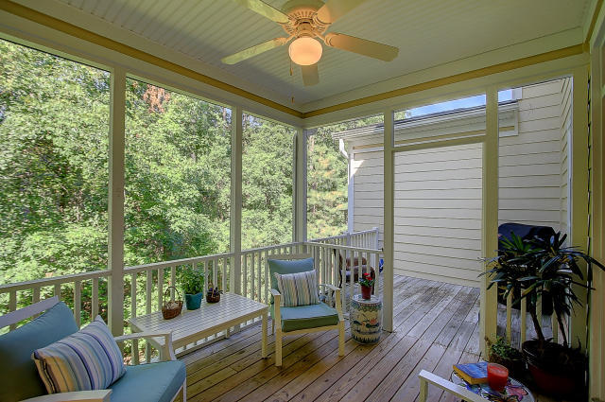
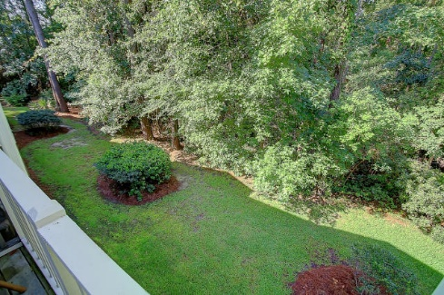


260 Fair Sailing Road
Dunes West
Mount Pleasant, SC 29466
MLS# 16018107
$282,000
A Smart Buy…
Show & Go!
Beautiful Condo in Egrets Walk...
Backs to Woods, Move-In Ready, With Screen Porch & Upgrades
This spacious, open plan is move-in ready! You will love the hardwood floors on the main level, the gas fireplace in the living room with built-ins and the fabulous light that streams into this room. Enjoy preparing meals in this open, eat-in kitchen with all stainless steel appliances, tons of storage, and an island with extra seating. This home has the so needed screen porch for summer bug free nights and if you want that full outdoor experience, there's also a separate deck. 260 Fair Sailing backs up to woods for that very private feel. Don't forget the over sized 2 car garage for extra storage or work space. This home won't be on the market long!
Darlene Smith
Office - (843) 886-8110
Mobile - (843) 696-7824
darlenesmith@carolinaone.com
DarleneSmithTeam.com
Carolina One Real Estate
1503 Palm Blvd Ste
Isle of Palms, SC 29451

