Slide 1
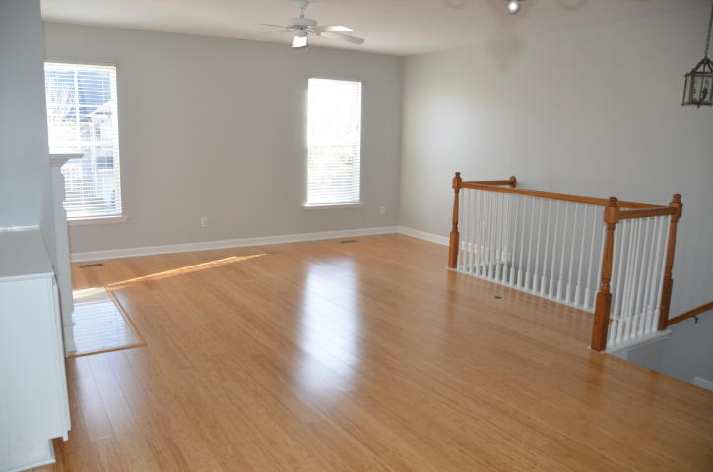
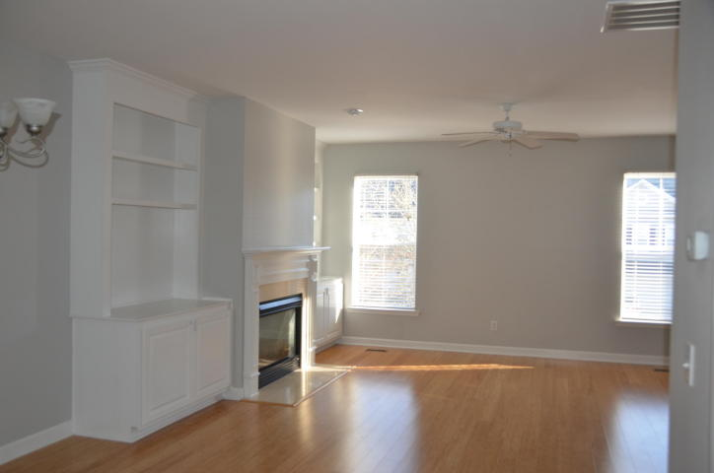
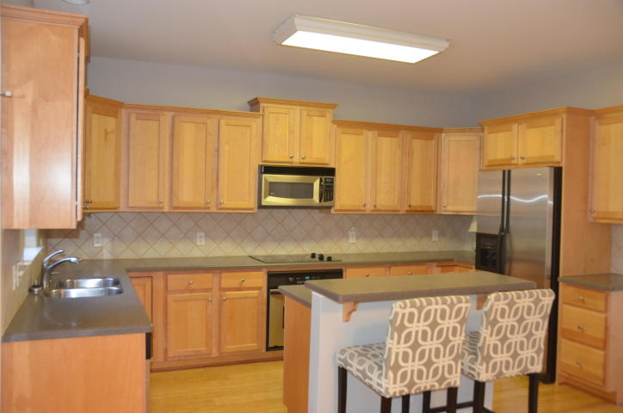
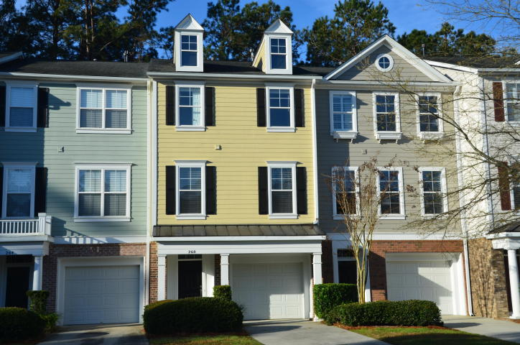
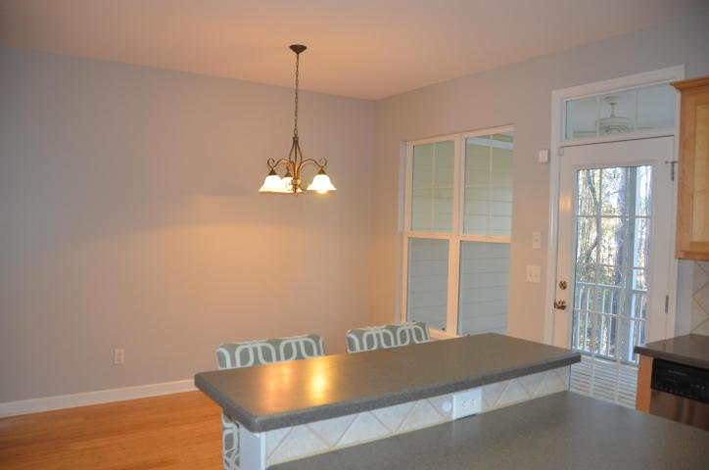
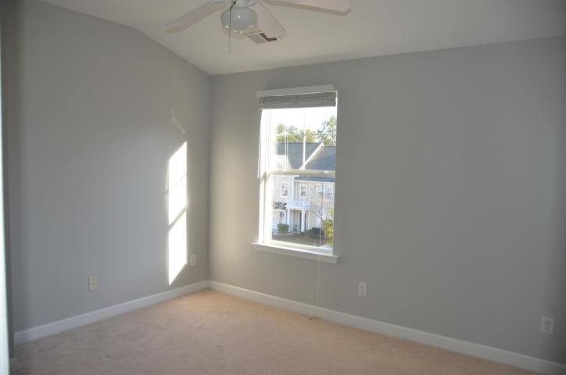
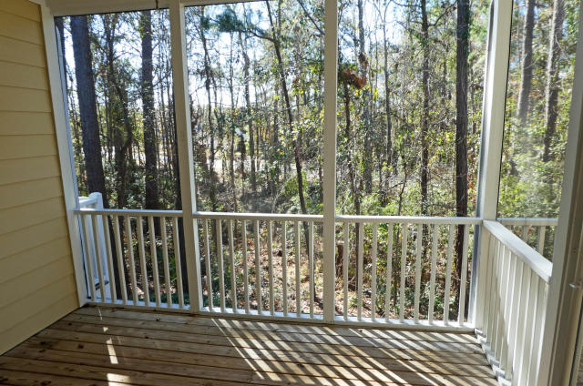
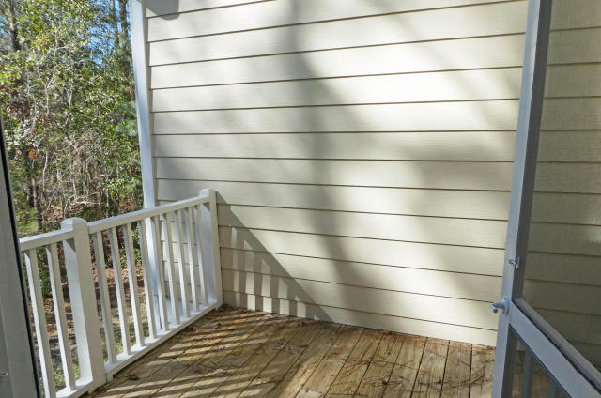
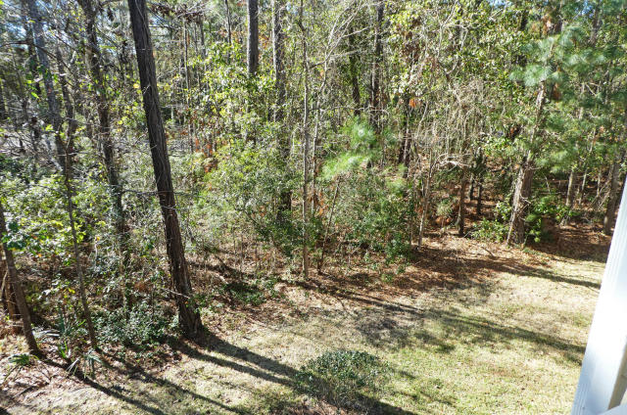
Great Rental behind the Gates in Dunes West
260 Fair Sailing Road
Mount Pleasant ~ MLS# 17032515 ~ $1,895
Enjoy this spacious 2 bedroom 2.5 bath townhouse in the quiet gated community of Dunes West. Second level features hardwood floors, a large living area with a gas fireplace and spacious eat-in-kitchen with all stainless appliances, extra storage and large island with extra seating. There is a screen porch off of the kitchen. All bedrooms are carpet and located on the third floor. Oversized 2 car garage with an attached grilling deck on the back. Newly painted throughout. Available NOW!
Margaret Kerr
(843) 884-3901 O ~ (843) 813-5344 M
mugsykerr@aol.com
Old Dominion, REALTORS · 890 Johnnie Dodds Blvd · Mt Pleasant, SC 29464

