Slide 1
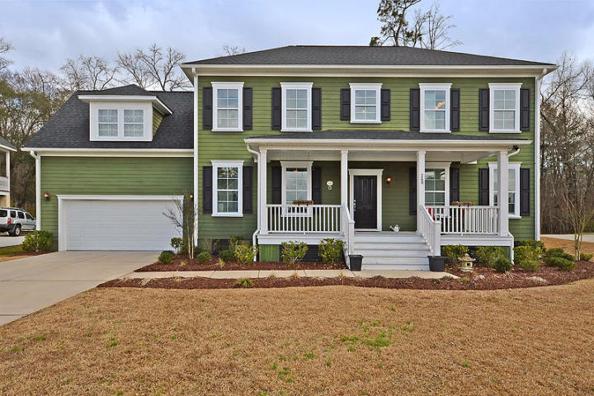
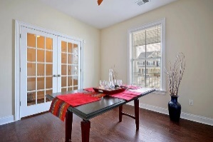
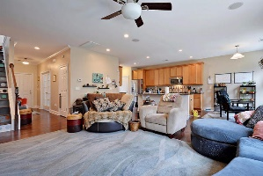
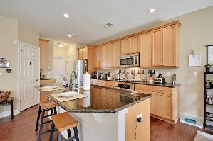
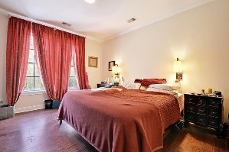
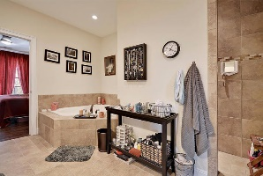
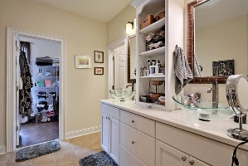
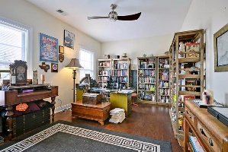
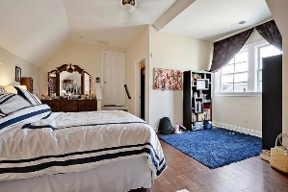
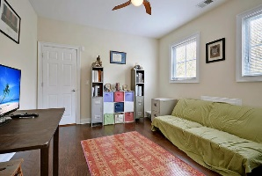
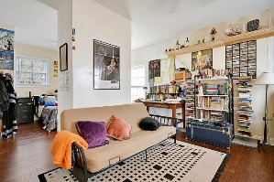
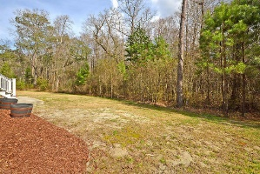
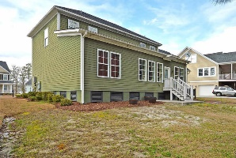


A Home To Make Your Own
260 Silver Cypress Cir
The Club at Legend Oaks Summerville, SC 29485
MLS# 15005446
$332,000
4 Bedrooms | 3½ Baths | 2,850 sf
Welcome home to this lovely Legend Oaks home in the gated section of the Club. Full front porch welcomes you to this like new home. Enter in to the foyer and notice French doors to the dining room. You'll notice wood floors throughout this home as you enter the living room which offers surround sound and recessed lighting. The kitchen overlooks the living room and has a large island, with room for at least four to sit, walk in pantry, an area for a beverage/wine cooler and stainless steel appliances. The eat-in kitchen overlooks the wooded, private back yard. Downstairs, you'll also find the master bedroom. The master bathroom offers dual vanities, a Jacuzzi tub as well as an oversized shower stall. Large master closet as well as built in shelving on the vanity.
Upstairs you'll find three very large bedrooms and again, all wood floors. The first bedroom is the size of the entire side of the house. This bedroom has access to the full bathroom in the hallway. The second bedroom, is currently being used as an office and is also a good size. The third bedroom upstairs, can also be used as a bonus room. This room has a full bath, a sitting area, then step down into the bedroom with offers a walk in closet with tons of storage. No space was wasted in this home! Storage galore including a pull down attic. Under the stairs, in the eaves, all turned in to finish storage space. The garage has hanging storage as well! This home is ready for you to move in!
Larry & Kathy Mazalatis
Larry Cell 843-693-0529
Kathy Cell 843-693-0159
Office 843-871-9133
AGENTOWNED PREMIERE GROUP | 1800 TROLLEY RD | SUMMERVILLE, SC 29485

