Slide 1

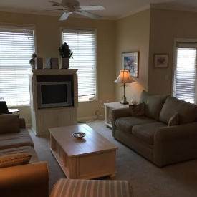
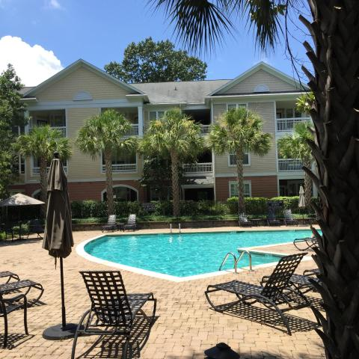
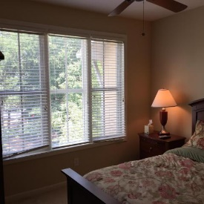
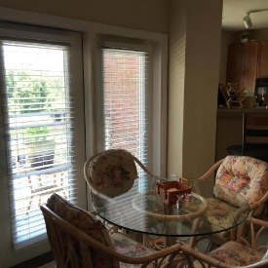
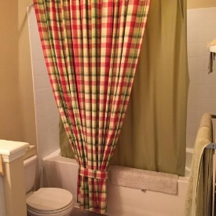
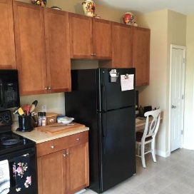
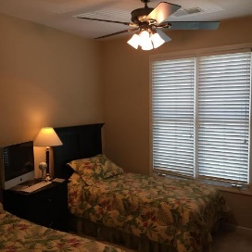
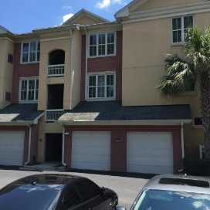
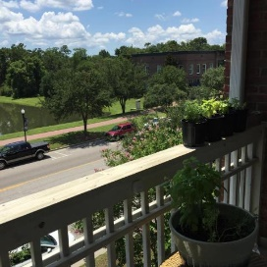

Furnished & Move-in Ready Condo On Daniel Island
Includes a 1-car garage
260 Seven Farms Drive #305
MLS# 16020210 ~ $255,000
Welcome to your Daniel Island getaway! Just pack your suitcase and move on in! This fully FURNISHED condo has been exceptionally maintained and is in great condition. The open floor plan, spacious kitchen, 2 large bedrooms; along with 2 full private bathrooms, is an ideal setup for entertaining guests. Lounge on your covered balcony in the mornings and enjoy views of the pond across the street. Located within walking distance to area shops, restaurants, the new Vovlo Car Stadium and just a few short steps away from the lovely neighborhood pool and private gym. You will never need to leave! No need to rent additional storage space - this condo has ample closet space inside the unit and additional storage in the 1-car Garage. GREAT AMENITIES! Take advantage of the outdoor grills, miles of walking/jogging trails, picnic areas, resort style swimming pool, clubhouse and fitness center.
Erin Quinn Hanhauser
(843) 743-8204
erin@radekopf.com
1205 Two Island Court, Suite 201 | Mount Pleasant, SC 29466
Phone: (843) 579.2217 | Fax: (843) 971-0281

