Slide 1
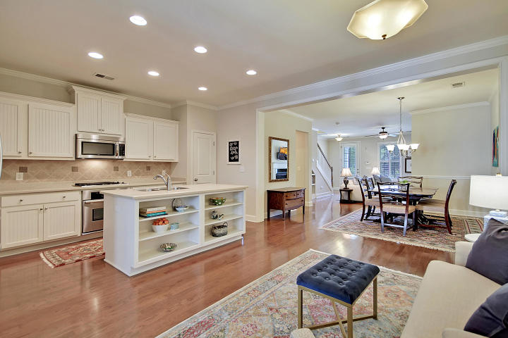
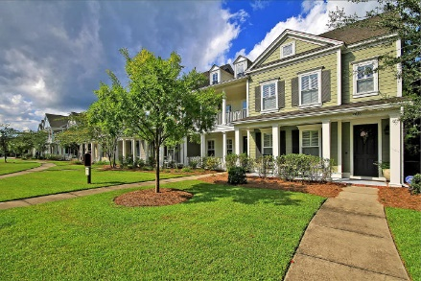
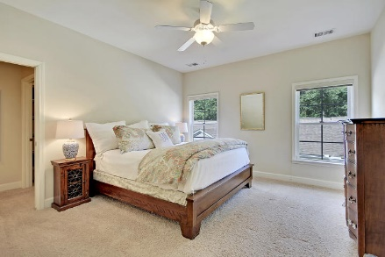
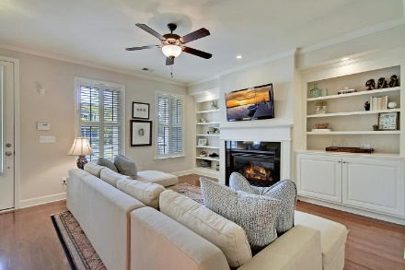
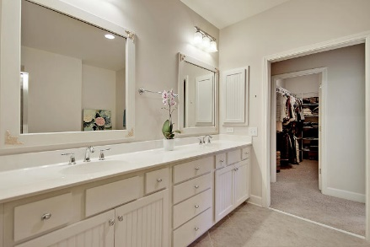
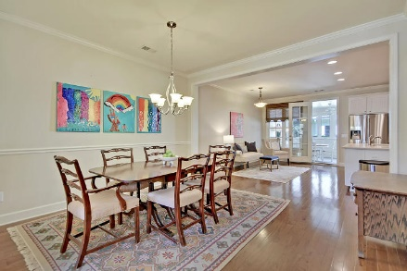
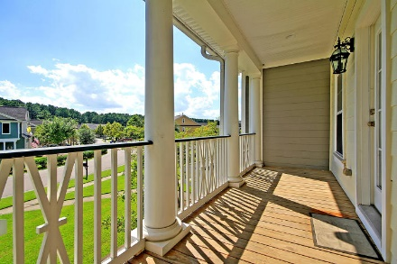
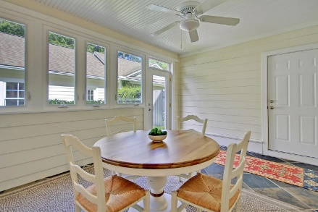
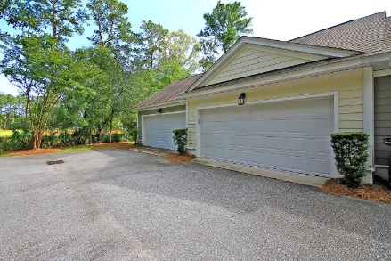
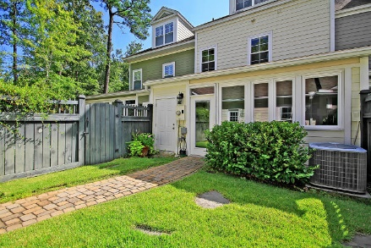
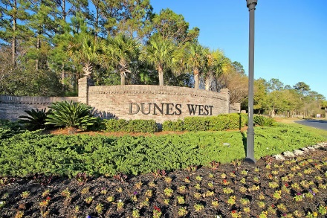

This One is Waiting For You!
Price Reduced
For Quick Sale
Open House Saturday 12-3
2612 Kings Gate Lane
Dunes West ~ Mount Pleasant ~ MLS# 19025359 ~ $374,900
Luxurious, low-maintenance living in Dunes West is ready for you! The foyer leads you into a gorgeous open floorplan which boasts gleaming hardwood floors, a fireplace with built-ins in the living room, beautiful chair rail molding in the dining room, a relaxing sun room with beautiful flooring, and an eat-in kitchen with a large center island, gas range, stainless steel appliances and tile backsplash. Downstairs is complete with a powder room. The owner's retreat features a large walk-in closet and a wonderful en-suite bath with a dual vanity, oversized garden tub, and walk-in shower. On the third level, you'll love the spacious bonus room that has a full bath perfect for a guest suite.
With double front porches, a private fenced-in yard, and sun room, you have lots of options to enjoy the outdoors from your very own home. The home has tons of storage including a two car detached garage. Dunes West is known for it's great amenities and you will have access to all of them with ownership of this move in ready home. Membership to Dunes West Golf and River Club is available with fitness center, pools, crab dock, tennis and golf clubhouses.
Dunes West's great location is close to shopping, restaurants, hospitals, airport, award winning schools, the local beaches, and just a short drive from Downtown Charleston. This move-in ready townhome will not last!
Additional features include:
Second floor laundry
$500 assessment paid to have exterior painting done in Oct
Brand new water heater; 2018
HVAC serviced and maintained in June 2019
Each bedroom has a full bathroom
Book your showing today!
Katie Wishneff kwishneff@mattoneillteam.com 843-870-8784

