Slide 1
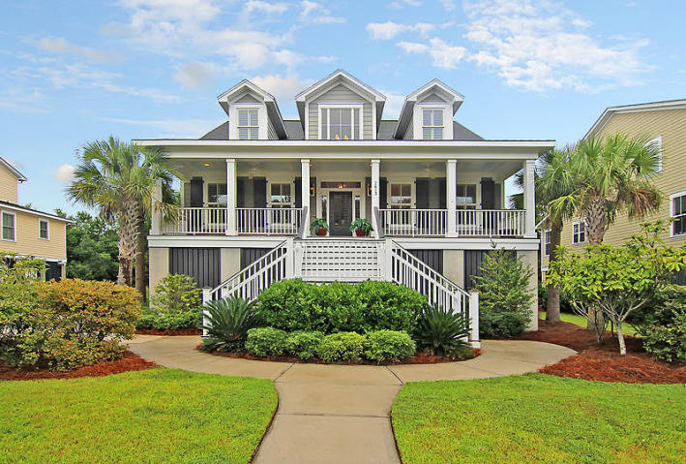
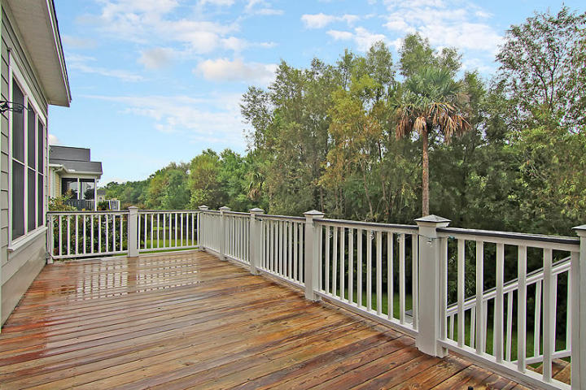
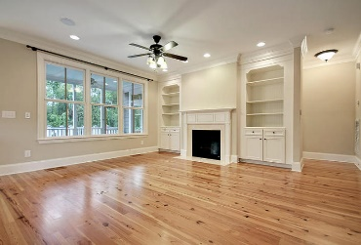
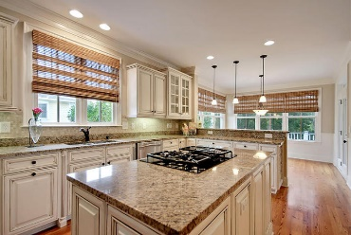
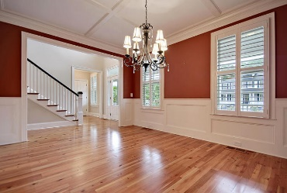
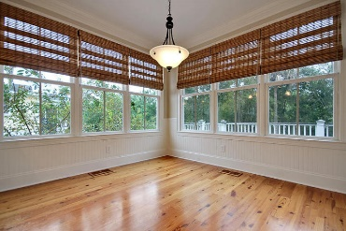
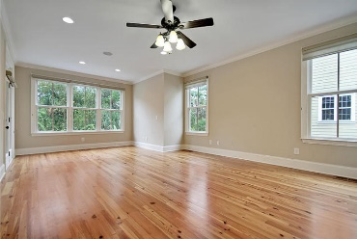
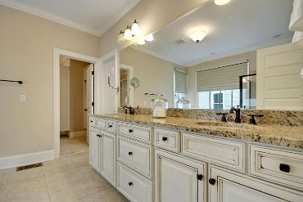
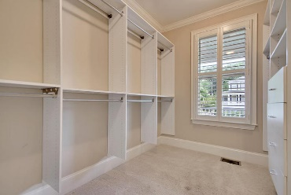
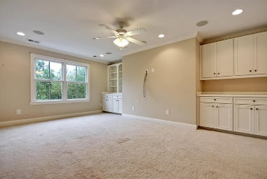


2613 Ringsted Lane Planters Pointe | Mount Pleasant | MLS# 15024823 | $559,000
Move-in Ready in Planters Pointe!
Beautiful elevated 4 bedroom, 3.5 bath home in the Indigo Chase section of Planters Pointe-Rivertowne entryway. This home boast gorgeous wood floors and heavy crown molding on the main level. The grand foyer is 2 stories tall with an abundance of natural light and leads to the formal dining room that is perfect for entertaining a large family holiday meal or the neighbors while playing Bunko. The gourmet kitchen has a HUGE island with a gas cooktop, stainless steel appliances, custom white cabinetry some with glass fronts, granite counter tops and plenty of prep space-a chefs dream! The kitchen is open an eat-in area and to the great room with a fireplace and built in shelving. The luxurious master bedroom and bath are also on the main level. The oversized bedroom has room for a private sitting area and has access to the screen porch to enjoy an early morning cup of coffee or reading a good book in the afternoon. The bath is large and spa-like with a soaking tub, separate shower, dual sinks, granite vanities, and spacious closet. Upstairs consist of three additional large bedrooms, one with it's own bath the others sharing a Jack-n-Jill bath. Also, upstairs is a landing and enormous room that could be a home theatre, office, or playroom. Finally, the big back deck and screened porch overlook a peaceful protected wooded puffer. The home is elevated and provides an abundance of storage and parking for all of your toys! Planters Pointe in Mount Pleasant is a wonderfully landscaped community with a play park, tennis courts and community pool! The neighborhood is close to local shopping and grocery stores and is a short drive to downtown Charleston with 5-star restaurants, world class shopping and iconic history as well as a short drive to the beaches, the airport, Boeing and Daniel Island. Come take a look because you will not find another home that offers as much as this one: a chef's delight and entertainer's dream!
Stan Huff
843-670-2835 stan.huff@agentowned.com
Jill Marcacci
843-297-5590 jill@agentowned.com
www.agentownedrealty.com
AgentOwned Realty Co. Preferred Group, Inc. | 824 Johnnie Dodds Blvd | Mt Pleasant, SC 29464

