Slide 1
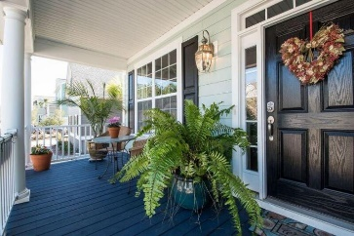
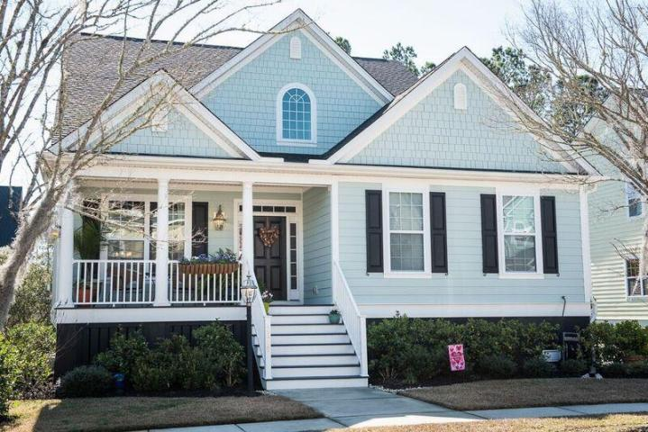
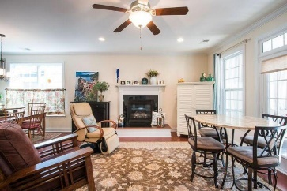
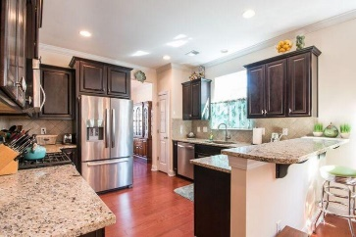
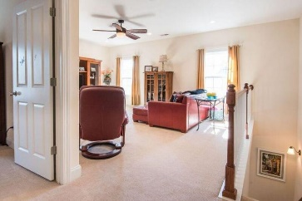
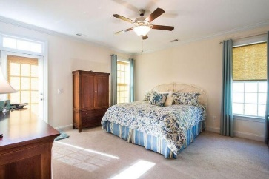
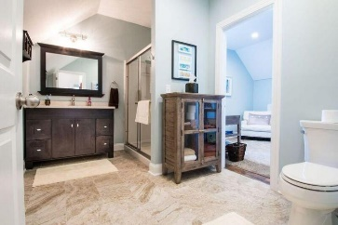
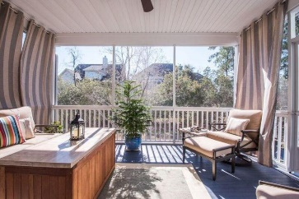
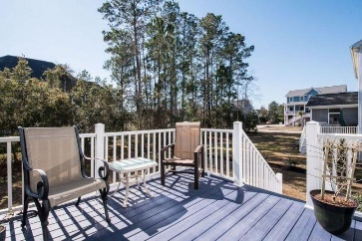


2615 River Bluff Lane Rivertowne On The Wando ~ Mount Pleasant MLS# 17002922 ~ $572,000
Coastal cottage style home Tucked away in Rivertowne on the Wando
This coastal cottage style home is tucked away in Rivertowne, one block from the Wando River, and walking distance to the dock. This home shows like a model. It has been lovingly cared for and the attention to detail is everywhere. Note the large rooms all with oversized windows. Besides a family room with fireplace that leads to a beautiful lanai and deck, there is also a gigantic upstairs loft & separate office. The kitchen and baths have matching granite & cabinets throughout. The garage boasts an oversized two car garage as well as an ''inside garage'' deck for ample storage. Cars can pull in under the deck. The professionally landscaped yard runs in to mature trees that create a nice green space between homes. Don't miss this opportunity to own a wonderful property.
Priced to go quick!
Tiffany Roetzel O (843) 884-1622
C (843) 860-8381
tiffany.roetzel@gmail.com
Carolina One Real Estate
628 Long Point Rd.
Mt Pleasant, SC 29464-3032

