Slide 1
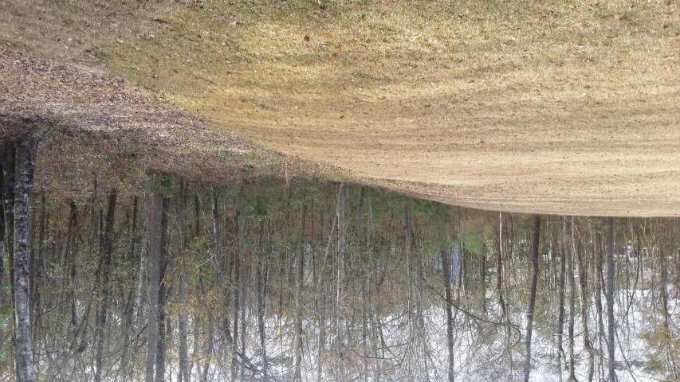
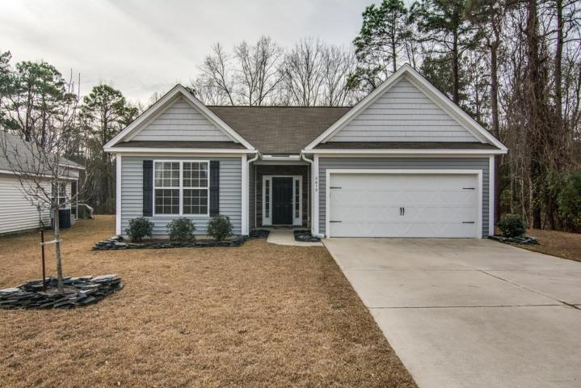
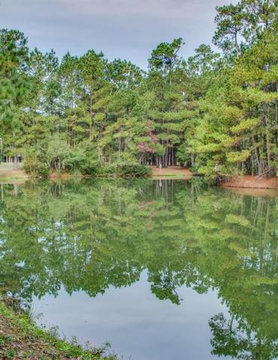
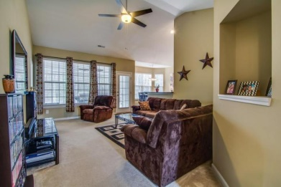
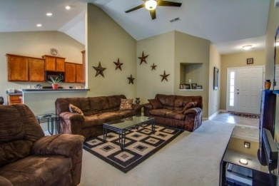
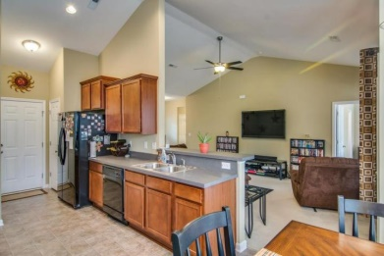
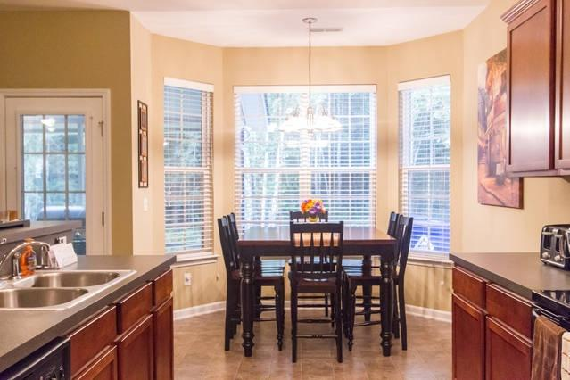
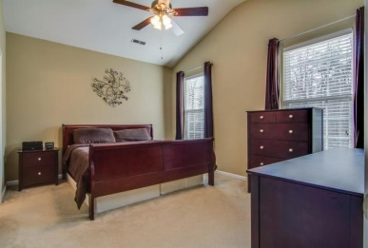
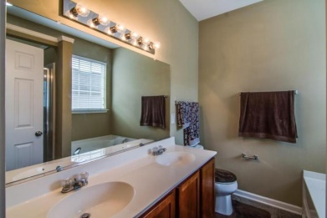
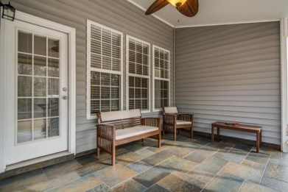
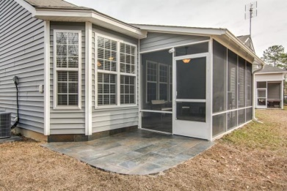


Location…
Location…
Location!
Charming & Comfortable Living
2615 Spivey Court
University Park ~ North Charleston
MLS# 14031941 ~ $158,000
3 Bed / 2 Baths ~ 1,345 Sq Ft
There are several reasons why this property is a must see if location is important to you. First of all, the subdivision's location is so convenient. It is less than two miles from I-26, Trident Hospital and dozens of other medical resources, Charleston Southern University as well as many restaurants. It is four miles to the Naval Weapons Base, and the Joint Base Charleston. I said it is CONVENIENT! Now the house sits on a corner (.018) lot which backs up to woods and on the side of the house is all woods- no neighbors in back or on one side and if that isn't enough, look out the front of the house and you see a pond which also backs up to woods- WONDERFUL LOCATION! The inside will not disappoint either. As you enter you will see a large family room, and no, that awesome TV does not convey! Next you will be greeted by a eat-in kitchen which has plenty of counter space and cabinets. Check out how large the Master Suite is. There are two other bedrooms and a full bath to round-out this home. Off the family room is a large new screened -in- porch with a slate floor which is still under warranty! The slate carries over to the outside of porch too. All in all between the location of the actual subdivision and the lot location, this home has a lot to offer in terms of privacy and convenience. Again, this is a must see if those items are important to you.
Liz & Bob Simonds
843-437-9696
lizandbob@agentowned.com
AGENTOWNED REALTY CO. PREMIER GROUP, INC.
141-A N. MAIN STREET
SUMMERVILLE, SC 29483

