Slide 1
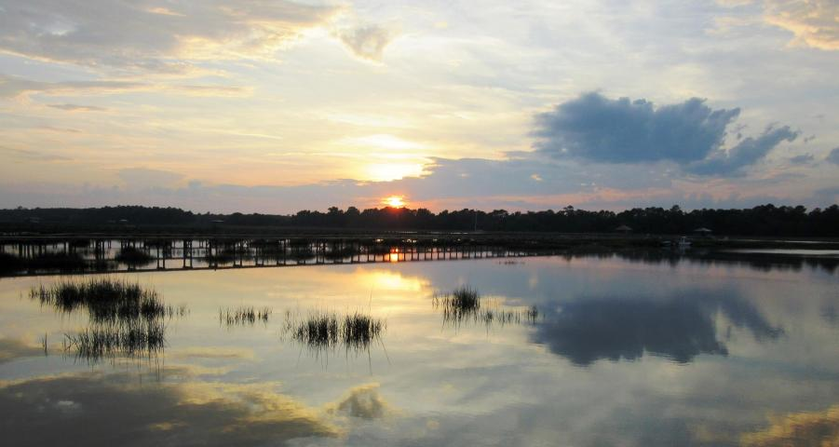
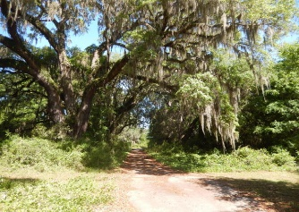
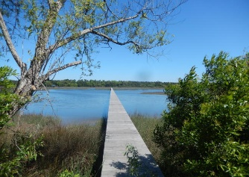
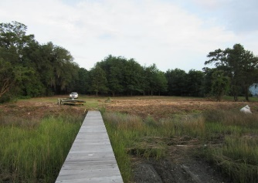
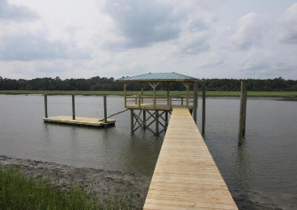
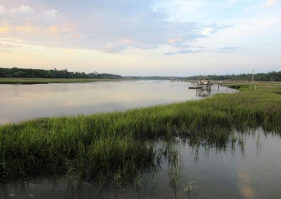


2616 Bohicket Road Fair Oaks | Johns Island | MLS# 16005802 | $825,000
Deep Water Lot With Dock In Place
$785,000
Magnificent 2.67 acre deep water, wooded lot with new dock.
Dock was completed in 2015 with covered pier head, floater and pilings for boat lift.
Property has been bushed hogged to accentuate the numerous grand oaks and unique oak lined avenue leading down to pristine marsh and Bohicket Creek.
There is no other building site quite like this property with acreage, mature trees, unbelievable views and deep water dockage.
A great opportunity to obtain a piece of paradise and to build your dream home.
Tommy & Lynne Lovett Tommy - (843) 442-1276
Lynne - (843) 697-0491
tlovett@carolinaone.com lynne.lovett@carolinaone.com
www.tommylovettrealestate.com
Carolina One Real Estate
628 Long Point Rd.
Mt Pleasant, SC 29464-3032

