Slide 1
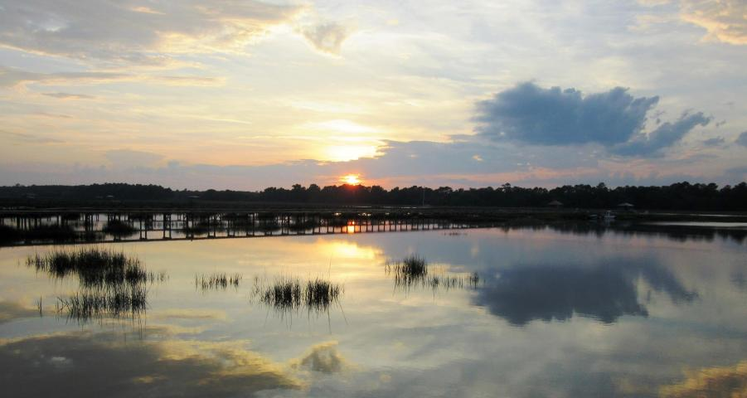
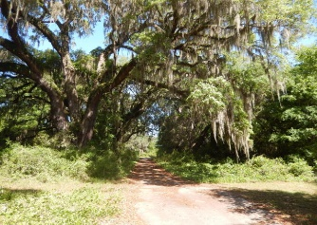
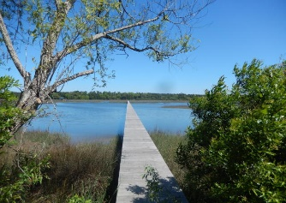
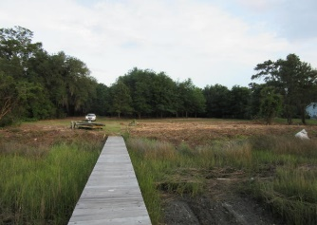
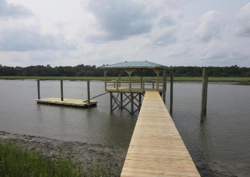
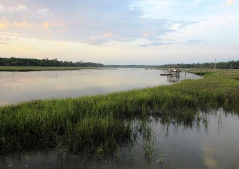


2616 Bohicket Road
Fair Oaks | Johns Island | MLS# 15013104 | $825,000
Deep Water Lot With Dock In Place
Magnificent building site on deep water creek which cannot be reproduced. This 2.67 acre home site could have been straight out of the movie ''Gone with the Wind''. The avenue of Grand Oaks line the drive way leading down to the ideal setting for your ''TARA'' overlooking pristine marsh and Bohicket Creek. The deep water dock is in under construction and being completed this month. This is truly a one of a kind property and a life style only a few can afford. Do not miss out on this once in a life time opportunity. Easy to show. Feel free to drive down the oak lined avenue off of Bohicket Road all the way to the new dock which is under construction. What else could you ask for in a home site (2.67 Acres, several grand oaks, 175 feet of water frontage and new dock in place).
Tommy & Lynne Lovett
Tommy - (843) 442-1276
Lynne - (843) 697-0491
tlovett@carolinaone.com
lynne.lovett@carolinaone.com
www.tommylovettrealestate.com
Carolina One Real Estate
628 Long Point Rd.
Mt Pleasant, SC 29464-3032

