Slide 1
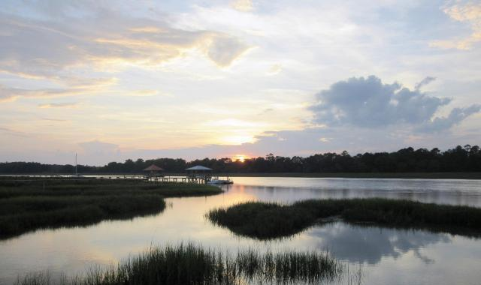
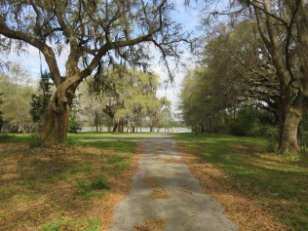
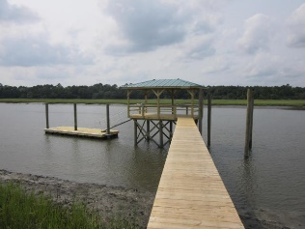
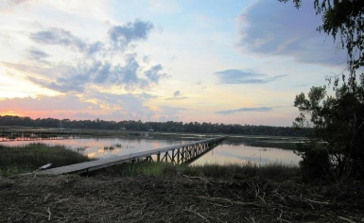
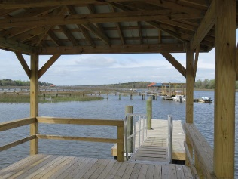
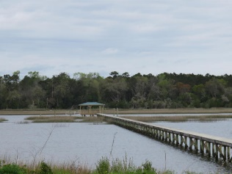


2616 Bohicket Road
Fair Oaks | Johns Island | MLS# 16005802 | $825,000
Deep Water Lot Ready For Construction
$699,000
Magnificent 2.67 acre wooded deep water building site with new dock.
Dock was completed in 2015 with covered pier head, floater and pilings for boat lift. Property has been bushed hogged to accentuate the numerous grand oaks and unique oak lined avenue leading down to pristine marsh and Bohicket Creek.
There is no other building site quite like this property with acreage, mature trees, unbelievable views and deep water dockage. The sunsets are breathtaking.
A great opportunity to obtain a piece of paradise and to build your dream home. Property zoned for 1 home per 1 acre. Unlimited possibilities.
Tommy Lovett
Tommy - (843) 442-1276
tlovett@carolinaone.com
www.tommylovettrealestate.com
Carolina One Real Estate
628 Long Point Rd.
Mt Pleasant, SC 29464-3032

