Slide 1
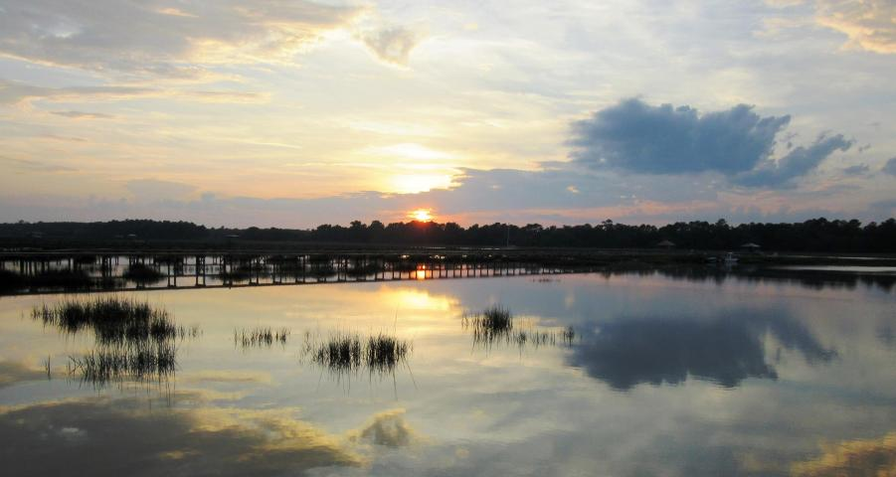
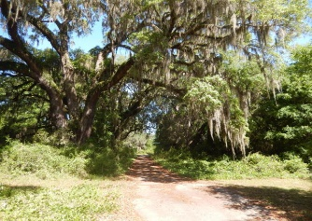
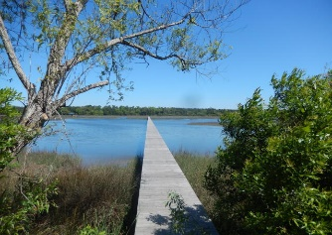
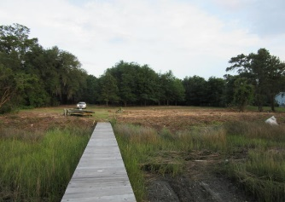
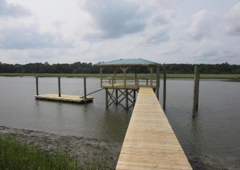
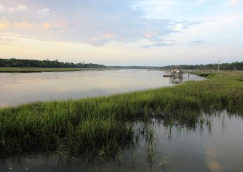


2616 Bohicket Road
Fair Oaks | Johns Island | MLS# 15013104 | $825,000
Deep Water Lot With Dock In Place
$799,900
Best Value on Deep Water with a Dock!!
Magnificent 2.67 acre building site on Bohicket Creek with brand new covered dock in place.
The avenue of Grand Oaks line the drive way leading down to the dock.
This is a one of a kind property that will naturally lend itself to a customized dream home with views of magnificent sunsets, pristine marshes, and boaters cruising the waterways.
Don't miss this chance on owning a piece of paradise!
Tommy & Lynne Lovett
Tommy - (843) 442-1276
Lynne - (843) 697-0491
tlovett@carolinaone.com
lynne.lovett@carolinaone.com
www.tommylovettrealestate.com
Carolina One Real Estate
628 Long Point Rd.
Mt Pleasant, SC 29464-3032

