Slide 1

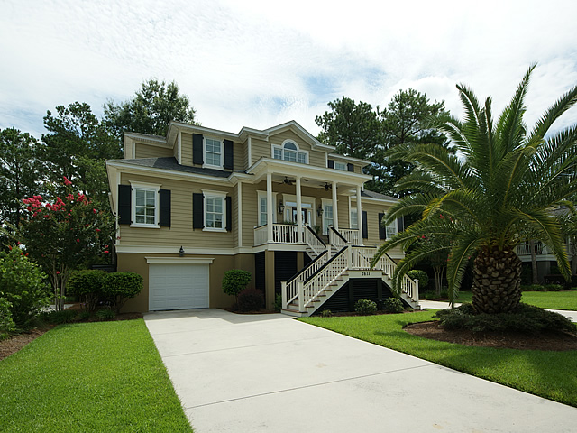
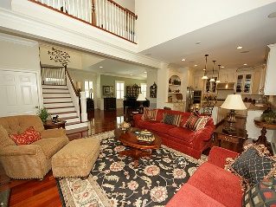
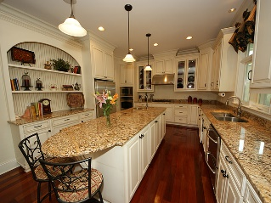
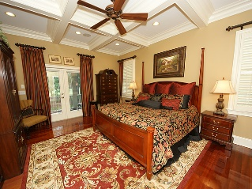
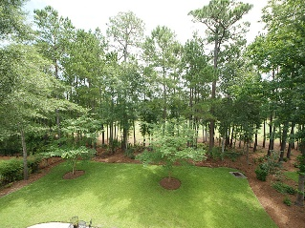
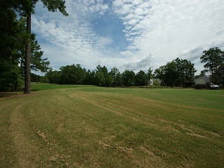

Price Reduced in Rivertowne Country Club
2617 Kiln Creek Circle
Mount Pleasant, SC 29466
MLS# 16018200
$659,900
4 Bedrooms | 3½ Baths
Custom design home that makes a statement! Located on Rivertowne Country Club Golf Course. Part of The Pointe neighborhood that also has access to Boat Slips. Cul- de- Sac street. Community pool, tennis,& community dock on the Wando. Columned front porch. Gas lanterns.2 screen porches. 2 upstairs decks. Open plan, hardwood floors, custom moldings, cathedral ceilings. Curved staircase showcases the foyer. Formal dining area. Butlers pantry. Walk in pantry. Large great room. Built in cabinets & shelving/ custom mantel/gas logs. Oversized mahogany ceiling fan. Gourmet kitchen/island/ bar area/wine cooler/prep sink/gas cooktop/granite/stainless. Large sunroom with dining area, marble tile, golf course views. Sunroom leads to outdoors and to one of two screen porches. Main level master bedroom with coffered ceilings, multiple closets. Master opens to its own screen porch. Master bath features dual vanities, walk in shower, jetted tub, linen closet, toilet room. Walk in storage closet. Upstairs has 3 bedrooms, laundry room, 2 full baths with dual vanities in one. Two of the bedrooms open to large upstairs decks. Security system and surround sound. Irrigation system. Elevated design, 4 car garage, plenty of storage underneath. Great back yard. Covered cooking area, golf course views. Located on the golf course on hole # 6. Convenient dual concrete driveways.
Fishing pier /floating dock / boat slips exclusively for residents. Allows 48 hour boat docking on the Wando!. Amenities also include pool/tennis/playground. Golf memberships are available. Golf cart/walker/biker/dog friendly neighborhood. Plenty of sidewalks and nature trails. It is all here to enjoy! List Agent is the owner.
Mark Mizzell
Mobile 864-314-5055
Office 843-284-8834
mizzellm@gmail.com
Gatehouse Realty, LLC
708 S. Shelmore Blvd, Ste. 102
Mt. Pleasant, SC 29464
www.gatehousecharleston.com

