Slide 1
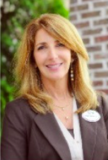
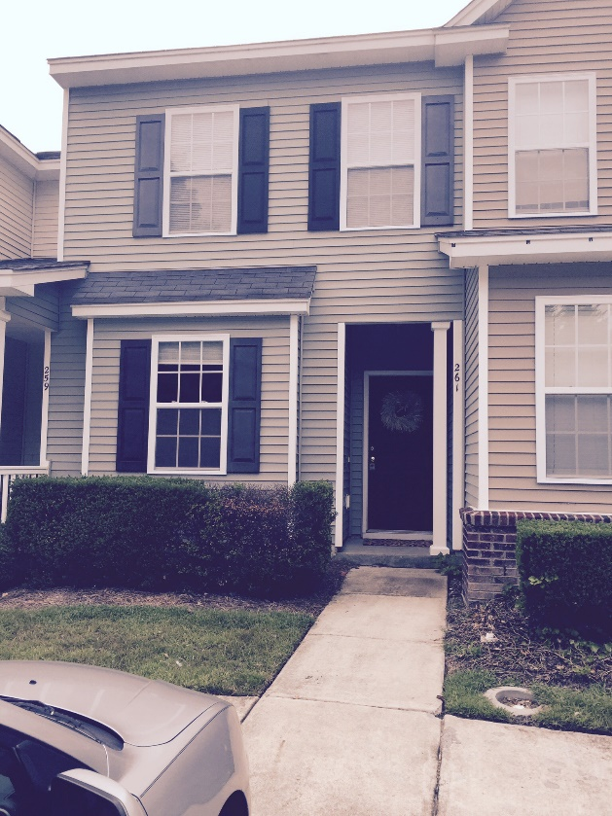
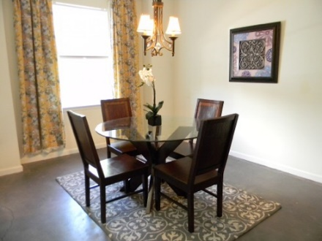
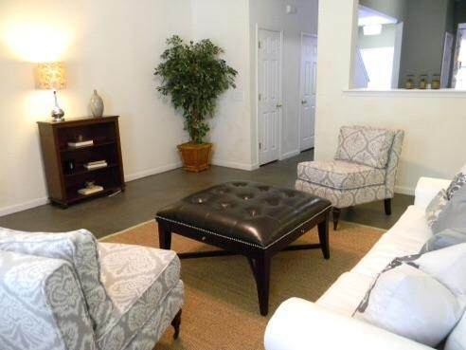
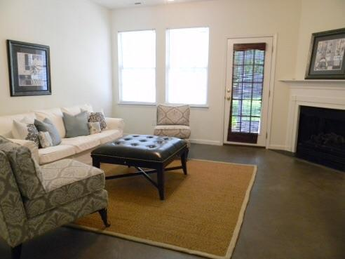
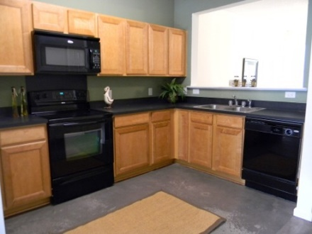
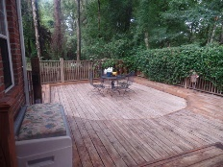
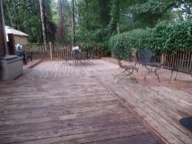
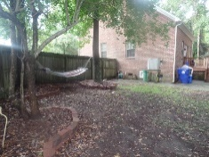
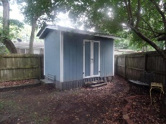
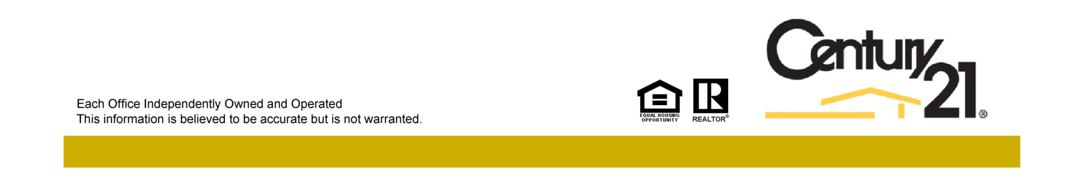
Liberty Hall Open House
September 19th from 11-2
Listed by
Debbie Himebaugh
(843) 324-6959
dhimebaugh@century21properties.com
www.DebbieHimebaugh.com
261 Brookshire Rd | Goose Creek | MLS# 15021075 | $116,900
Wonderful 2 bedroom / 2.5 Bath townhome in the highly desired Wedgewood subsection of Liberty Hall Plantation. This home features an Open floor plan that flows nicely. Enter through into the foyer, a formal dining room to your left, the kitchen just beyond has gorgeous maple cabinets, smooth top range and built in Microwave, opened to the great room. The great room has an electric fireplace to use year round and sliding doors to your screened porch and partially fenced yard. With it's unique modern glazed cement flooring throughout this first floor truly makes a statement. Upstairs you will find 2 Masters with double closets and their own bath, Laundry area and plenty of storage. Liberty Hall features many amenities pools, walking paths and more. Across the street from Dogwood park containing soccer, baseball fields and basketball courts, close to great schools and shopping this is a must see!
Open House Hosted by
Moriah Murphy
(843) 900-0340
MMurphy@Century21Properties.com
Century 21 Properties Plus | 3301 Salterbeck Ct Suite 100 | Mt. Pleasant, SC 29466

