Slide 1
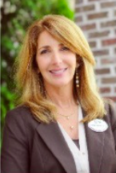
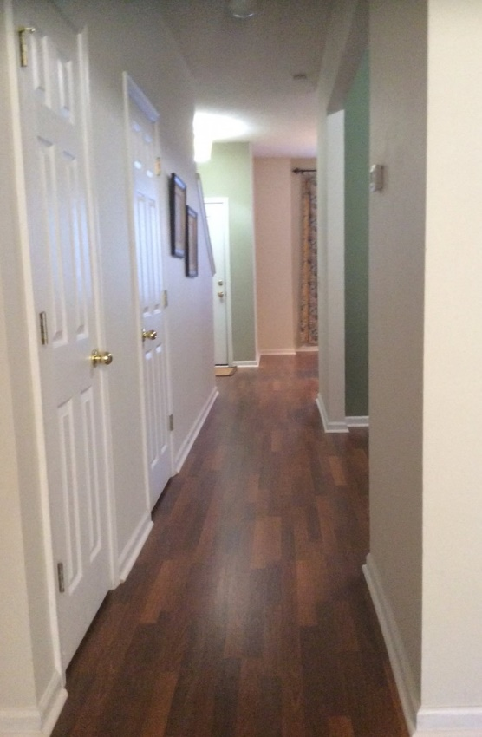
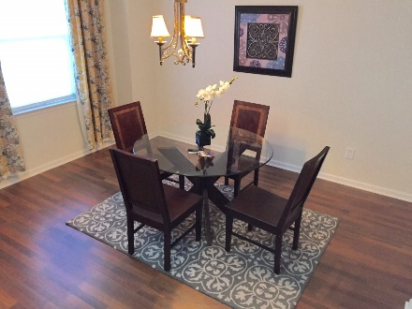
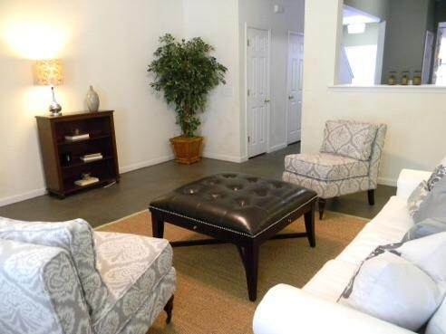
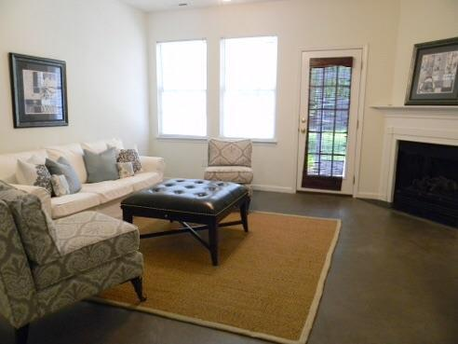
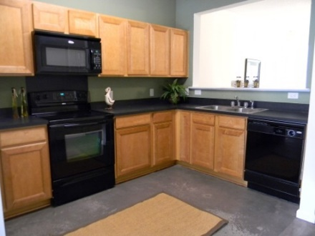
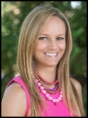

Liberty Hall Open House
Saturday November 14th from 2-5pm
Listed by
Debbie Himebaugh
(843) 324-6959
dhimebaugh@century21properties.com
www.DebbieHimebaugh.com
261 Brookshire Rd | Goose Creek | MLS# 15021075 | $115,900
Brand New Flooring!
All New Flooring on Lower level, 2 bedroom / 2.5 Bath townhome in the highly desired Wedgewood subsection of Liberty Hall Plantation. This home features an Open floor plan that flows nicely. Enter through into the foyer, a formal dining room to your left, the kitchen just beyond has gorgeous maple cabinets, smooth top range and built in Microwave, opened to the great room. The great room has an electric fireplace to use year round and sliding doors to your screened porch and partially fenced yard. With it's brand new wood laminate flooring throughout the first floor truly makes a statement. Upstairs you will find 2 Masters with double closets and their own bath, Laundry area and plenty of storage. Liberty Hall features many amenities pools, walking paths and more. Across the street from Dogwood park containing soccer, baseball fields and basketball courts, close to great schools and shopping this is a must see!
Open House Hosted by
Erin Drobnicki, Realtor
912-574-8773
edrobnicki@Century21Properties.com
Century 21 Properties Plus | 3301 Salterbeck Ct Suite 100 | Mt. Pleasant, SC 29466

