Slide 1
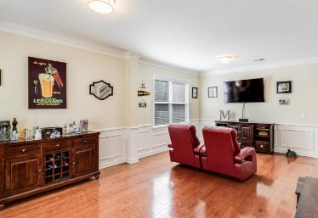
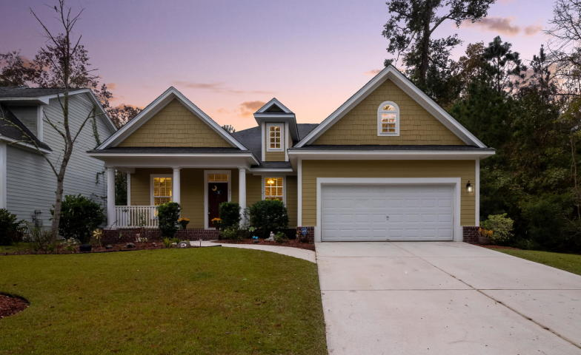
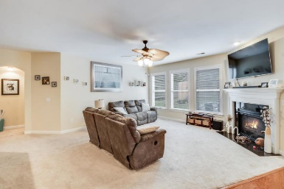
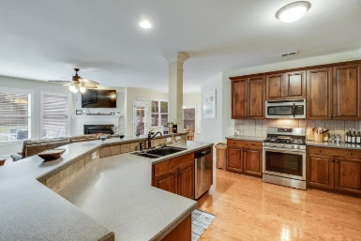
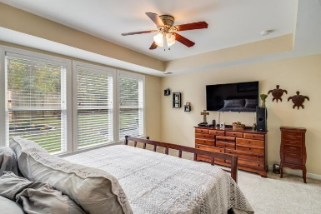
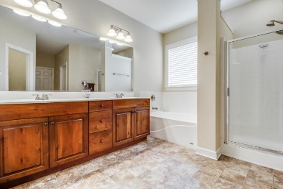
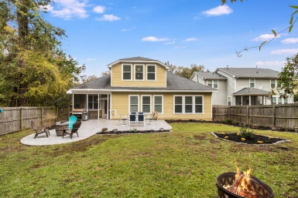
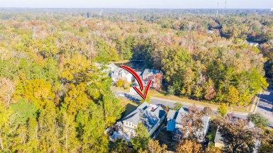


261 Carolinian Drive Legend Oaks Plantation | Summerville, SC 29485 MLS# 19032204 | $329,900
$1,500 Agent Bonus!
$1500 Agent Bonus!
Welcome to this beautiful ranch home located in the quiet neighborhood of Legend Oaks Plantation. Offering 4 bedrooms and 3 full baths with over 2,900 sq. ft., this home is sure to have everything you are looking for. Enjoy the view relaxing or conversing with neighbors on the front porch. Enter the home through the foyer and a formal living room. Off the formal living room is the open concept kitchen and family room area. The kitchen offers stainless steel appliances, plenty of cabinets for storage and a large island perfect for entertaining. The spacious family room has plenty of space for furniture arrangement and a beautiful gas fireplace as a focal point. The separate dining area lends to more seating and a great space for family meals. Towards the back of the home is the master bedroom. The master has trey ceilings and wonderful natural light coming through three windows that look out to mature trees. The en suite has a glass door walk in shower, a relaxing soaking tub and dual sinks. Two more generous sized bedrooms and one more full bathroom are on the first floor of this home. The fourth bedroom and third full bathroom are upstairs. This space can be used as a second master suite or a game room if you choose. This room has space for a sitting area, bedroom area and its own en suite with a glass door walk in shower and cabinet space for your linens. Through the family room is a patio door leading out to your fenced in private backyard. Enjoy relaxing away from the bugs in your screened porch or bring the entertainment outside on your gorgeous extended stamped concrete back patio. This home is ready for you to move right in! Located in the sought after Dorchester II District schools, minutes away from the town of Summerville and easy access to the highway makes this home central to many amenities. Schedule your showing today!
Brandon Ray
(843) 499-1928
brandon.ray@carolinaone.com
www.therightrayhome.com
Carolina One Real Estate
900 N Main St
Summerville, SC 29483

