Slide 1
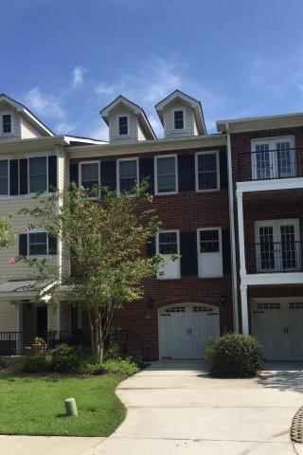
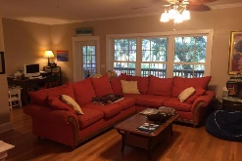
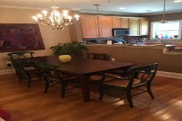
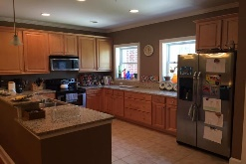
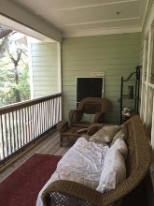
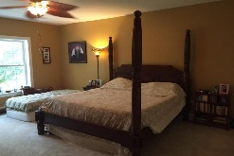
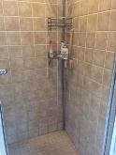
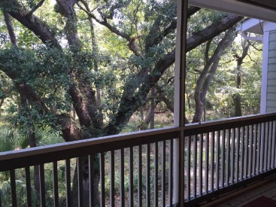
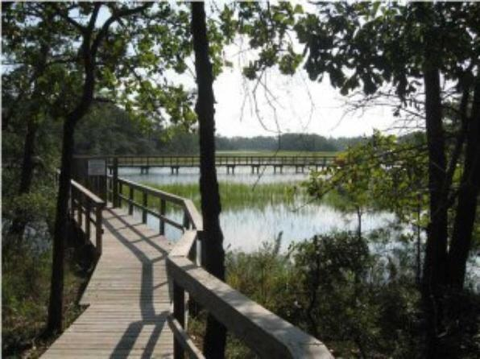
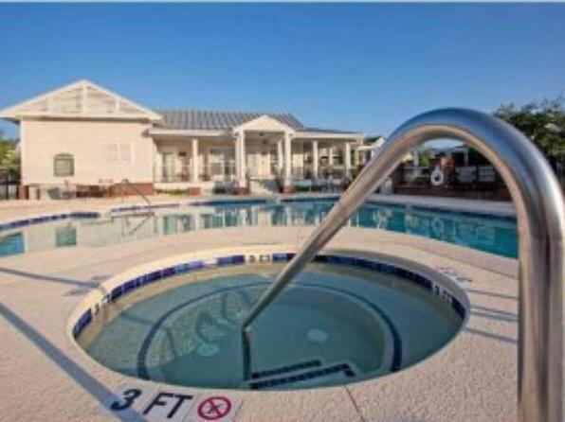
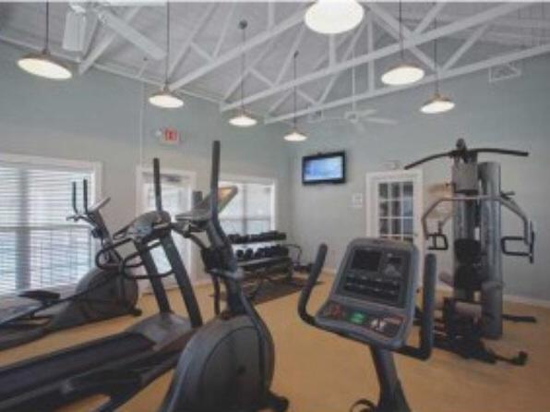



Motivated Seller Price Reduced
261 Etiwan Pointe Drive
Etiwan Pointe
Mount Pleasant
MLS# 15023951
$264,000
FABULOUS CONDO ON THE MARSH! Main floor has Open floor plan with hardwood floors, dining room, half bath, screened in porch and great kitchen. Granite countertops in the kitchen with stainless appliances and cherry cabinets. 3 bedrooms are upstairs. Huge master bedroom has double closets. Master bath has large tub, separate tiled Shower, dual vanity. 3 BR/2.5 BA. 2 CAR GARAGE...QUIET AND SERENE SETTING. ETIWAN POINTE is ideal for everyone! Walk down the sidewalks of the Charleston designed row houses and you'll notice how each one has its own character and charm. Have a seat on your back porch and take in views of creek and marsh views and wildlife from your bedroom window. Deer, egrets and more have been seen in the back yard. Etiwan Pointe has it all.
Jennifer Frampton Pait
843-568-9509
jenniferfp@carolinaone.com

