Slide 1
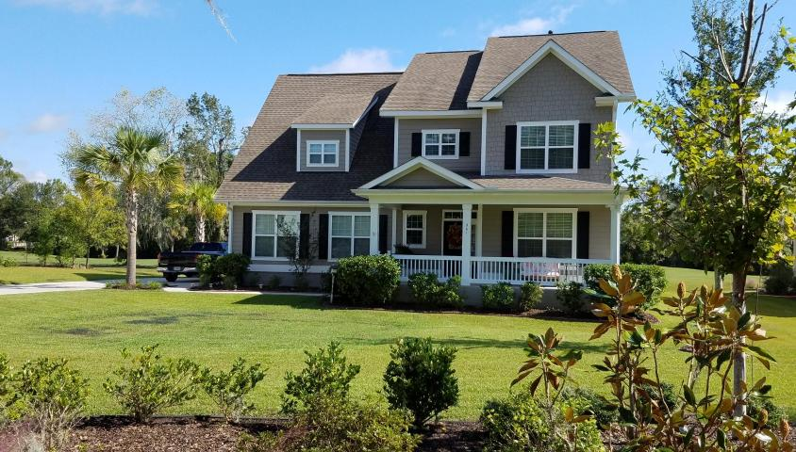
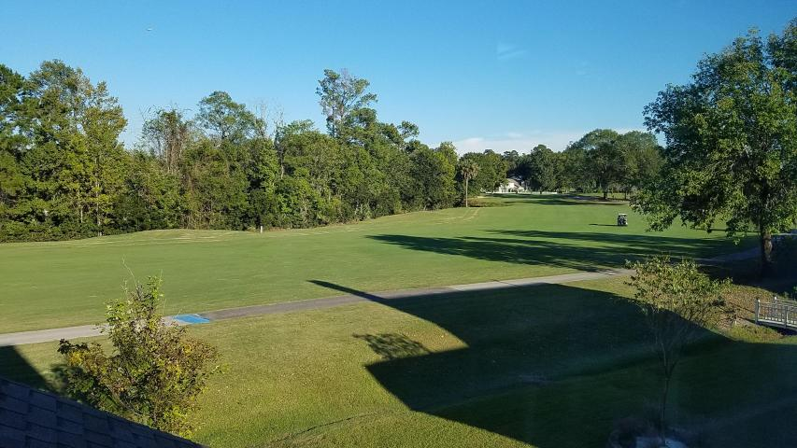
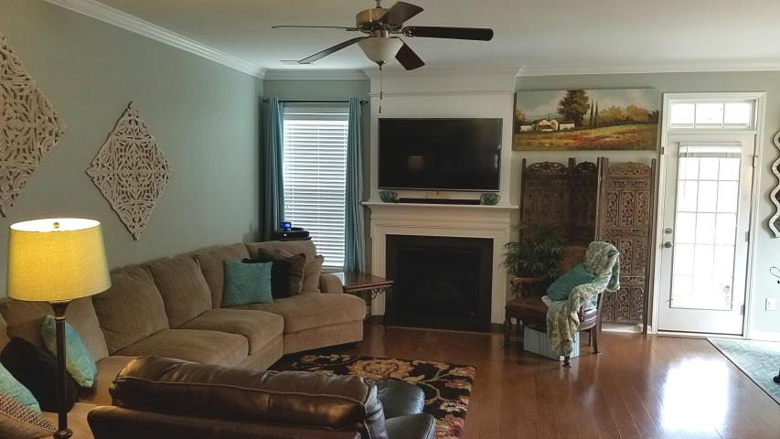
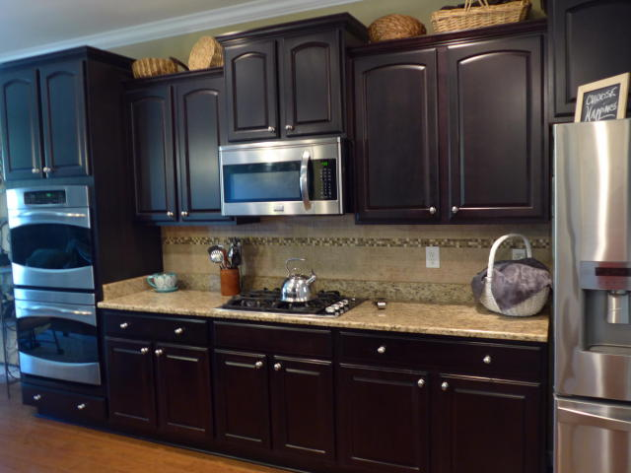
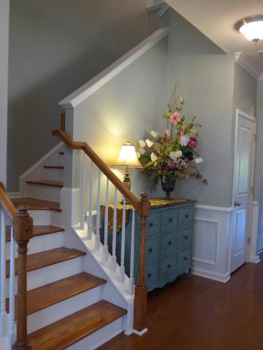
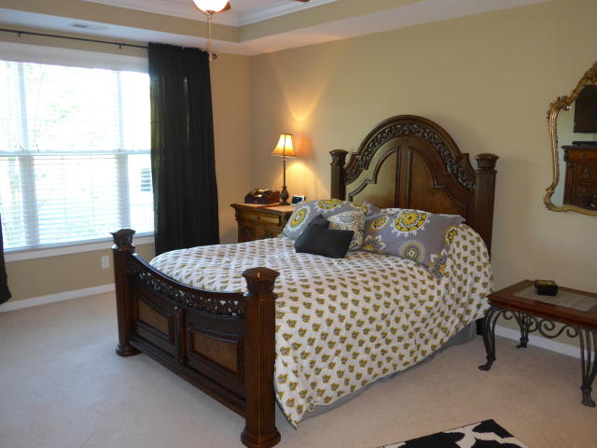
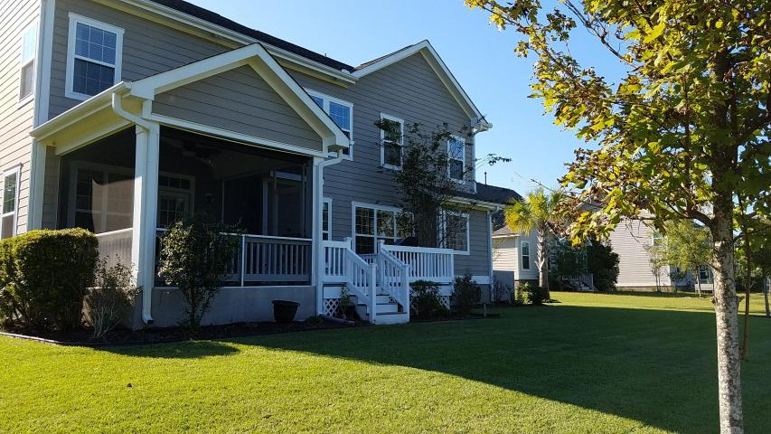


Agent/Broker Open House ~ Thursday 11/16 ~ 11-1
Light Lunch Served
Buy.......Build.....Begin
261 Shadowmoss Parkway
Shadowmoss | Charleston, SC 29414 | MLS# 17028227 | $494,000
IMMACULATE 5BR EXECUTIVE HOME overlooks Golf Course!
Open Floor Plan ~ High .36 acre lot ~ upscale Middleborough section of Shadowmoss, LOW HOA fee ~ SUPER UPGRADES: *WOOD FLOORS* in most of 1st story. GOURMET KITCHEN: GAS COOK-TOP, DOUBLE OVENS plus built-in Microwave, French Door Refrigerator, S/S Appliances, Granite Countertops, Pantry. DOWNSTAIRS MASTER SUITE: tray ceiling, walk-in closet, sep shower, garden tub, double vanity, sep water closet ~ Crown Molding ~ Separate Dining Room has tray ceiling & handsome wainscot molding. French Doors lead to beautiful office ~Large Great Room w/Gas Log Fireplace is open to kitchen & breakfast area ~ Hardwood stair treads ~ Smooth 9' Ceilings ~ Upstairs is a 2ND LARGE FAMILY ROOM/loft, 4 large bedrooms (could have 2nd Master), 2 full baths & LOTS OF CLOSETS!!!
This house has so much storage upstairs and down!!! Grill on the DECK & relax on the SCREENED PORCH while watching golfers pass by on their carts...Beautifully kept landscaping with irrigation system...Some other extras are: a security system, gutters, garage door openers on both doors, EXTRA LONG DRIVEWAY that can accommodate lots of cars!!! Country Club membership is an option for tennis, golf, pool and fitness center. Super neighborhood with sidewalks and so convenient to Grocery Stores, Costco, Super Walmart, Roper St Francis Hospital, Churches, and Restaurants!
Barbara Harper
843-224-5759
Barbara.Harper@agentownedrealty
www.ISellCharleston.com
The AgentOwned Realty Co. • 902 Savannah Hwy. • Charleston, SC 29407
Real Estate • Mortgage • Insurance

