Slide 1
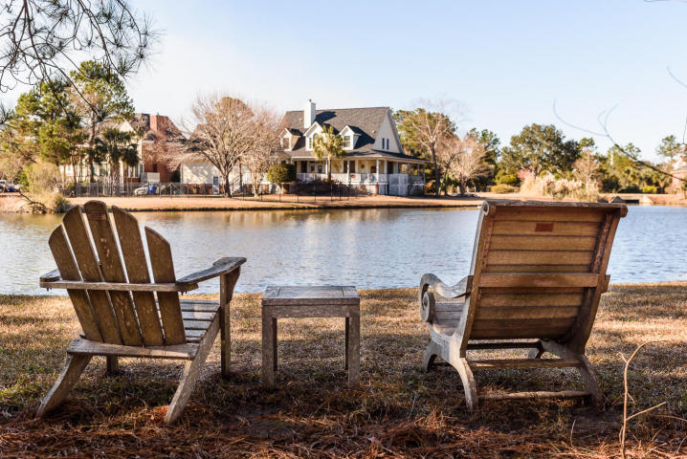
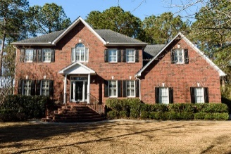
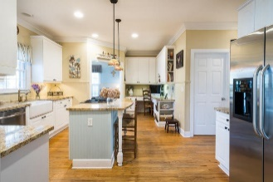
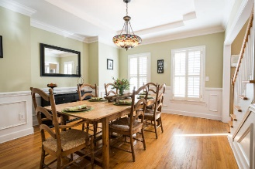
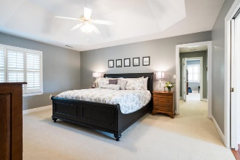
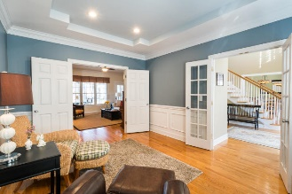
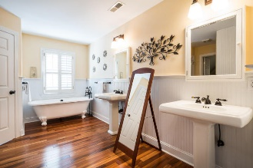
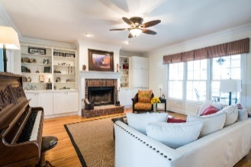
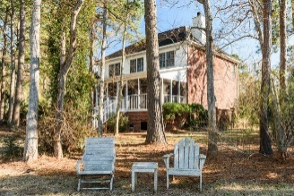


2621 John Boone Court Brickyard Plantation ~ Mount Pleasant ~ MLS# 18001106 ~ $615,000
Price Reduced
in the Old Village!
Now offered at $615,000
Great family home, beautiful pond lot!
Huge Price
Reduction
This house exudes peace and serenity!
Located on a quiet cul-de-sac with magnificent lake view. What a setting! The den has a wood-burning fireplace and the kitchen opens to a hexagon shaped breakfast room with many windows which provide natural light. There's a three car garage! The large screened porch overlooking a shaded backyard and the water views provide the perfect setting for entertaining or just relaxing. Upstairs are four bedrooms; three bedrooms for family and guests and a huge master suite with flex space that could be used for adjoining office, den, work-out area or whatever you want! Check out this home while it is available.
Mac Jenkinson
M (843) 224-0210
mac@carolinaone.com
Beth Moore
M (843) 532-4892
bmoore@carolinaone.com
www.jenkinsonandmoore.com
Jenkinson & Moore, LLC | Carolina One Real Estate | 1503 Palm Blvd | Isle of Palms, SC 29451-2280

