Slide 1
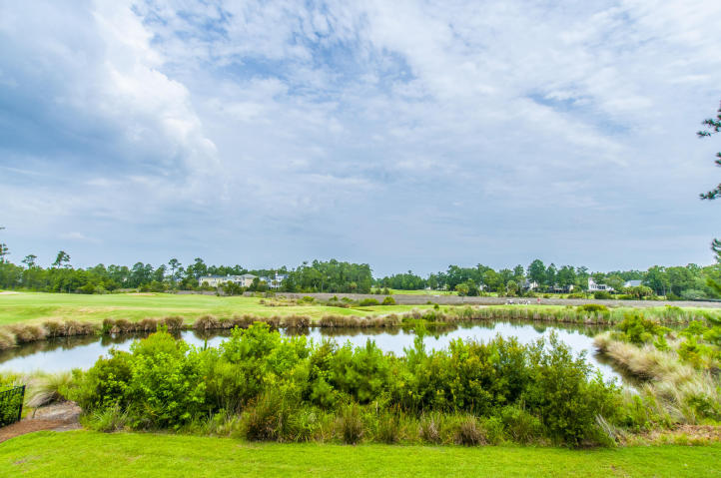
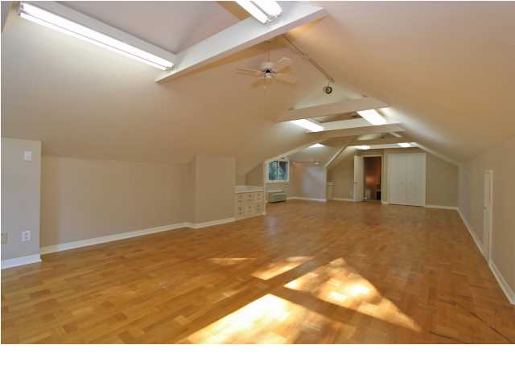
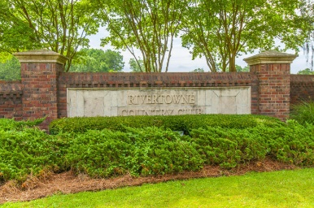
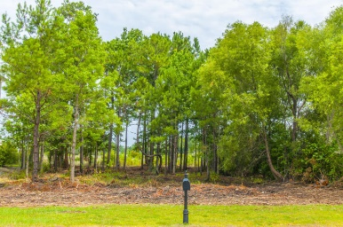
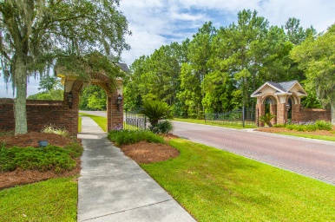
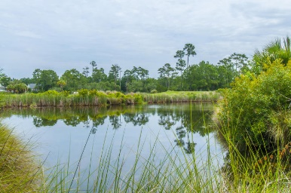
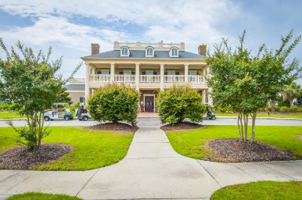
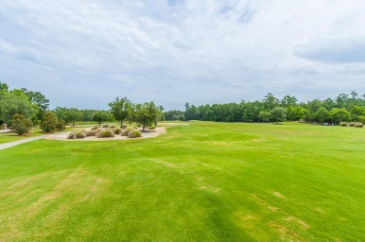
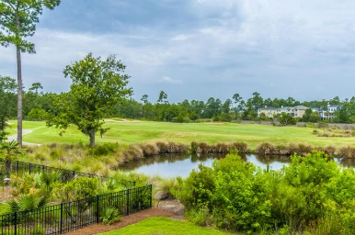
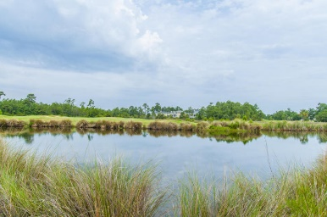


2624 Crooked Stick Lane Rivertowne ~ Mount Pleasant ~ MLS# 15017247 ~ $195,000
Fabulous Golf Course Lot with Magnificent Views!
Fabulous Golf Course Lot with magnificent Views of a Large Pond, Golf Course Fairway and Marsh. Super Great evening Sunsets. Located with in walking distance to Club House, Swimming Pool, Tennis Courts and 18 Hole Arnold Palmer Signature Golf Course. A great place to build your dream Home.
Bob Crawford
ABR, EPRO, SRES, REALTOR
Mobile - (843) 860-8008
bcrawford@carolinaone.com
www.CharlestonGolfProperties.com
Carolina One Real Estate
2713 Highway 17 North
Mt. Pleasant, SC 29466

