Slide 1
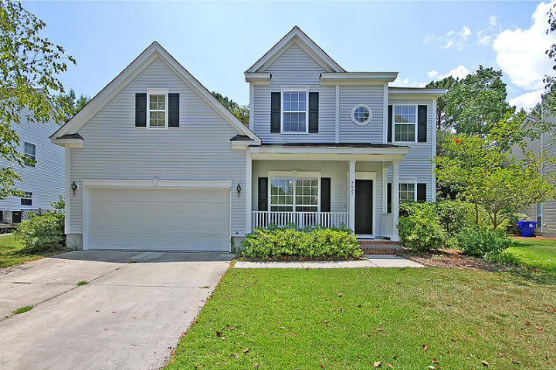
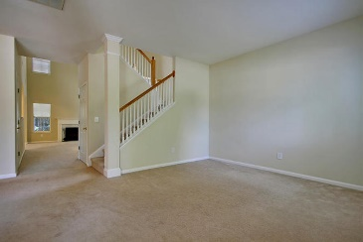
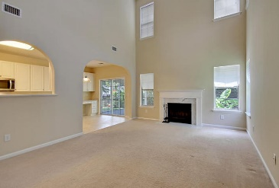
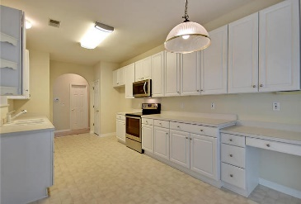
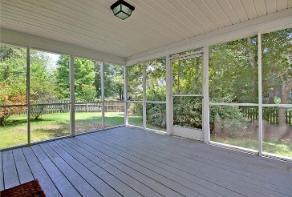
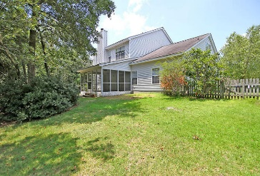


NEW YEAR SPECIAL!
2627 Planters Pointe Blvd
Planters Pointe
Mount Pleasant
MLS# 15020025
$362,000
This Remarkable fully detached 2 story home is situated on a quiet tree lined street and is surrounded by a large private child safe fenced yard. This Sensational home with 9ft. smooth ceiling has 3 large bedrooms upstairs and a separate bonus room for the kid’s entertainment center or Dad’s office.
There are several large rooms on the main floor including a spacious master bedroom with tray ceilings, a huge walk in closet and a private master bathroom with double vanities, a large soaking tub and a separate walk-in shower. The foyer opens to the large formal dining room on the left and formal living room or music room positioned on the right. The Stunning great room with dramatic 18ft ceilings offers surprising natural lighting through the many large windows and offers a classic cozy fireplace for those cool evenings.
The stylish kitchen is surprisingly large and is appointed with new upgraded appliances and an abundant number of selected cabinets. For outside enjoyment, there is a private walkout to the valuable screened porch and the large tree shaded fenced back yard. The Planters Pointe neighborhood is perfect for families and provides a community Club House/Amenity Center, incredible pool, tennis courts and park/field amenities.
FYI, the seller will be installing, with an acceptable offer, new flooring in the kitchen and breakfast area and new shingles on the roof (50 year warranty) prior to closing. Buyer will have selection of color for each. A one year American Home Shield Warranty transfers to the buyer at closing. You will be hard pressed to find a better buy in Mount Pleasant. Do you recognize a Great Buy when you see one?
Bill Everett, Jr
Broker
843-693-8539
Bill@TheEverettGroup.net
RE/MAX Pro Realty, 9209 University Blvd, Charleston, SC 29406

