Slide 1
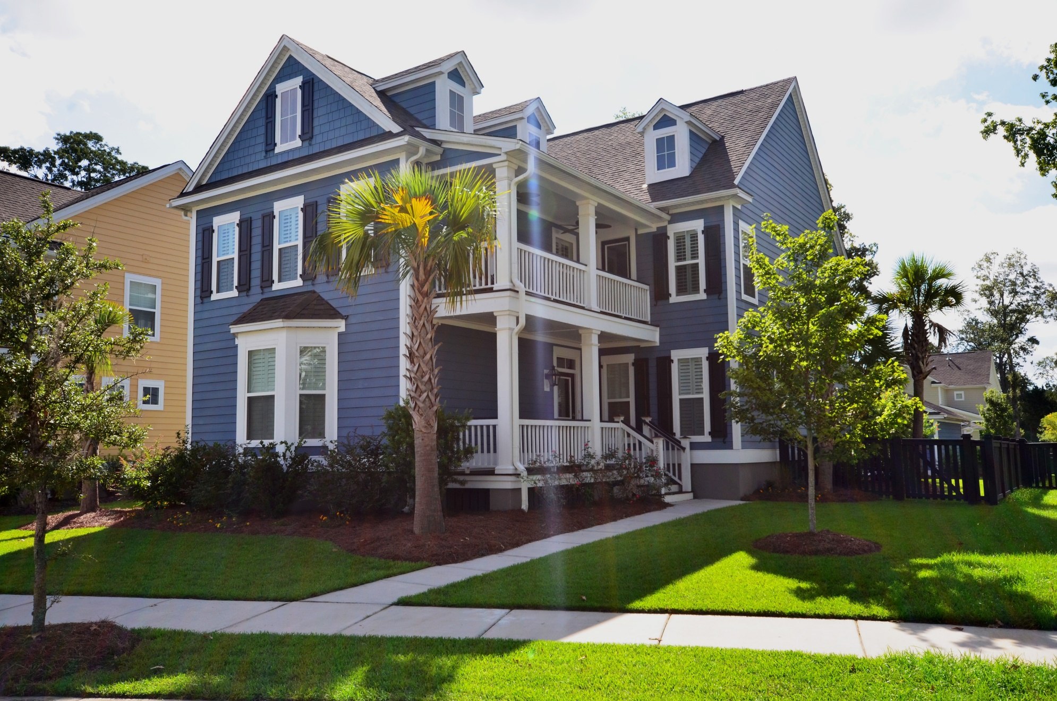
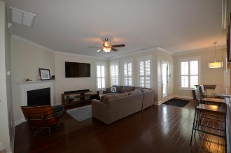
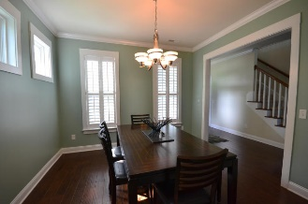
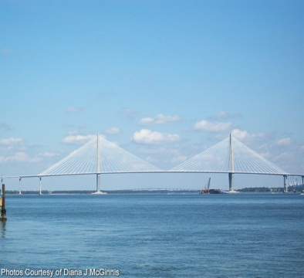
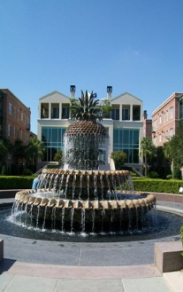
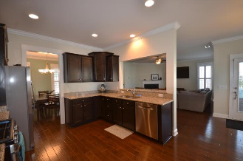
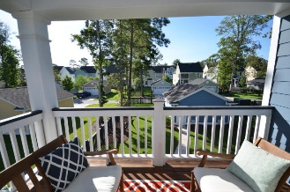
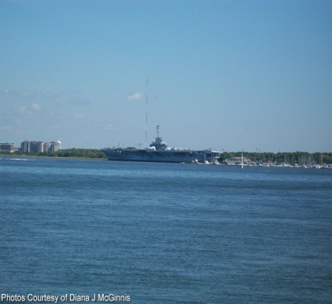
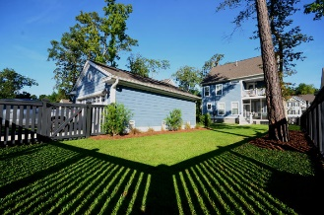


OPEN HOUSE
Saturday Sept 10th
10:00a-1:00p
$450,000
$450,000
2627 Rutherford Way
Carolina Bay · Charleston · MLS# 16022893 · $429,999
Rodney Hancock
(843) 437-1347
rodneyhancock08@gmail.com mortgageprofessionalsonline.com
This gorgeous home with southern-style double front porches is in a prime location in the heart of West Ashley. Desirable Carolina Bay Essex is nestled among protected wetlands, old rice fields with nature trails and sidewalks. The neighborhood features a pool, kayak launch, lake, flourishing gardens, scenic walking/biking trails and a playground. The openness of the kitchen, family room and breakfast room make this area of the home ideal for family living and entertaining -These areas have been upgraded to stunning hickory floors- The kitchen boasts granite countertops, Whirpool stainless steel appliances and a gas stove. A large screened porch off the family room is ideal for grilling, entertaining or relaxing. -The master suite is on the main level and features two walk-in closets and a beautiful bath with a sink vanity, garden tub and a separate shower. -The second floor consists of three additional bedrooms, two full baths plus 2 bonus lofts that could serve as a playroom, office, or media room - The second floor has access to two gorgeous porches- -The yard has been professionally landscaped with gorgeous palms, sweet grass, and bottlebrush-The detached two-car garage backs up to a rear alleyway.
AgentOwned Charleston Group
902 Savannah Hwy
Charleston, SC 29407
Real Estate ● Mortgage Insurance ● Business Brokerage

