Slide 1
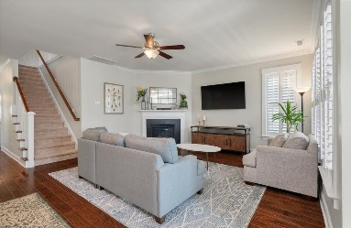
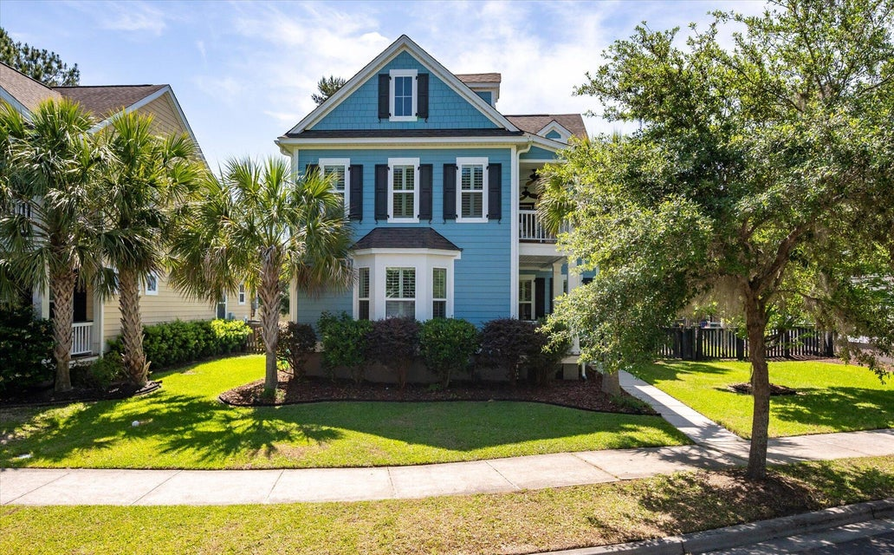
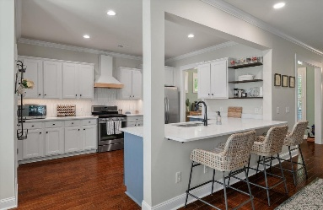
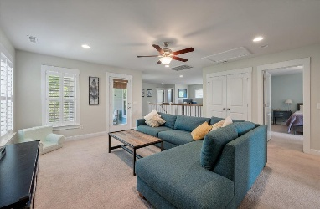
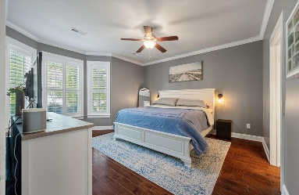
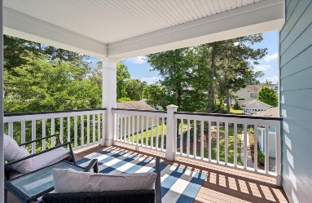
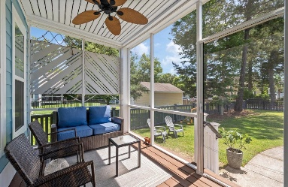
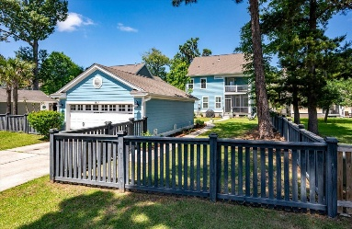

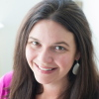
2627 Rutherford Way
Carolina Bay · Charleston, SC 29414 · MLS# 25012729 · $755,000
Charleston Single Home Family Available in Carolina Bay
Step into Lowcountry elegance with this beautifully maintained Charleston Single-style home, ideally located in the highly desirable Essex section of Carolina Bay. Boasting 4 spacious bedrooms and 3.5 baths, this residence offers thoughtful design and refined living spaces, starting with a luxurious downstairs primary suite complete with dual walk-in closets and a spa-inspired en suite bathroom featuring double vanities, a garden tub, and a separate walk-in shower. The open-concept layout centers around a stylish kitchen adorned with a farmhouse sink, open shelving, elegant cabinetry, and stainless steel appliances. With counter seating for four and an adjacent breakfast area, this kitchen is both functional and inviting.
The formal dining room connects seamlessly to a modern pantry/laundry room combo, while the expansive family room is anchored by a cozy gas fireplace.
Step outside to the charming screened-in porch - perfect for enjoying the quintessential Charleston lifestyle. Upstairs, you'll find three generously sized bedrooms, two full baths, a versatile loft space ideal for an office or playroom, and an expansive media room or secondary living area that opens onto the iconic second-story front balcony - a hallmark of Charleston Single homes.
Additional upgrades include plantation shutters and detailed crown molding throughout the main floor, enhancing the home's upscale feel. The fully fenced backyard features a detached garage, custom stone walkway, and lush, elegantly landscaped gardens - all meticulously maintained by the current owners.
Located in West Ashley's premier neighborhood, Carolina Bay offers unparalleled amenities including walking trails, multiple pools, dog parks, playgrounds, community events with food trucks, and more. Enjoy the convenience of being just minutes from downtown Charleston, area beaches, Roper Hospital, Costco, Target, and a variety of grocery stores.
Carey Nikonchuk
843-276-1701
cnikonchuk@gmail.com
www.brennamangroup.com

