Slide 1
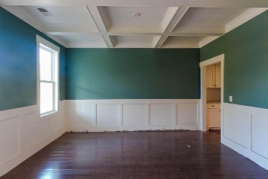
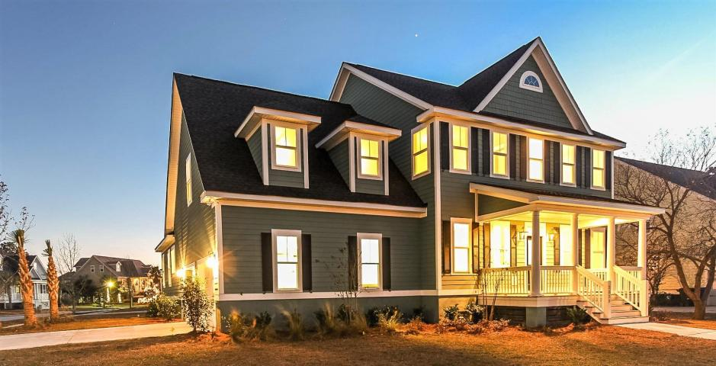
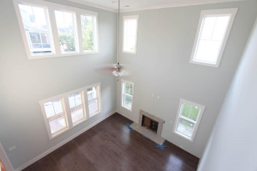
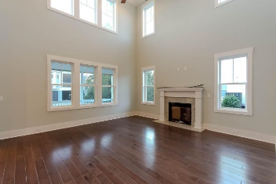
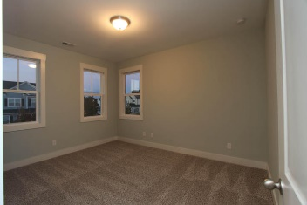
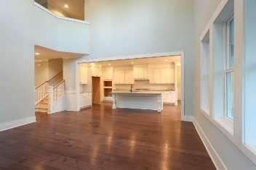
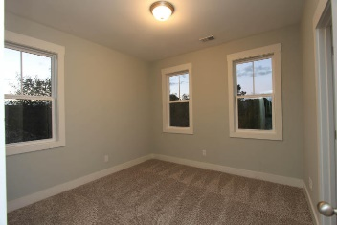
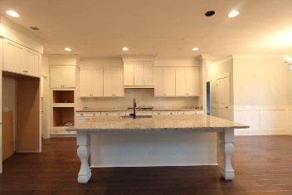
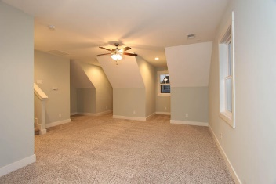
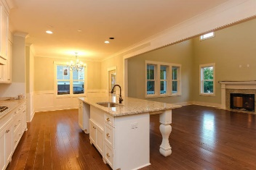
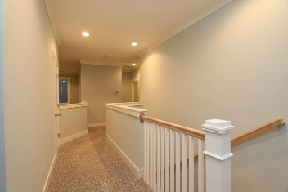
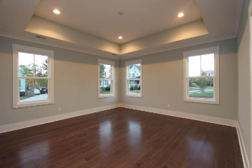
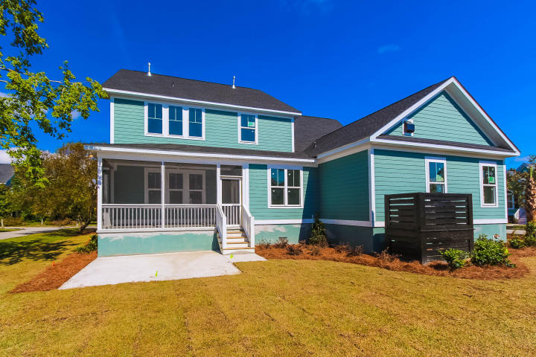
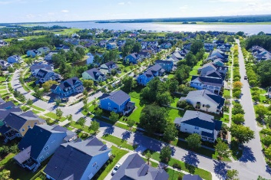

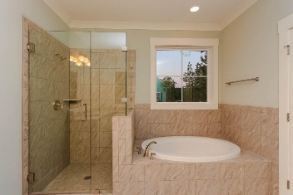
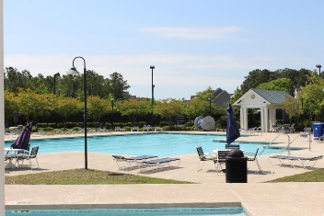
2629 Alderly Lane
Rivertowne On The Wando :: Mount Pleasant :: MLS# 16011146 :: $579,990
NEW YEAR, NEW PRICE AND WILL NOT LAST LONG!
Just completed in 2017 - This New Construction Home is a 5 Bedroom, 4 Bathroom home with an additional Bonus Room over the 2 Car Side Garage. The Owner's Suite is on the main Level and with 20ft Ceilings in the Family Room the home feels even bigger. The Open Kitchen looks out to the Family Room with an Oversized Granite Island. The Included Features are Hardwood Floors in the Foyer, Dining Room, Family Room, Kitchen and Breakfast area, Granite Countertops in the Kitchen and all Bathrooms, Tile Floors in the Guest Bathroom, Laundry Room, and Master Bathroom. Screened Porch off of the Kitchen. 42'' Maple Kitchen Cabinets allows for ample storage space, Structural Wiring and Gas Fire Place with a Granite surround as well as a wood mantle. Short walk to the Rivertowne CC clubhouse, swimming pool, tennis courts and golf course. Short 15 minute drive to Isle of Palms beaches;25 minute drive to historic downtown Charleston.
Chris Eller
EPRO, GRN, SFR, REALTOR, CRS
(843) 343-3359
iconicdevelopments@gmail.com
GFH Realty, LLC
498 Wando Park Blvd Suite 1125
Mt. Pleasant, SC 29464
www.gallowayfamilyhomes.com

