Slide 1
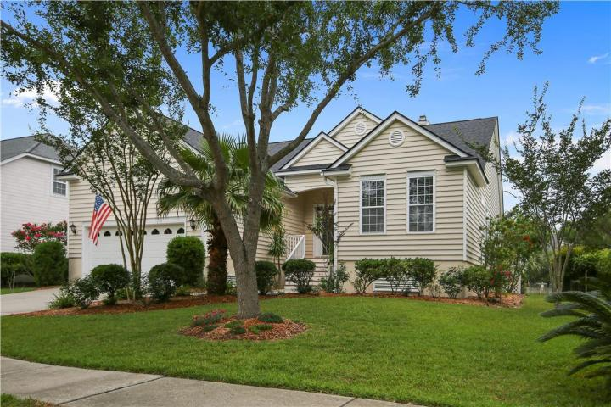
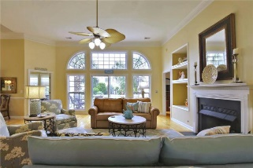
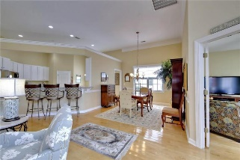
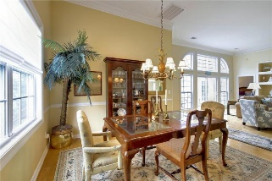
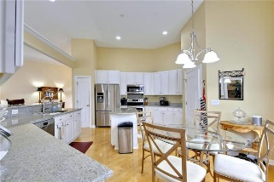
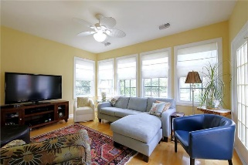
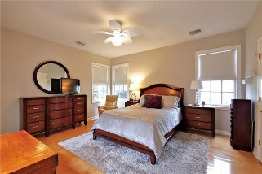
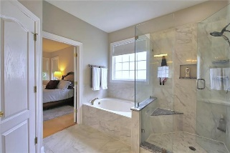
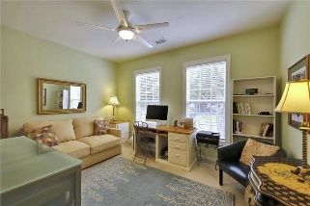
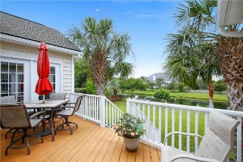
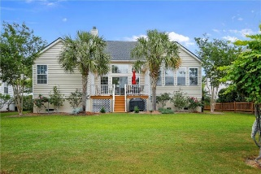

2629 Magnolia Woods Drive
Mount Pleasant, SC 29464 ~ MLS# 17015544 ~ $589,000
Desirable Seaside Farms Home
Price Reduced in Seaside Farms
LOCATION, LOCATION, LOCATION! Pride of ownership in this beautiful 1 story, open concept home located in the desirable Seaside Farms subdivision. This updated home is move-in ready! Some items include 16 SEER HVAC replaced in 11/15, roof replaced 12/16, and bathrooms tastefully remodeled 1/14. Upon entering the foyer, you will see a bright and spacious great room with 12’ ceilings and wide plank maple hardwoods. The updated, oversized kitchen has ample cabinet space, kitchen island, granite countertops, stainless steel appliances and an eat-in area. Access to the garage/large storage loft and laundry room are located off the kitchen. The 'flex' room, overlooking the backyard and pond, can be used as a home office, play room, or TV room. The master bedroom is accessed from the deck or great room. The renovated master bath must be seen to be appreciated! Two spacious bedrooms and the second updated bathroom are located near the front of the home.
Any concerns of lack of storage in this house can be put to rest, as you walk out into the garage and see the large 'loft' style storage that has been added without compromising any garage floor space for your vehicles!
Scott Fulton
(843) 324-8845 O | (843) 324-8445 M
scott.fulton@agentownedrealty.com
AgentOwned Preferred Group | 824 Johnnie Dodds Blvd | Mt Pleasant, SC 29464

