Slide 1

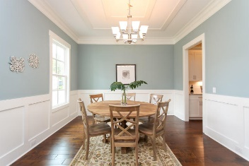
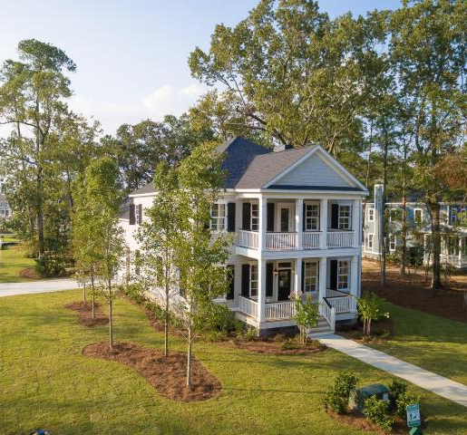
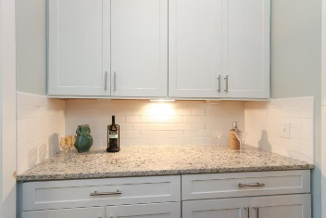
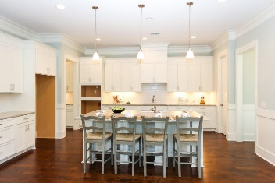
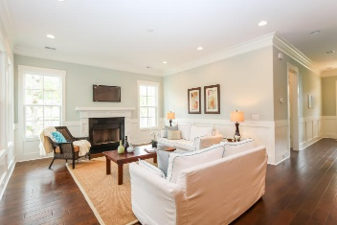
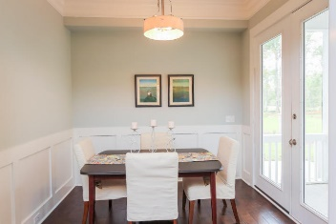
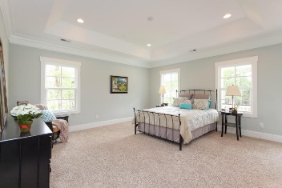
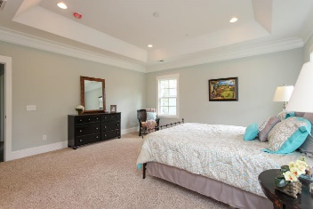
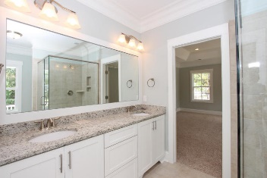
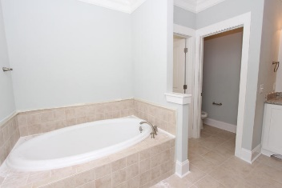
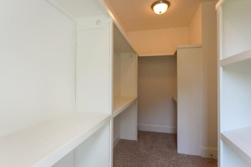
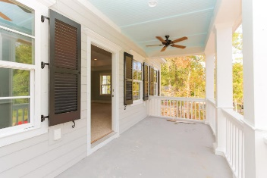
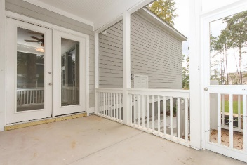

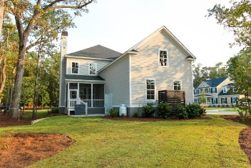
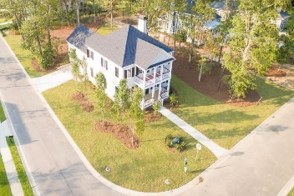
262 Commonwealth Road
Darrell Creek :: Mount Pleasant
MLS# 15006324 :: $619,990
Ready Now - This 5 Bedroom, 3 Bathroom, 2 Car Side Entry Garage. 42'' Maple Cabinets, 4 Piece Stainlesss Steel Appliance Package: Stove, Built-in Hood, Dishwasher and Oven. This home has a Screened Porch, Structured Wiring, Hardwood Floors in the Dining Room, Family Room, and Kitchen. Wainscoting trim will be located in the Dining Room and the Foyer Area. Granite Countertops in the Kitchen and Bathrooms. The Bonus Room over the garage is a perfect place for a pool table or a nice get away spot. This home is settled on a Huge Corner Lot. Darrell Creek is in a great location that still feels private yet close to shopping, schools, and the new Mount Pleasant Hospital! Darrell Creek amenities include pool with cabana, and crabbing dock.
Chris Eller
EPRO, GRN, SFR, REALTOR, CRS
(843) 343-3359
iconicdevelopments@gmail.com
GFH Realty, LLC
498 Wando Park Blvd Suite 1125
Mt. Pleasant, SC 29464
www.gallowayfamilyhomes.com

