Slide 1
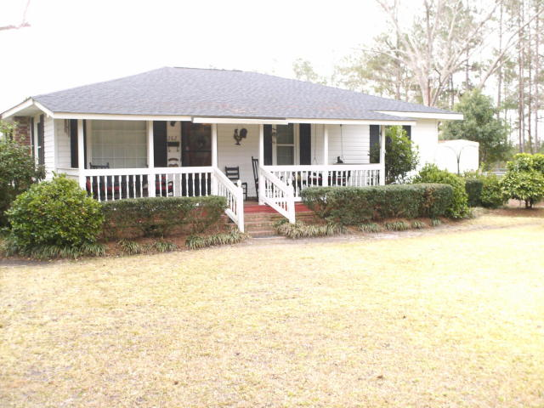
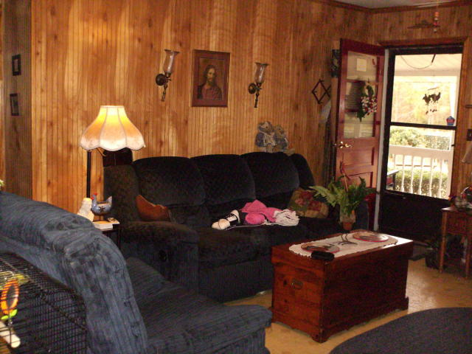
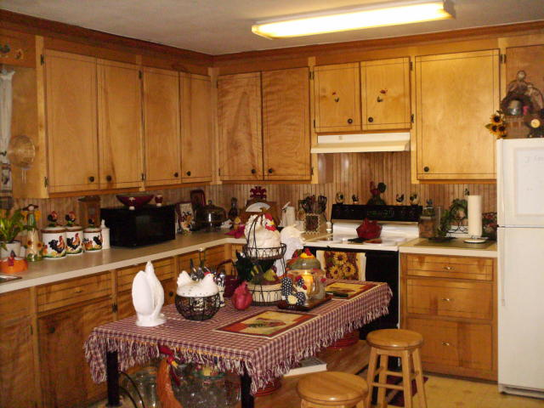
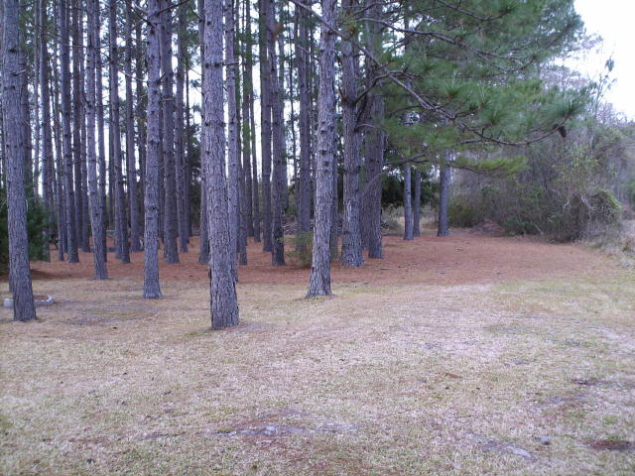


262 Midnight Lane
Ruffin, SC 29475 ~ MLS# 17001513 ~ $98,000
Country Living Or Retreat
Well kept, 2 year new roof, 5 year new HVAC, starter home, country retreat, chickens can stay or go, secluded, middle neighbor may check you in or out and quiet (security).One road in and one road out. (more security). 1 shed laundry 9X14', 1 shed greenhouse 4x6', 20x30' open face garage and 7x15' metal storage shed. WELL KEPT GROUNDS. HOME IS OCCUPIED.
Bob Glover, CCIM
(843) 572-0000
bobgloverccim@gmail.com
Bob Glover Real Estate LLC | 105 A Old Hwy 52 | Moncks Corner, SC 29461

