Slide 1
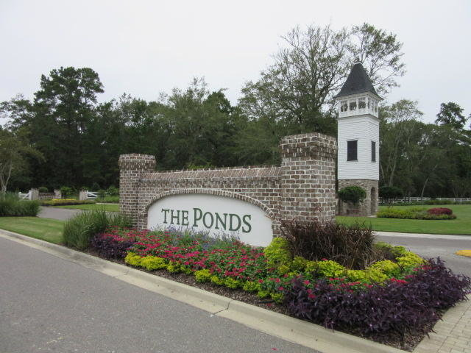
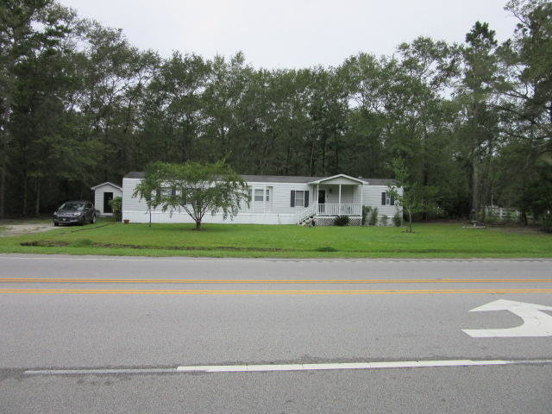
COMMERCIAL ZONING
Adjoins “THE PONDS”
2636 Highway 17-A
Summerville, SC 29483
MLS# 30163876
0.95 Acres
$299,000
$40,000
Price Reduction!
Commercial property that adjoins "The Ponds". Timing is perfect...buy now before Harris Teeter builds a grocery store across the street. 1 Acre parcel ideally located within 100 yards of the intersection of Highway 17-A and Dorchester Rd.
Ideal site for any commercial use...Dentist...Attorney... Restaurant...Strip Shopping Center, or any Business use. The mobile home can remain or be removed or used as a temporary office until Buyer develops the property...its 1240 sq ft and in excellent condition.
Rick Willis
843-327-3017 Rick@RickWillis.com The Group, LLC

