Slide 1
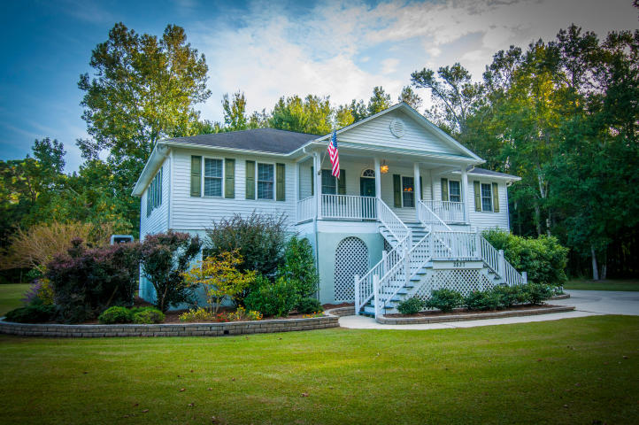
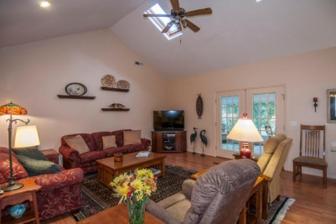
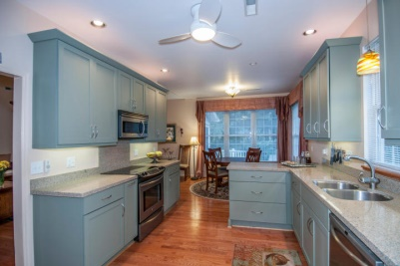
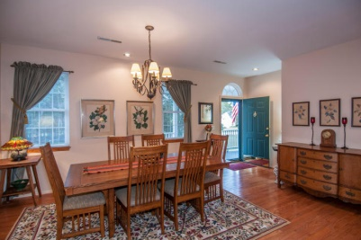
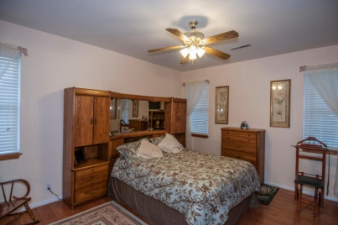
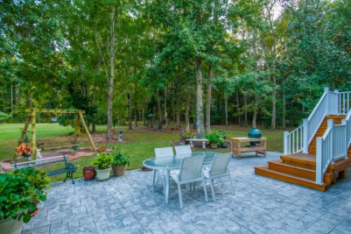
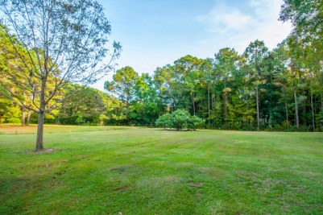


Hidden Gem
2637 Coquina Dr
Shoreline Farms - Johns Island - MLS# 14028909 - $400,000
Three bedroom, two bath home in the quiet Shoreline Farms subdivision of Johns Island.
Home was built in 1997 and has an updated kitchen with stainless steel appliances that convey.
Elevated home is built on a large 2.19 acre lot.
Back of house boasts a sunroom, deck, and outdoor patio.
Del Shaffer
843.408.6821
dshaffer@carolinaoneplus.com

