Slide 1
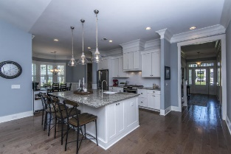
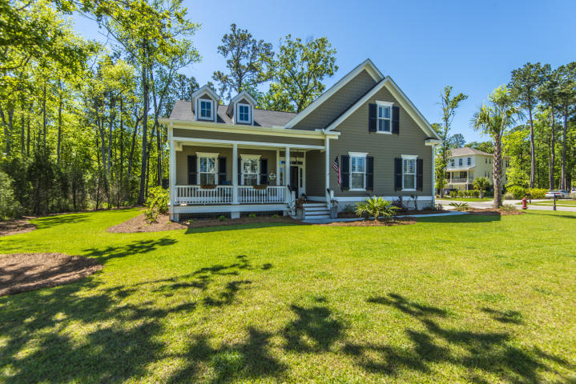
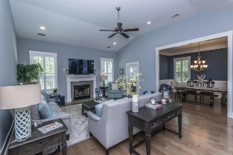
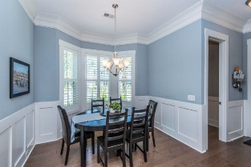
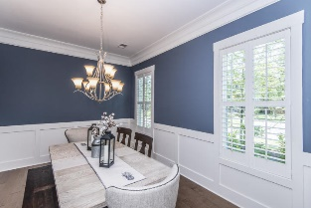
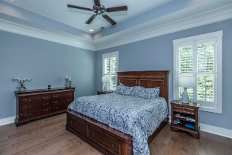
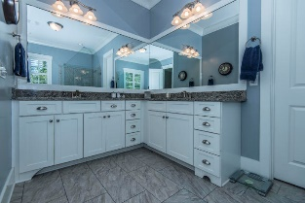
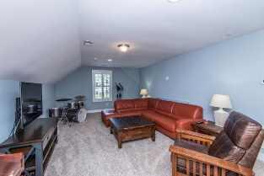
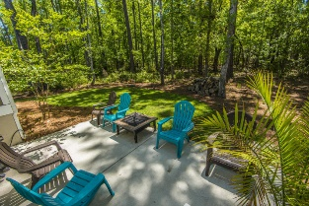
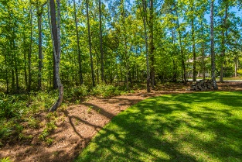


263 Commonwealth Road Darrell Creek ~ Mt Pleasant ~ MLS# 19011563 ~ $709,900
Just Reduced & Ready to Sell!
Stunning, almost new Darrell Creek home on a very desirable, quiet, half-acre corner lot with extra privacy. Enter to a formal foyer with architectural details that carry throughout the home like custom trim, molding, wainscoting, and beautifully engineered wood flooring. The open main living area includes a gourmet kitchen with granite counter tops and large center island which overlooks the family room, eat-in area, and separate formal dining room. A gorgeous master suite is also located on the first floor, along with two secondary bedrooms with shared bath. Upstairs, there are 2 more bedrooms, a small room that could be a study or office, as well as an additional room over the garage that could serve as a 6th bedroom or bonus family room. This room also boasts extra storage/attic space. A screened porch with large grilling area that backs to a private backyard with more than enough space to add a private pool area or additional garage for boat, etc. A $2,200 Lender Credit is available and will be applied towards the buyer's closing costs and pre-paids if the buyer chooses to use the seller's preferred lender. This credit is in addition to any negotiated seller concessions.
Kristin Schatmeyer
Cell - (843) 697-7370
kristin.schatmeyer@carolinaone.com
www.KristinSchatmeyer.com
Carolina One Real Estate
2713 Highway 17 North
Mt. Pleasant, SC 29466

