Slide 1
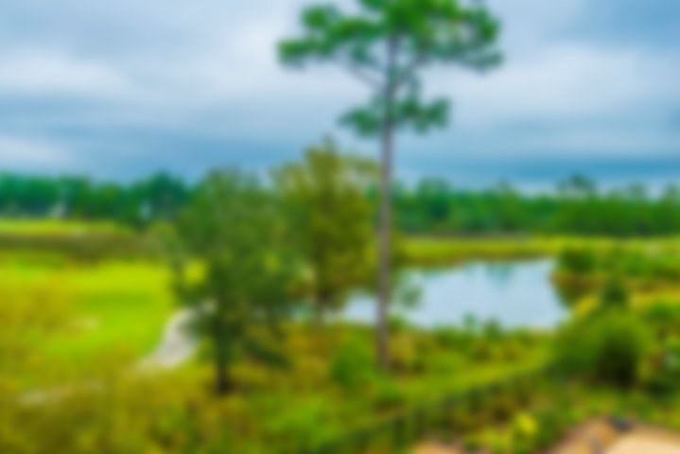
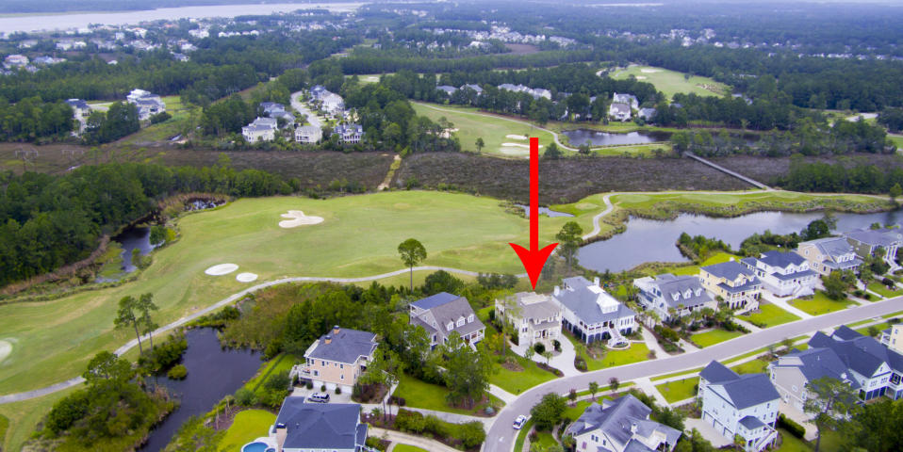
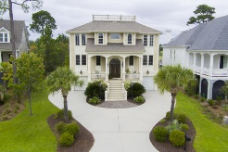
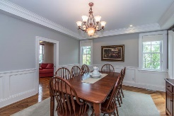
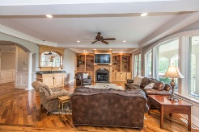
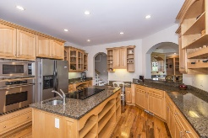
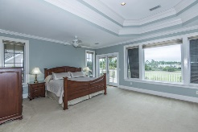
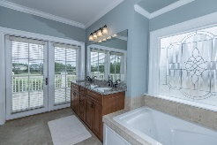
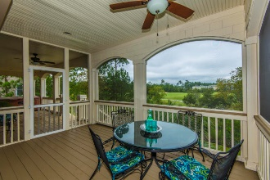
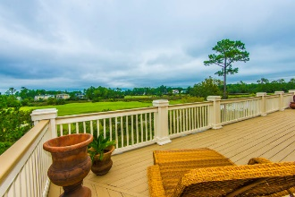
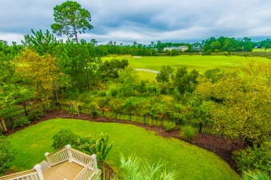
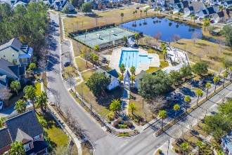
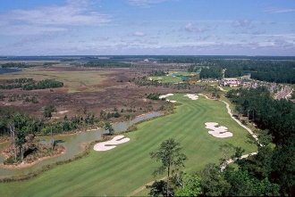



2640 Crooked Stick Lane Rivertowne Country Club ~ Mt Pleasant
Gorgeous Golf Course Views!!
Wake up everyday to the views and a setting that most get to experience only on vacation! This striking custom home is situated on the 7th fairway of Charleston's only Arnold Palmer Signature golf course. Sweeping views of the rolling greens and the privacy this setting affords are just a few of the many details that set this home apart from the rest. You'll immediately notice the attention to detail the moment you drive up. The split driveway, lush tropical landscaping and classic Southern verandah with gas lanterns set the tone for what you'll find inside. Step inside to a true foyer and details such as board and batten, natural stone tiles and two-piece crown moulding provide a glimpse of the understated elegance of this home. This home transitions from everyday family living to entertaining a crowd with ease.
Asking $830,000
MLS# 17024344
3,600 SqFt
5 Bed/3½ Baths
Perfect for Entertaining
Great Golf Steps Away
Don Dawson 843-514-0452 ddawson@carolinaone.com Carolina One Real Estate • 2713 Highway 17 North • Mount Pleasant, SC 29466
www.TeamDawsonSC.com

