Slide 1


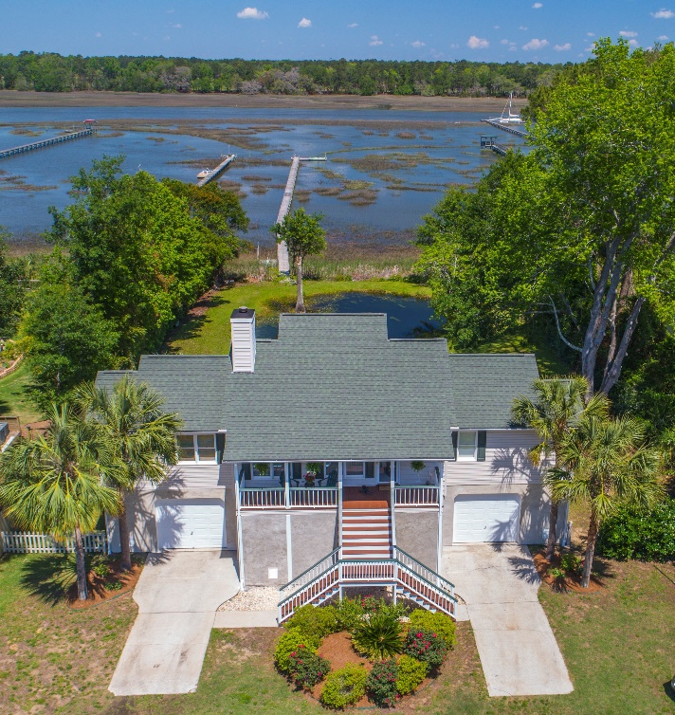
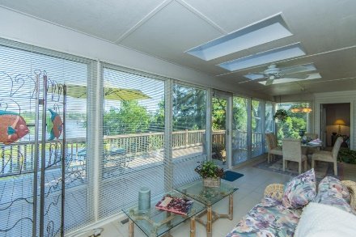
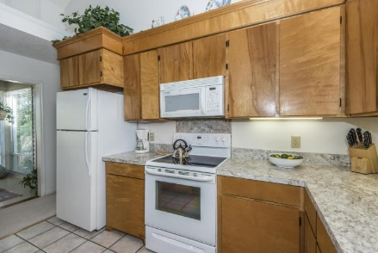
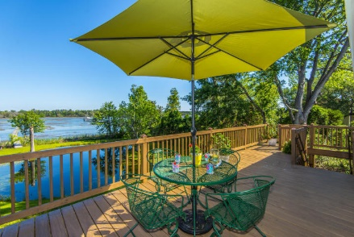
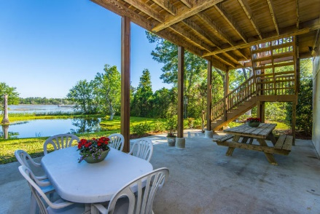
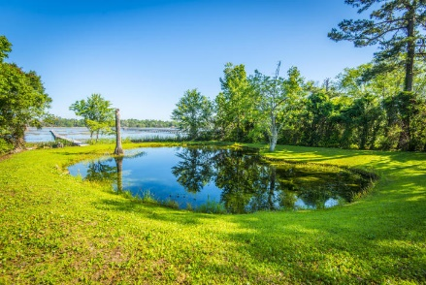
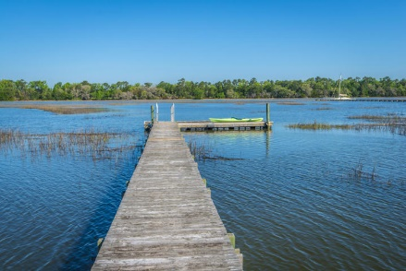
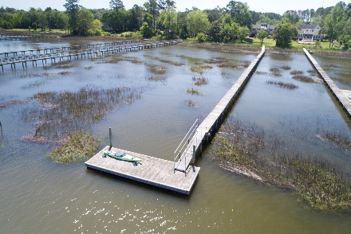


Open House ~ Thursday, May 11th, 10-12 Leave your card for a chance to win!
2648 Bohicket Road
Seabrook Shores ~ Johns Island, SC 29455 ~ MLS# 17011859 ~ $499,000
River access & seconds to Bohicket Creek! Life on the creek affords both sport & relaxation! Beautiful & well-maintained, elevated home on 1.6 acres. Family room has handsome flagstone fireplace & soaring ceilings! Elegant glass sunroom has skylights, ceramic flooring & walks onto approx. 11' x 30' deck! Kitchen has good storage; custom cabinets throughout! Split bedroom arrangement (one BR serves as an office at present) assures privacy. Large master bedroom overlooks creek; master bath has double bowl vanity. Secondary bedrooms adjoin jack-n-jill bath. Separate powder room near entry. Dock your boat at Bohicket Marina & enjoy a day at Freshfields Village or Beachwalker Park at nearby Kiawah!
Recent improvements include roof, exterior paint & stucco, heat pump, renovated back deck & stairs and new kitchen countertops.
Please visit www.BohicketTidalCreek.com
Dianne Broom
(843) 343-6207
dbroom@carolinaone.com | www.diannebroom.com
Carolina One Real Estate | 2713 Highway 17 North | Mt. Pleasant, SC 29466

