Slide 1

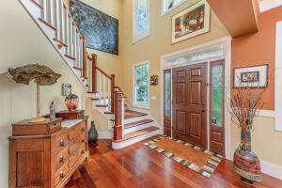
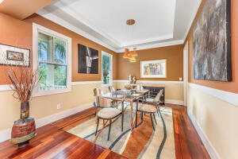
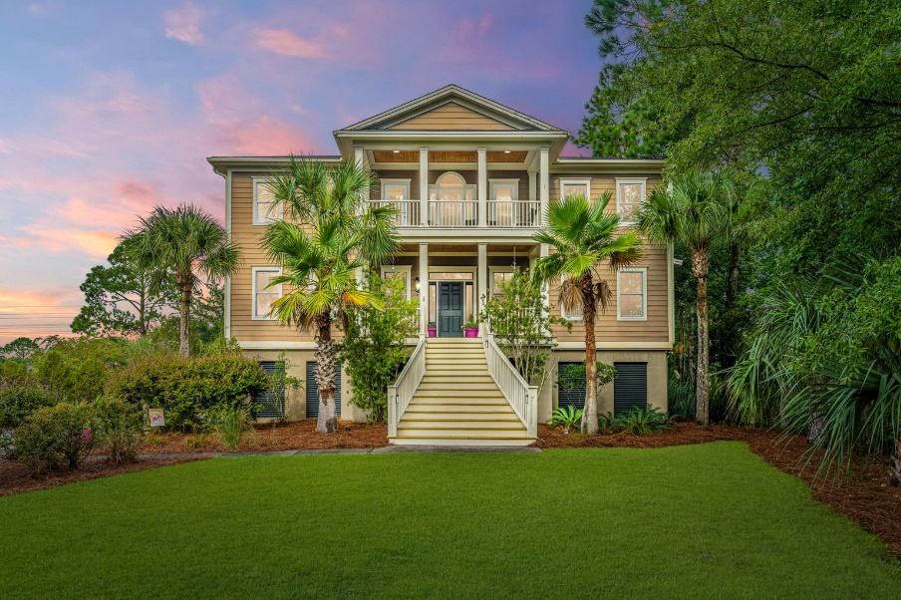
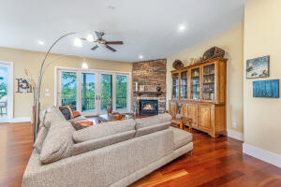
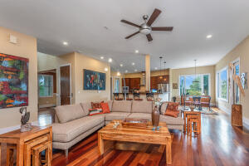
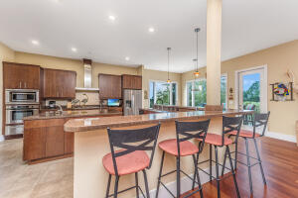
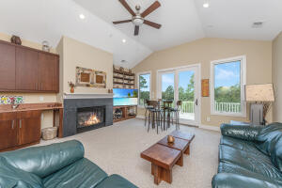
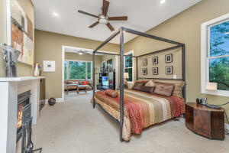
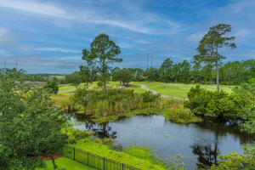
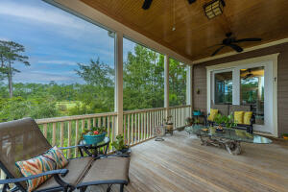
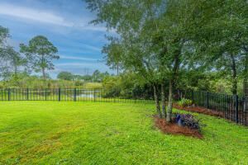
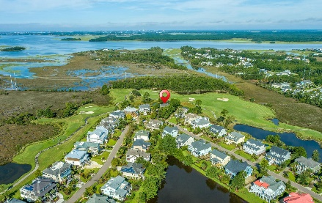
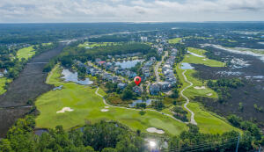


2648 Crooked Stick Lane
Rivertowne Country Club
Mount Pleasant, SC 29466
MLS# 22023899 | $1,385,000
Motivated Seller!
Price Refreshed!
Tucked into a lush Lowcountry setting, inside the prestigious Rivertowne Country Club, this spacious and well-appointed home sits at the edge of a lagoon and features stunning marsh and golf course views. The traditional exterior belies the interior's clean lines and decidedly craftsman finishes. A welcoming foyer full of natural light shows off the gorgeous hardwood floors that run throughout the main living areas of the home. This open, perfect-for-entertaining space boasts a gorgeous stacked stone fireplace and offers access to the screened-in porch and open deck. An impressive main floor owners suite features a beautiful fireplace and sitting area with private access to the porch as well as walk-in closets and a luxury en-suite bath. Two decks, a screened-in porch, and a covered patio as well as a fully fenced yard offer plenty of space for fun and relaxation. All of this and located in the prestigious Rivertowne on the Wando Neighborhood with three community docks for fishing, boating or just to relax and watch the amazing Wando River sunsets. Enjoy golf at Rivertowne Country Club's Arnold Palmer Signature Course then meet friends at the club for dinner. Additional amenities include neighborhood pool, tennis courts, walking trails and play park all conveniently located to beaches and the world class dining and shopping of historic downtown Charleston.
Don Dawson
843-514-0452
ddawson@carolinaone.com
Carolina One Real Estate • 2713 Highway 17 North • Mount Pleasant, SC 29466
www.TeamDawsonSC.com

