Slide 1
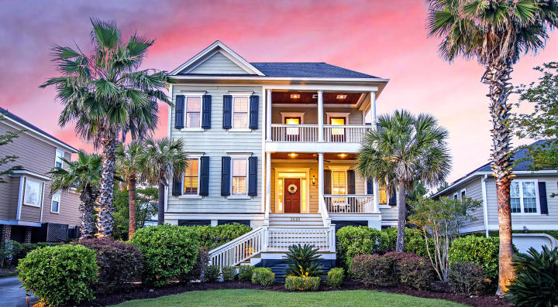
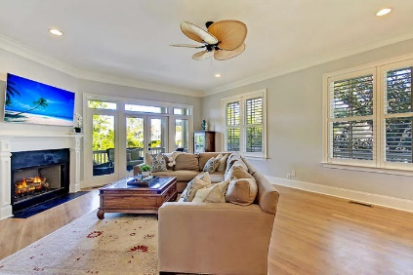
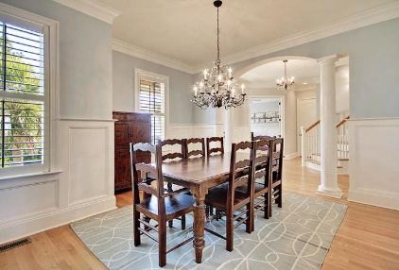
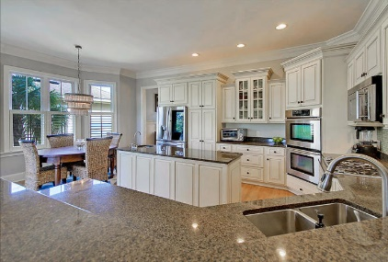
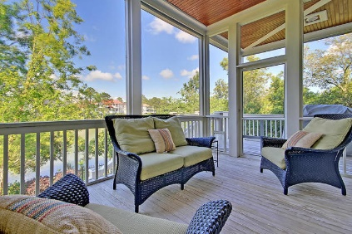
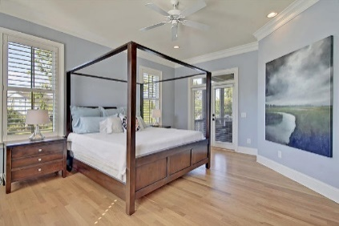
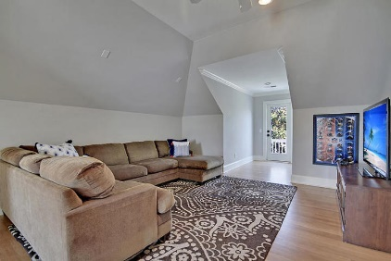
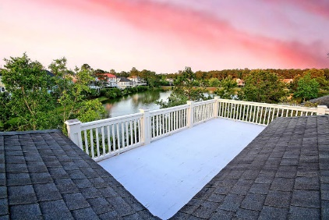
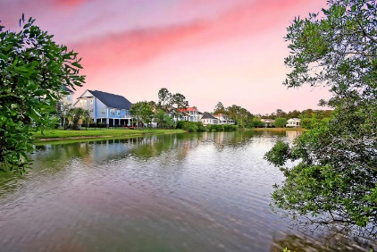


Open House Saturday 1-4
Rivertowne Country Club
2649 Crooked Stick Lane Mount Pleasant, SC 29466
MLS# 19013046
$800,000
4 Bed · 4 Bath · 3,893 sf
Looking for Southern Charm? This elevated home backing to a pond has it! 4 porches plus a patio; there's tons of outdoor living space! Inside you'll be impressed with the 10' ceilings on the 1st level, 9' on the second, hardwoods throughout, plantation shutters & generous moldings, giving the home a grand feel. The kitchen that's open to the family room is nicely appointed with double ovens, a 2nd sink, island, breakfast bar, granite counters & updated lighting. Main level master has access to the screened porch, his/hers closets and a remodeled bathroom with beautiful finishes. An office on the main level could be a 5th bedroom. Generously sized bedrooms upstairs PLUS a bonus room AND an additional sitting/play area that leads to upper level porch. Each bedroom has in-room bath access!
The 3 car garage has enough room for a 21' center console! This home also has an elevator shaft to the main level. Beautiful views from all the different porches leaves you feeling relaxed. You'll be pleased!
Rivertowne Country Club is a fantastic golf community with great amenities such as golf, community pavilion, pool, play park, tennis and basketball courts. Neighborhood grocery store and restaurants too! A great place to call home!
Lauren Zurilla (843) 991-9149
laurenismyrealtor@gmail.com
LaurenZurilla.com
Carolina One Real Estate
628 Long Point Rd.
Mt Pleasant, SC 29464-3032

