Slide 1
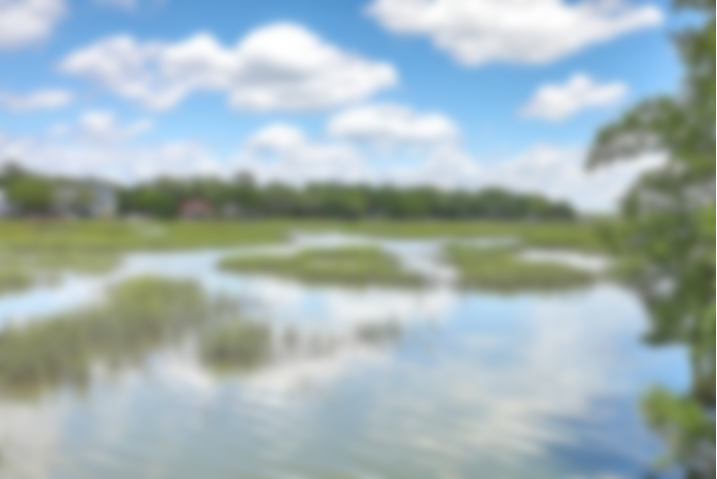
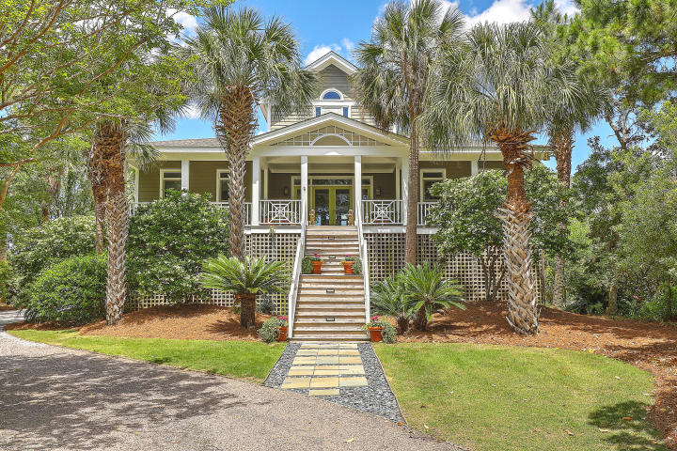
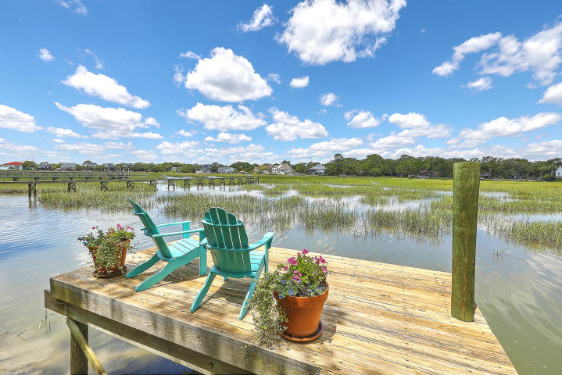
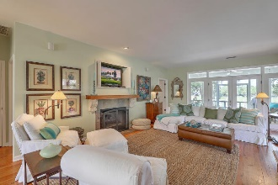
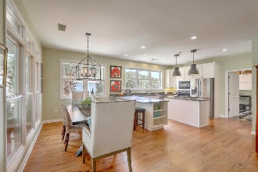
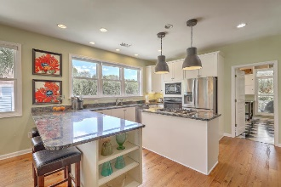
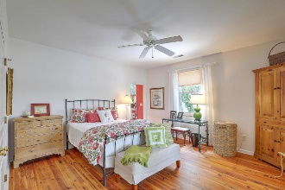
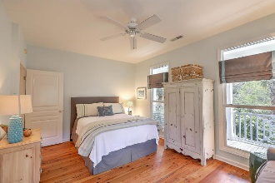
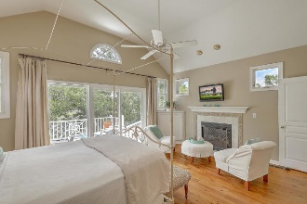
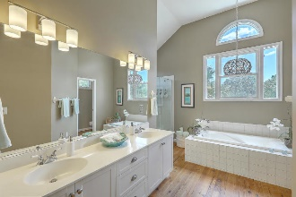
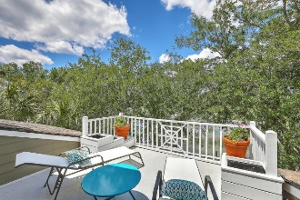
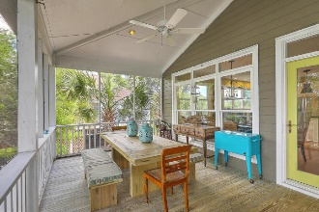
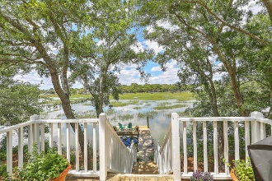


JUST LISTED! Gorgeous Lowcountry-Style Waterfront Home in Gated Community
264 Little Oak Island Drive
Little Oak Island | Folly Beach, SC 29439 | MLS# 20012634 | $924,975
Take advantage of this rare opportunity to live waterfront in the highly sought after gated community of Little Oak Island. An inviting glass double door entrance on a sprawling, true Lowcountry-style porch, draws your attention to the detail and warmth in design throughout as you enter this gorgeous open floor plan with glistening hardwood floors throughout. The spacious layout features a wonderful flow from the living, dining and kitchen areas, perfect for hosting dinner guests who can meander onto your outdoor living area. Enjoy the island breezes on the expansive rear screened porch or move on down the stairs to your own private dock where everyone can sit and enjoy the calming sound of the marsh as the stars glisten over the water. On those chilly nights, enjoy the warmth of the fireplace or sitting at the breakfast bar, making a puzzle with your family, after finishing dinner in your spacious kitchen, which has plentiful counter space, cabinet storage and a large island with gas cooktop to make those family dinners. Escape upstairs to your own private suite complete with vaulted ceiling, plenty of natural light, a sitting area with fireplace and porch which is the perfect place to enjoy a cocktail at the end of a long week while guests or family retreat to their rooms on the main level. The 2 additional bedrooms each have their own bathroom and are located on opposite ends of the home, offering plenty of privacy. And, you will love the large space off the kitchen which would be perfect for a home office, craft room or home gym! The garage has ample space for multiple cars, toys, storage and workshop and even has an outdoor shower to wash off the sand when returning from the beach. Fish, kayak, and boat from your private dock or enjoy the quiet community pool. Just a short bike ride over the bridge, you will love the ability to put your toes in the sand at any given time as you make Folly Beach your new home!
Desiree Maurer Office - (843) 416-2000
Mobile - (843) 327-9010 desiree.maurer1@gmail.com
www.yourcharlestonhousesearch.com
Keller Williams Realty 496 Bramson Ct Ste 200 Mt. Pleasant, SC 29464

