Slide 1
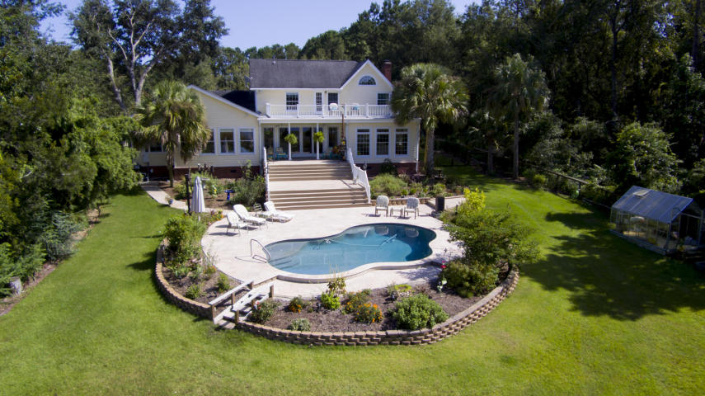
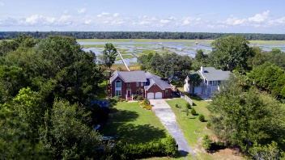
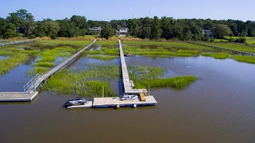
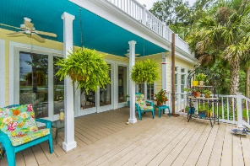
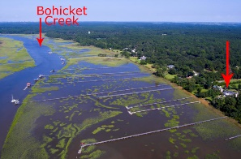
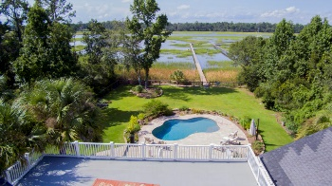

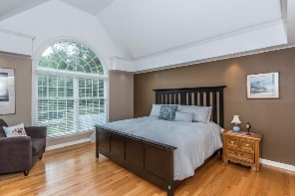
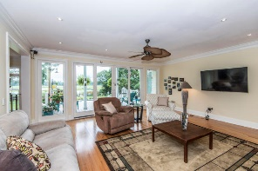
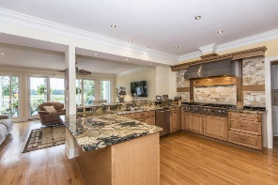
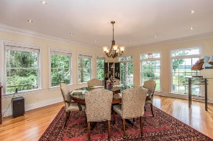
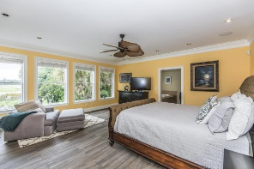
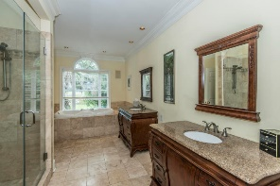
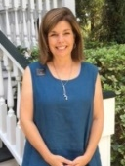


Live the Lifestyle Bohicket has to offer!
2654 Bohicket Road
Seabrook Shores ~ Johns Island, SC 29455
MLS# 17024491 ~ $1,350,000
Watch spectacular sunsets every evening from your living room, pool, porch or dock! Wonderful west view! Beautiful brick two story traditional with rear porches privately located on 1.59 acres overlooking marshes and tidal Bohicket Creek. A refreshing salt water pool installed in 2015 with a travertine tiled patio and new landscaping overlooks the existing dock and new 32' floater with deep water access. Fully fenced yard and a greenhouse too! Once inside, you will be pleasantly greeted with an open layout, large windows with panoramic views from every room. A new (2017) stunning gourmet kitchen with custom maple cabinetry finished in a ginger glaze and topped with magma granite counter-tops awaits the cooking enthusiast. An 8 Burner Viking gas cook-top, Jenn Air Hood, Dacor double electric wall ovens and Uline ice maker, lead into the newly added breakfast morning room. The spacious first floor Master bedroom is highlighted by custom dual vanities, tiled double shower, garden tub, and a huge walk-in closet with custom shelving. The living room features a trey ceiling, gas fireplace, and gleaming hardwood floors, the remaining first floor encompasses an office, dining room and family room with 9 ft ceilings and hardwood floors. The upstairs features a dual Master bedroom with vaulted ceiling and palladian window, marble bath, garden tub and shower, a guest room, a third bedroom currently being used as an office, and a sitting room (potential 5th bedroom)which leads out to the above deck overlooking Bohicket Creek and the beautiful back yard. The garage is oversized with an extra space containing a double door for lawn equipment and tools. The home is wired throughout with sophisticated security and a state of the art audio/visual, and lighting systems. A short boat ride to boaters favorite sandbar Devaux! Close to Beachwalker Park, Freshfields, and Bohicket Marina!
Elaine Nugent
(843) 330-7044
enugent@carolinaone.com
John Nugent
(843) 304-2061
john.nugent@carolinaone.com
nugentknowsrealestate.com
Carolina One Real Estate | 628 Long Point Rd | Mt Pleasant, SC 29464

