Slide 1

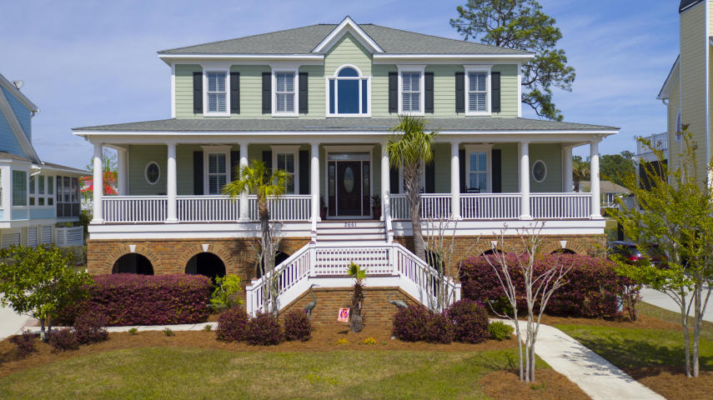
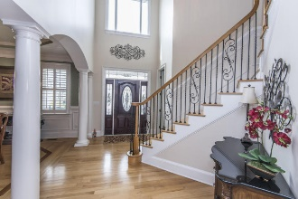
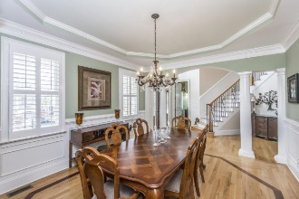
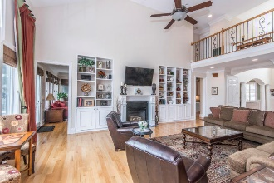
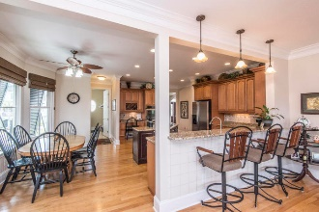
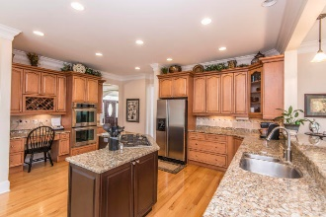
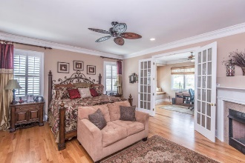
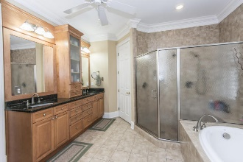
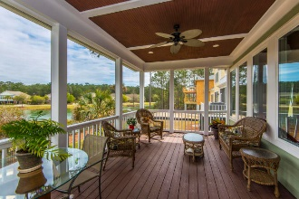
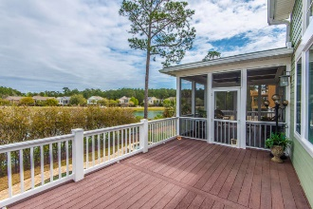
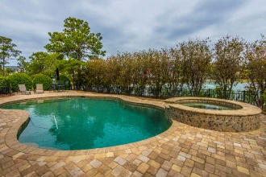


2661 Crooked Stick Lane
Rivertowne ~ Mount Pleasant, SC 29466
MLS# 18008772 ~ $825,000
Best Buy in Rivertowne Country Club
Asking $1,200,000
MLS# 17023051
3,692 SqFt
4 Bed/3½ Baths
Short Drive to Historic Downtown Charleston & Beaches
Traditional southern charm combines with luxury resort style amenities in this gorgeous custom home. A large front porch welcomes guests to the home and into an impressive foyer with that "wow factor" everyone is searching for! Graceful arches, a dramatic staircase and two-story height ceilings hint at the impressive details this home offers. Gleaming hardwood floors and crown moldings are found throughout. A formal dining room features architectural columns, trey ceiling, wainscoting and plantation shutters and is the perfect place to host those special occasion dinners. Afterwards, gather family and friends in the large living room, which features a vaulted ceiling and a gorgeous focal-point fireplace flanked by custom built-in bookshelves. As ideal as this home is for entertaining, it is truly suited for everyday family living.
Don Dawson
843-514-0452
ddawson@carolinaone.com
Carolina One Real Estate • 2713 Highway 17 North • Mount Pleasant, SC 29466
www.TeamDawsonSC.com

