Slide 1

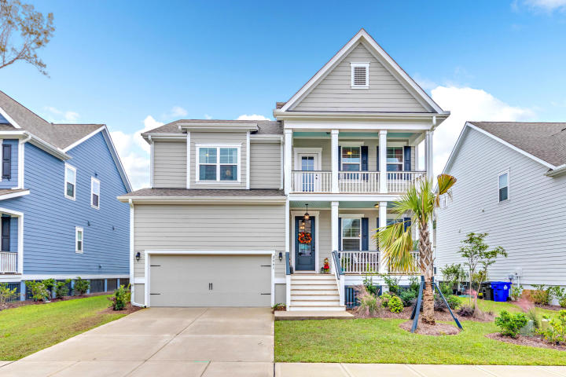
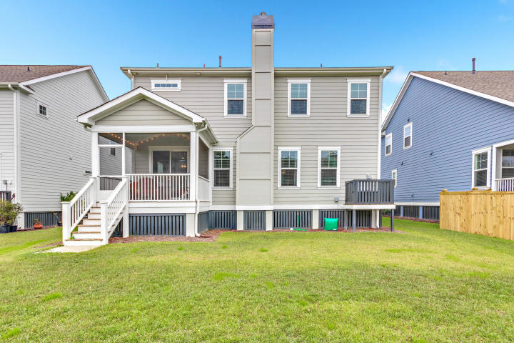
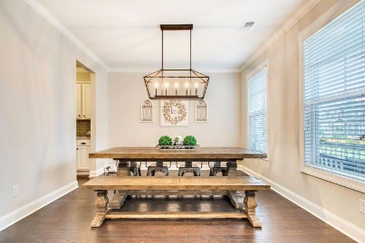
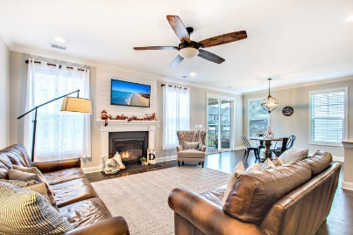
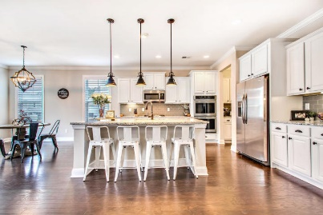
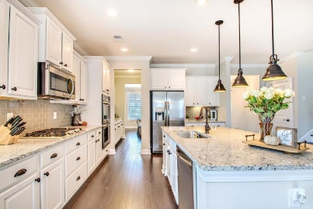
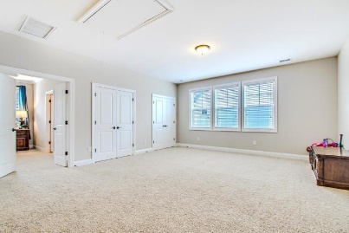
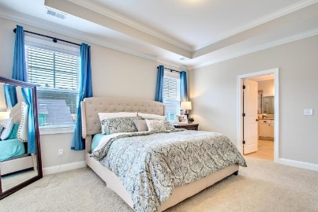
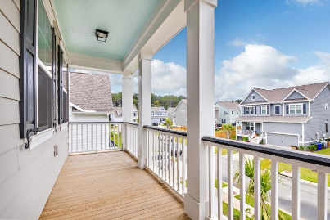
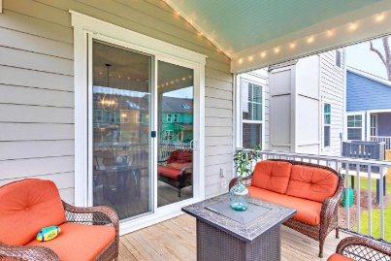

$5,000 Closing Credit
2661 Kingsfield Street
Park West | Mount Pleasant, SC 29466 | MLS# 20021513 | $578,900
Right in the heart of Park West Center Park South! This open plan the Harbor Oak plan was one of the more popular plans! It featured a formal dining, butler's pantry, gourmet kitchen with large island, stainless appliances and tile backsplash, eat in breakfast nook which opens to the screened porch and a ground floor bedroom & full bath! The master suite with sitting room and a walk-in closet on the second floor a second living area in the loft, a laundry room, 2 additional bedrooms with full bath! - Agent is owner.
Lucas Dollarhite
276-734-5693
lcdollarhite@gmail.com
Landcrafters Inc
520 Folly Road PMB 126
Charleston, SC 29412

