Slide 1
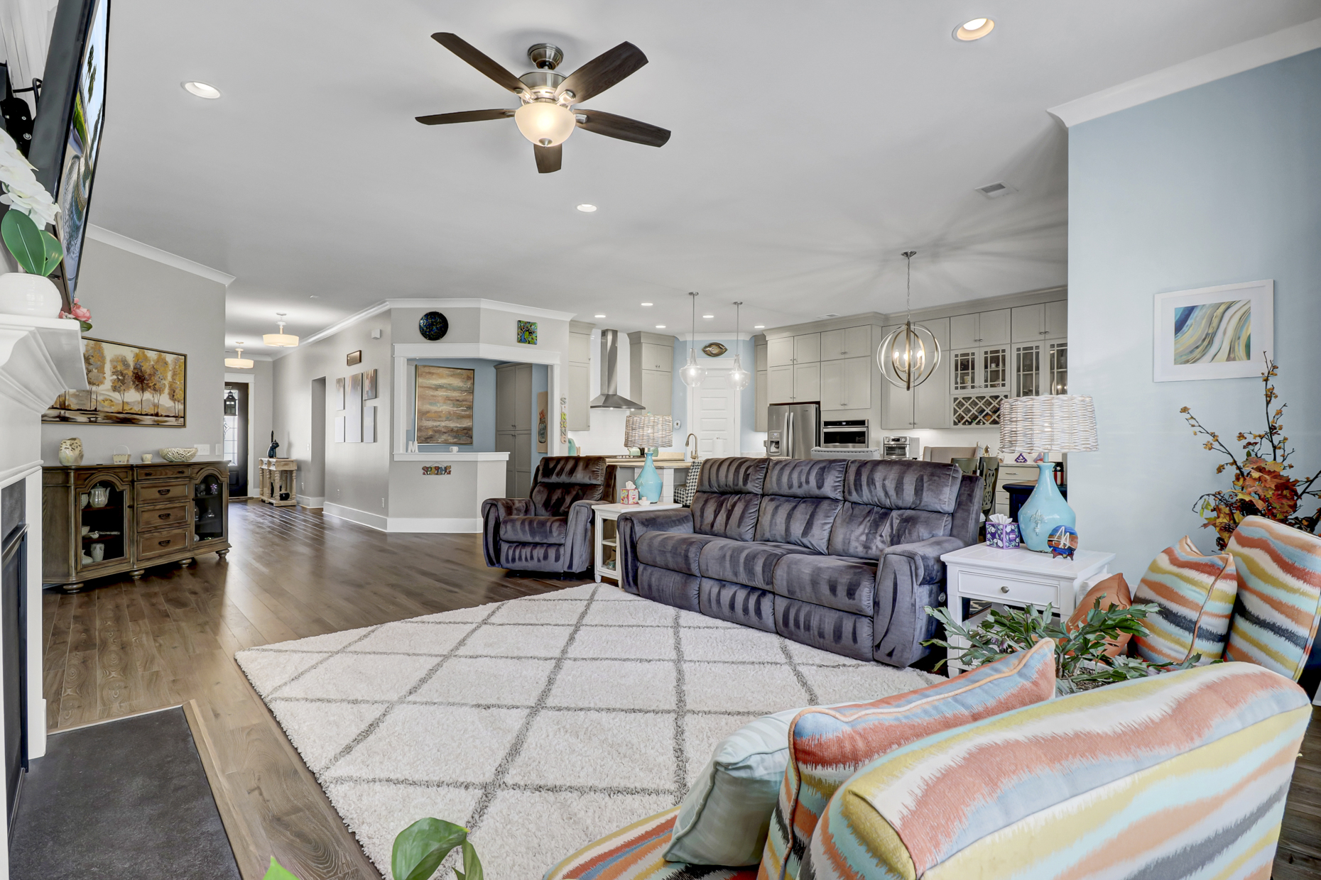
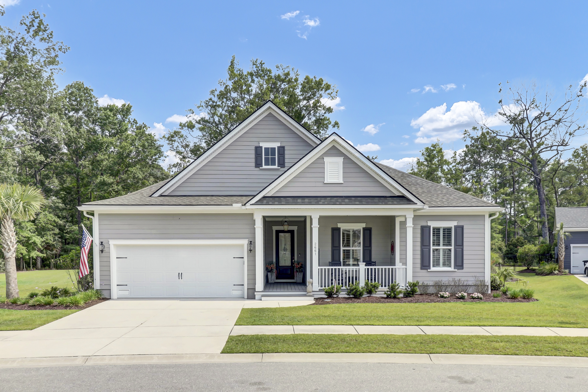
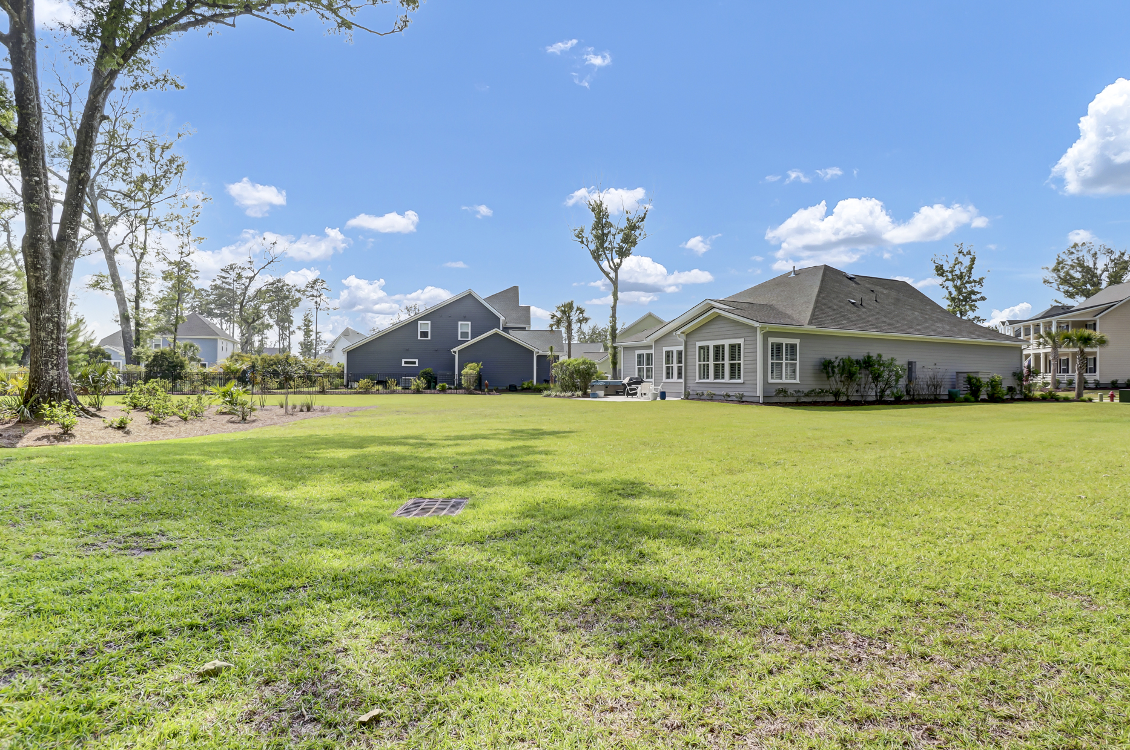
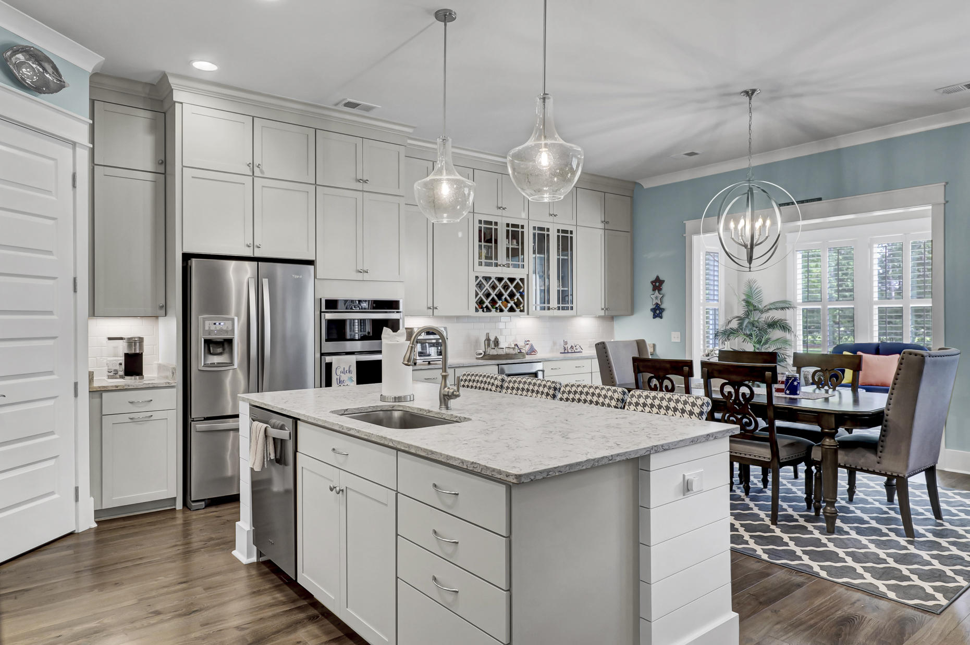
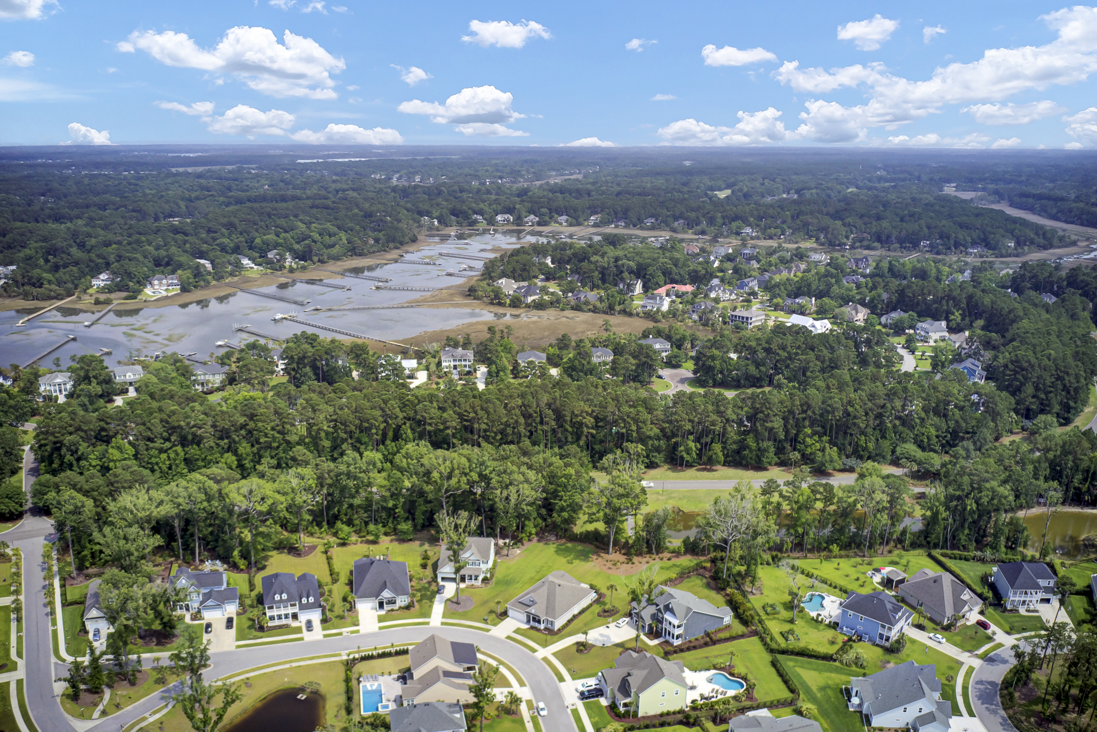
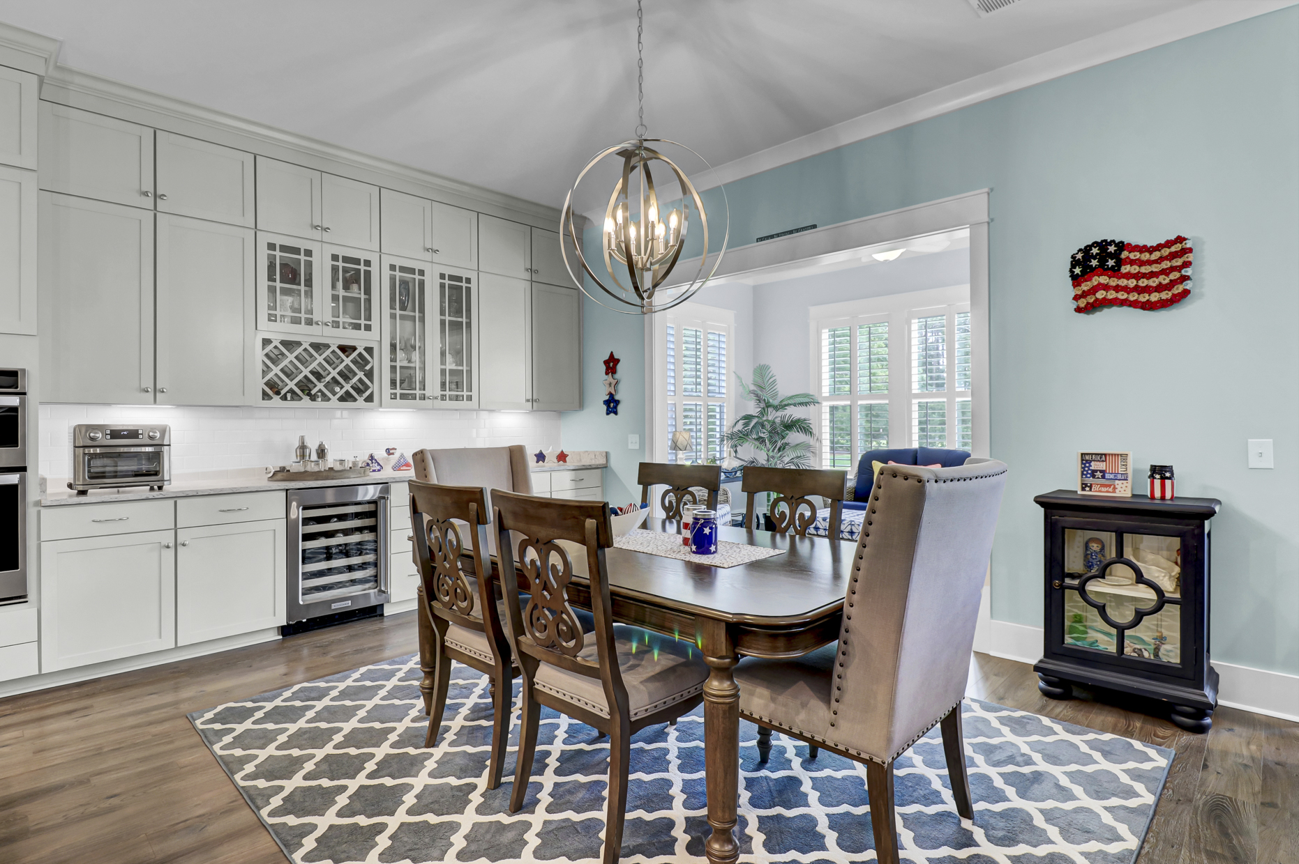
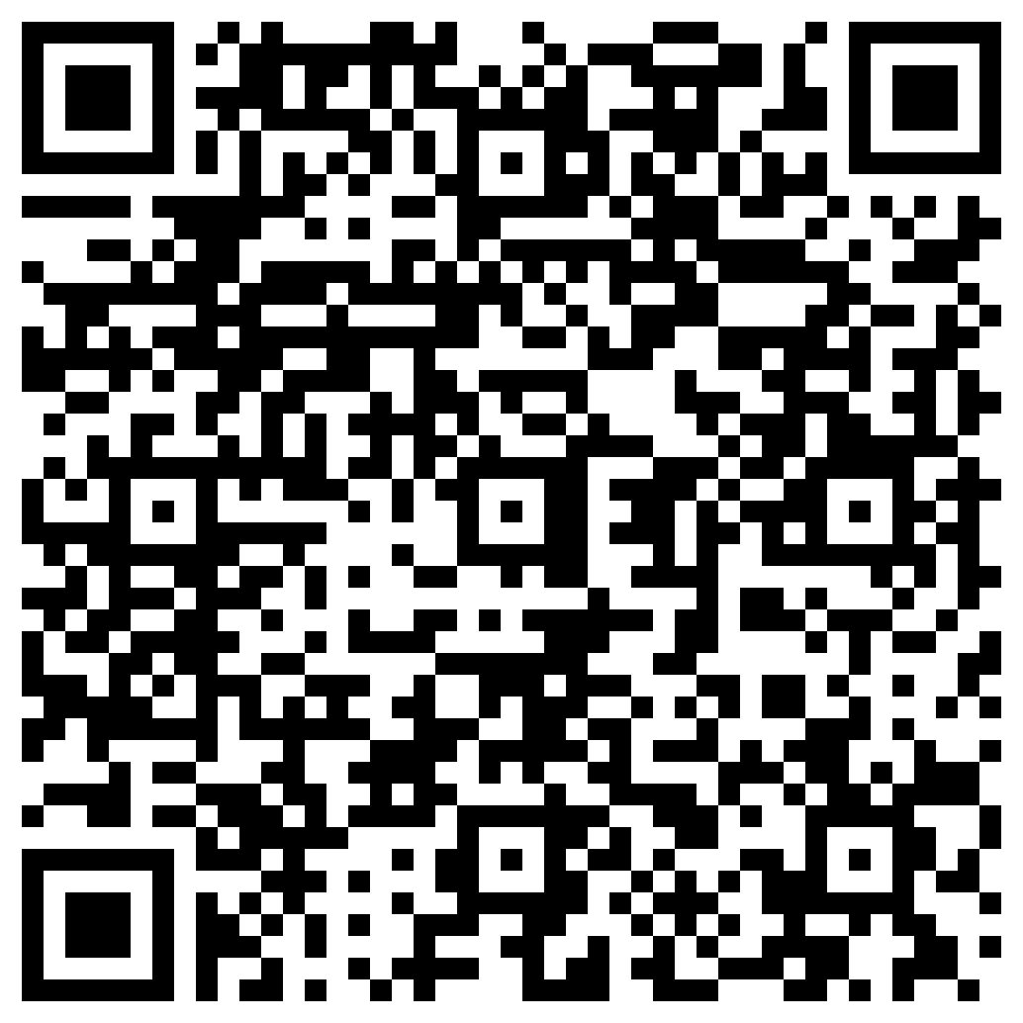


Better Than New Dunes West Single Story on Half Acre
2661 Dutchman Drive
Mount Pleasant, SC 29466
MLS# 23012787
$989,500
A rare find- One Story Living on a HALF ACRE manicured lot! Home has been lovingly maintained and enhanced to the degree that this home looks and feels like a brand new model home! The open concept floor plan is a winner, and the Chef in your house with LOVE this kitchen with gas cooking, floor to ceiling cabinets, two pantries, and stunning leathered quartz counters. Dreams of a pool of your own can become a reality with this massive back yard. Dunes West is one of Mt. Pleasant’s most coveted communities. It is gated, has a beautiful clubhouse and 18 hole golf course, and offers country club style amenities to its residents. Check out the property video to see the fine finishes throughout and make your appointment to tour while you still have the opportunity!
Take a virtual tour of the property!
Ellen O'Neil
Broker/Owner, ABR, e-PRO, CNE
Charleston Realtor of Distinction
(843) 300-8530
www.EllenONeilProperties.com

