Slide 1
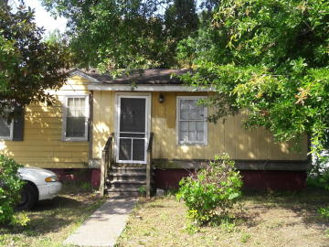
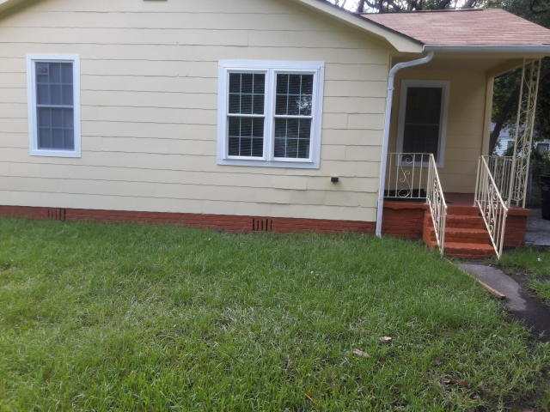
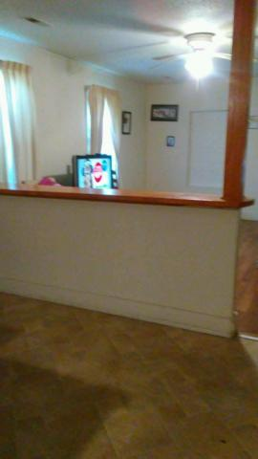
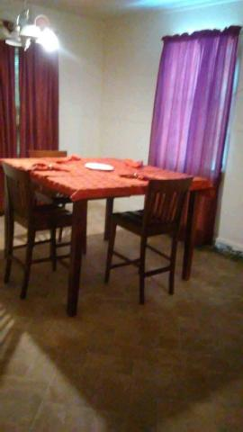
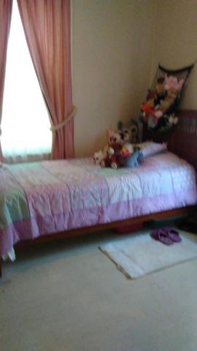
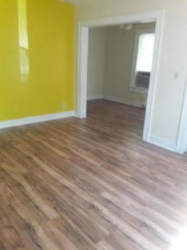
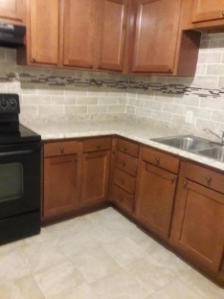
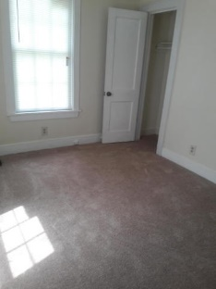

Waylyn Investment Properties Your clients should take a look at these two houses. Owners say to "Sell Them"
Starbucks card to first 10 agents
2645 Ranger Drive
North Charleston, SC 29405
MLS# 18021096
$112,000
2666 Hull Street
North Charleston, SC 29405
MLS# 18021765
$110,000
Great fixer-upper in North Charleston. Close to schools, hospital shopping and interstate.
Move In Ready.
Geraldine Sands
(843) 224-1911
gw.sands67@gmail.com
AgentOwned Charleston Group | 902 Savannah Hwy | Charleston, SC 29407-7802

