Slide 1

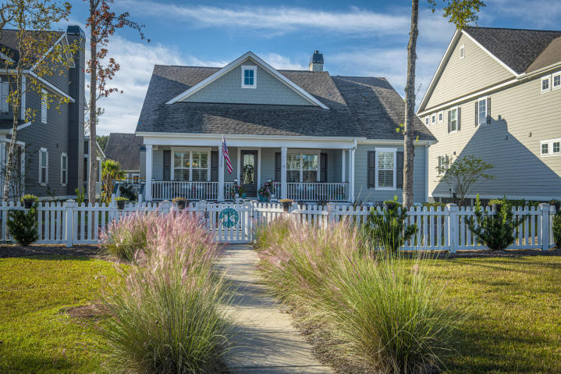
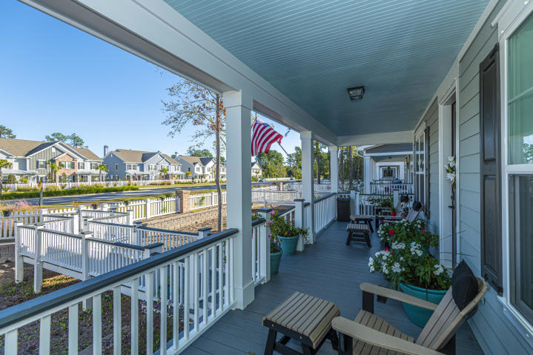
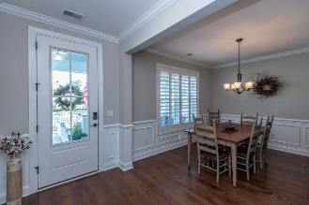
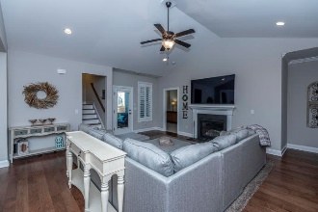
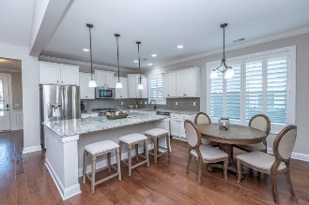
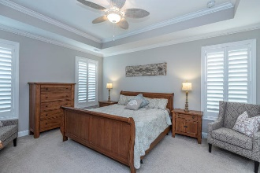
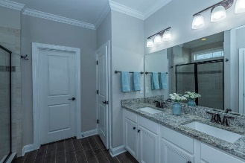
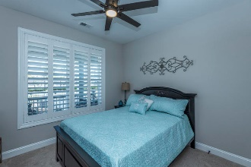
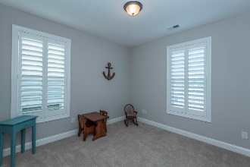
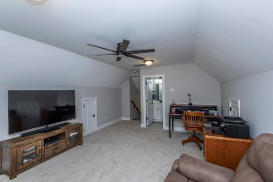
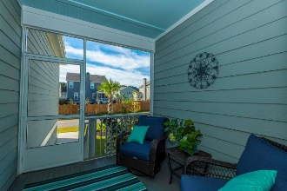
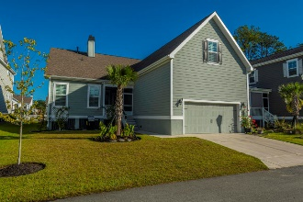

Come Tour Your Next Home Today!!
2667 Park West Boulevard
Park West | Mount Pleasant, SC 29466 | MLS# 19029583 | $485,000
Basically brand-new single-story home ready for you!! As you enter the front door you will notice all the details and natural light in the home. There is a formal dining room at the front of the home. Your gourmet kitchen is waiting for you with soft close cabinets. Ample counter top space and cabinets. Countertop space for stools. Also, a spacious eat in breakfast area. The kitchen is open to the family room with a fireplace. Master on the main level. Large master bathroom with dual sinks and a walk-in closet. Two secondary bedrooms on the main level with a full bathroom. This cottage style home has all of the essential living on the main level with a BONUS room and full bathroom upstairs. Enjoy relaxing on your screened in porch and gardening in your yard.
Walk, ride your bike or golf cart to the Park West Pool and tennis courts - so close to the house! Park West is a wonderful community with walking trails, schools, grocery store, shops and restaurants. The Mt Pleasant rec center is an added bonus to the neighborhood!! All Hardie Plank exterior, HERS Rated and energy efficient and an X Flood zone. Amazing single-story home within minutes to the beaches, 526 and downtown Charleston. Extra features: Rinnai tankless water heater, multi zone 14 seer HVAC with 90% gas furnace. Home details: fully cased windows, 9 ft ceilings, 8ft front and back doors, crown molding, hardwood floors, tile in laundry and bathrooms, carpet in bedrooms, soft close cabinets and drawers in the kitchen, tray ceiling in the master bedroom, split bedroom plan, oversized kitchen island, dual zone A/C, oversized front porch, oversized two car garage with storage room, irrigation system, upgraded landscaping.
Carolina One Real Estate
195 W Coleman Blvd
Mt Pleasant, SC 29464-3495
Jennie Hood Emerson
(843) 327-0384
jhood@carolinaone.com
www.yourcharlestonhomes.com

